Slide 1
Information Retrieval (IR)
Rudra Murthy
Staff Research Scientist
rmurthyv@in.ibm.com
IBM

Slide 2
Slides adapted from: Information Retrieval: An Introduction. Dr. Grace Hui Yang, InfoSense, 2019 Introduction to Information Retrieval. C.D. Manning, P. Raghavan, H. Schütze. Cambridge UP, 2008.

Slide 3
Outline
Introduction
IR Approaches
Metrics
Indic IR
Neural IR
Traditional IR
LLMs

Slide 4
Introduction
What is Information Retrieval?
Information Retrieval is finding material of an unstructured nature that satisfies an information need from within large collections.
This Photo by Unknown Author is licensed under CC BY-SA
Reference: https://nlp.stanford.edu/IR-book/information-retrieval-book.html

Slide 5
Motivation
India is experiencing a major climate disaster in recent history
Record breaking heatwaves, rainfalls leading to flood and landslides have increased
Need to understand the role of climate change and how it affects Indians
Assume the information is uploaded to a common portal
Need to search for relevant information

Slide 6
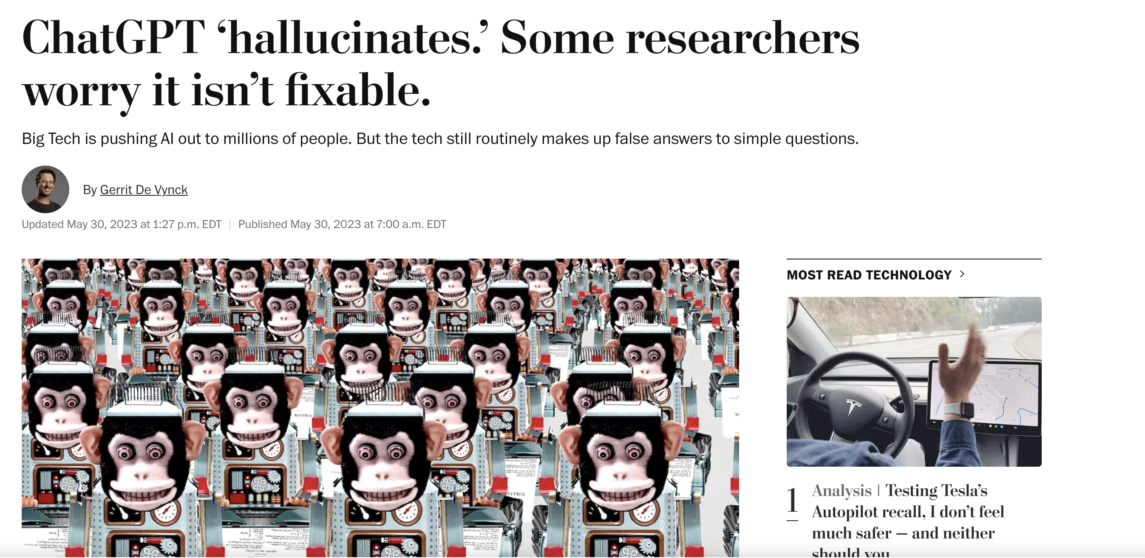
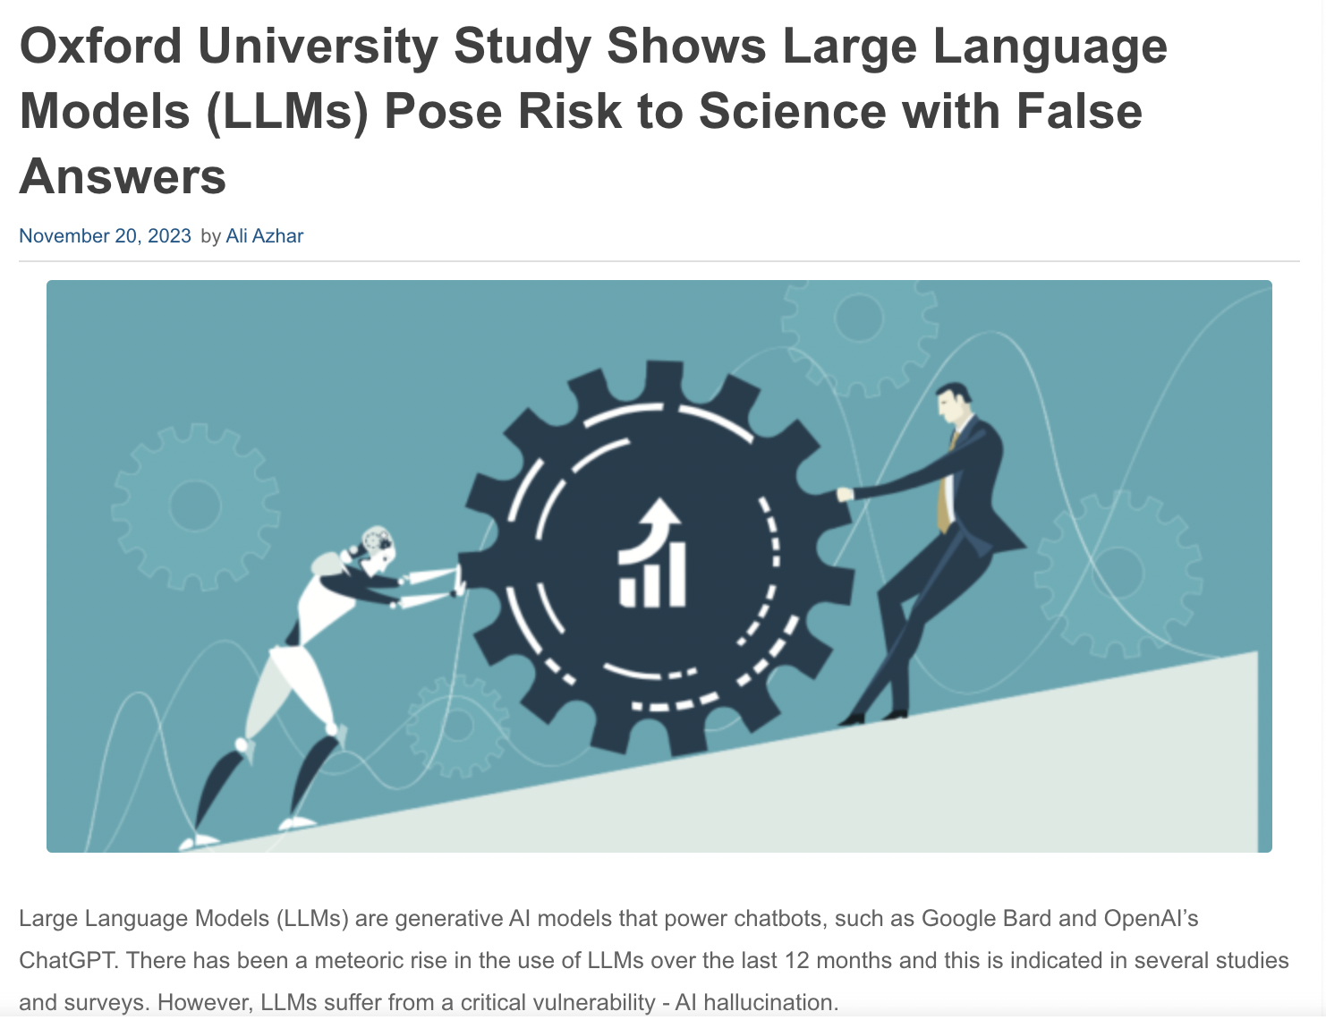
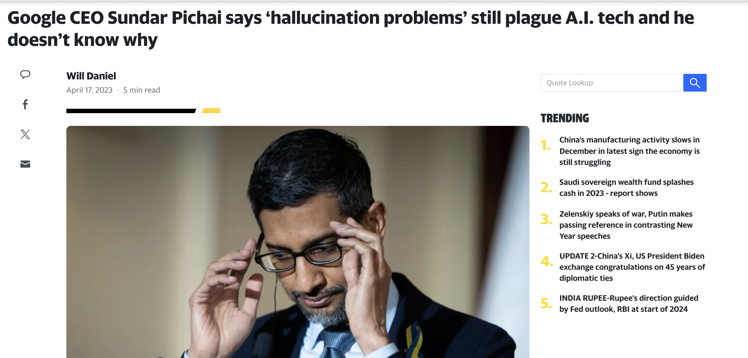
Motivation
https://finance.yahoo.com/news/google-ceo-sundar-pichai-says-173747803.html
https://www.enterpriseai.news/2023/11/20/oxford-university-study-shows-large-language-models-llms-pose-risk-to-science-with-false-answers/

Slide 7
Information Retrieval Architecture
Corpus
Query
Document Representation
Indexing
Retrieval Models
Index
Retrieved Documents
Evaluation Feedback

Slide 8
IR Approaches
How do we find relevant documents given a query?
By Keyword matching
By Similarity
Understanding how a query is written
How web pages think about other web pages (Page Rank)
How other people find relevant documents for the same/similar query

Slide 9
Terminology

Slide 10
TERMINOLOGY
Document: An unit which contains information we need
Collection/Corpus: group of documents over which we perform search
Query: text the user conveys to the computer to communicate the information need
Relevance: a document is relevant if the user perceives as containing information of value
Precision: Fraction of returned results relevant to the information need
Recall: Fraction of relevant documents in the collection returned by the system

Slide 11
INDEX
Term-Document Incidence Matrix
Create a set of all possible words in the document collection (Vocabulary)
For every term in the vocabulary, have an entry 1 if the word/term is present in the document else 0
If we have 100M documents and 1M unique words in vocabulary,
this matrix will be difficult to fit in computer memory
The matrix is mostly sparse
 | climate | IPCC | …
Document 1 | 1 | 0 | ..
Document 2 | 0 | 1 | …
… | … | … | …

Slide 12
Inverted INDEX
An inverted index, maps the terms back to the documents
It is a dictionary of terms
Each term has a list of documents in which the term appears
climate | Document 1 | Document 12 | ..
IPCC | Document 2 | Document1245 | …
… | … | … | …

Slide 13
Boolean RETRIEVAL
Each document is a set of words
Queries uses Boolean operators like AND, OR and NOT to join query terms
Sometimes they might be associated with weights
Retrieved documents will have all the conditions matched

Slide 14
Boolean RETRIEVAL
Assume the the user wants to search for Impact of climate change on India based on IPCC report
The search query might look like
climate change AND India AND IPCC report

Slide 15
Summary
Advantages:
Complete control of the search
Nearly transparent to the user
Disadvantages:
Only inclusion or exclusion: no rankings
Labor intensive to manually examine the returned sets
Precise queries needs to be written

Slide 16
Ranked Retrieval
Rank the retrieved sets from most relevant to the least relevant
Given a query q, and a set of documents D, the task is to rank the documents based on a ranking score
Score(q, d_{i}) in the range of [0, 1]

Slide 17
Vector SPACE Model

Slide 18
VECTOR Space Model
Treat query also as a document
Every document is represented in the word vector space
Similarity between documents is computed as the proximity in the word vector space
This similarity metric can be used for ranking the documents

Slide 19
Vector SPACE Model
Term-Document Incidence Matrix
Create a set of all possible words in the document collection (Vocabulary)
For every term in the vocabulary, have an entry 1 if the word/term is present in the document else 0
We can represent the query also using this term-incidence matrix
 | climate | USA | …
Document 1 | 1 | 0 | ..
Document 2 | 0 | 1 | …
query | 1 | 0 | …

Slide 20
VECTOR SPACE Model: SIMILARITY COMPUTATION
Euclidean Distance:
If document d = (d₁, d₂, …, d_{n}) and q = (q₁, q₂, …, q_{n})
n is the length of vocabulary
S(d, q) = $\sqrt{\sum_{i=0}^{n}{{(d}_{i}−q_{i})^{2}}}$
Cosine Similarity:
$\cos\left(d,q\right)= \frac{d ⋅q}{\left|d\right||q|}= \frac{\sum_{i=0}^{n}{d_{i}q_{i}}}{\sqrt{\sum_{i=0}^{n}{d_{i}^{2}}} \sqrt{\sum_{i=0}^{n}{q_{i}^{2}}} }$
Intuitively, the larger the overlap of words between the query and document, the larger will be the similarity

Slide 21
Vector SPACE Model: Term Weighting
Consider the query
Impact of climate change on India based on IPCC report
It is important to give importance to words/terms relevant for retrieval
Our encoding gives importance to all words in query/document
 | based | climate | change | IPCC | impact | India | of | on | to | report
Query | 1 | 1 | 1 | 1 | 1 | 1 | 1 | 1 | 0 | 1
… | … | … | … | …

Slide 22
How do we determine such TERM weights?

Slide 23
Vector SPACE Model: Term Weighting
Term Frequency
How many times a term appears in a document
In our example query, Impact of climate change on India based on IPCC report
If the terms climate change , India , IPCC and report appears frequently, then the document is relevant for us

Slide 24
Vector SPACE Model: Term Weighting
Term Frequency
How many times a term appears in a document
Closed-words (Function words) are very common
Example: in, at , a , an , the
How do we separate the important terms from the function words?
In our example query, Impact of climate change on India based on IPCC report
The irrelevant terms in the above query are
Of, on, based,

Slide 25
Vector SPACE Model: Inverse Document Weighting
Inverse Document Frequency
Closed-words (Function words) maybe common in a document
But they also appear in other documents too
However, relevant terms appear only in that or a small subset of related documents
${df}_{t}$ is the document frequency of the term t
Number of documents that contain the term t
Higher number means less informative
IDF, ${idf}_{t}=\log_{10}\frac{N}{{df}_{t}}$
N is the total number of documents

Slide 26
Vector SPACE Model: Inverse Document Weighting
Inverse Document Frequency
In our example query, Impact of climate change on India based on IPCC report
Terms/words like of or based or on or impact appear in many documents
Terms like climate change or IPCC appear in very few documents only

Slide 27
Vector SPACE Model: if-idf Weighting
The weight assigned for a particular term and a document is given by $w_{t,d}=\log\left(1+ {tf}_{t,d}\right)× \log_{10}\frac{N}{{df}_{t}}$
High
If a particular word appears more frequently in a document
If the same word appears only in a subset of documents

Slide 28
Vector SPACE Model: if-idf Weighting
 | based | climate | change | IPCC | impact | India | of | on | to | report
Query | 0.2 | 0.7 | 0.4 | 0.8 | 0.3 | 0.4 | 0.01 | 0.01 | 0 | 0.3
… | … | … | … | …
Hypothetical query representation using tf-idf weighting

Slide 29
BM25
Material Borrowed From https://www.elastic.co/elasticon/conf/2016/sf/improved-text-scoring-with-bm25

Slide 30
BM25
Term Frequency (TF)
Number of times a term appears in a document
The more frequently a term from query appears in a document, highly relevant is that document

Slide 31
BM25
Issues with Term Frequency
Consider two documents, D₁ and D₂
D₁ contains 1000 words and D₂ contains 50 words
Our query term appears 10 times in D₁ and 9 times in D₂
Term frequency would be 10 for D₁ and 9 for D₂
But D₂ seems to be more relevant for the search term

Slide 32
BM25
Issues with Term Frequency
The issue would be solved to a certain extent if we had considered document length
Normalized TF $TF\left(x,y\right)= \frac{number of times term x appears in document y}{total number of words in document y}$

Slide 33
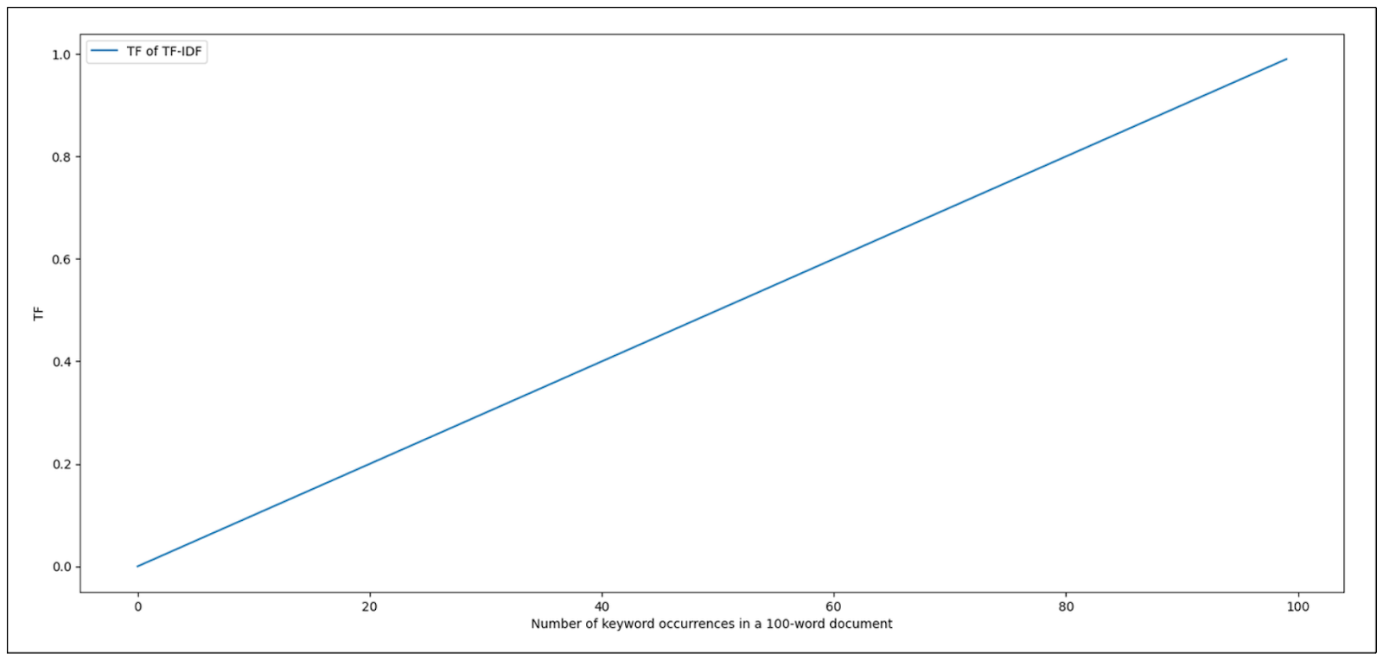
BM25
Issues with Term Frequency
If a term appears more frequently in a document, the document’s relevance increases?
What if a document contains only the search term and nothing else?
Should we give higher relevance to it?
Maybe we need to put a restriction on number of times that keyword can appear in the document
Source: https://zilliz.com/learn/mastering-bm25-a-deep-dive-into-the-algorithm-and-application-in-milvus

Slide 34
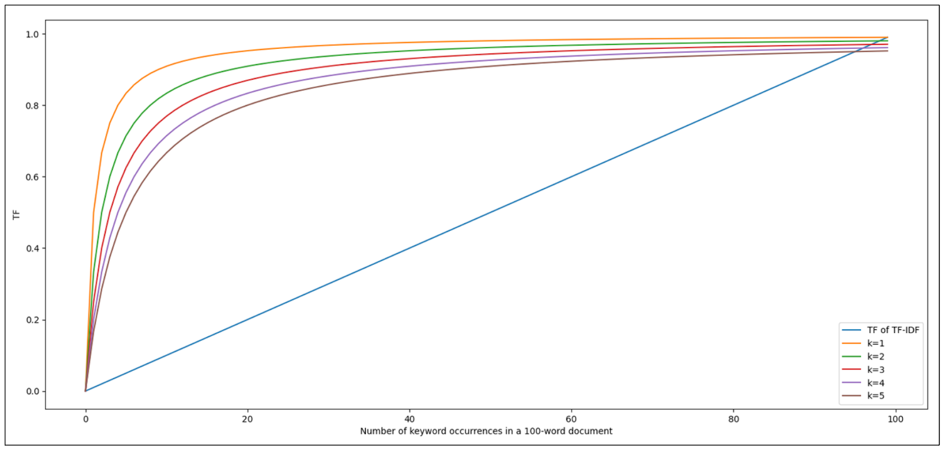
BM25
Modified Term Frequency
Modification 1 $TF\left(x,y\right)= \frac{TF(x,y)}{TF\left(x,y\right)+k}$
K is a hyper-parameter which controls how incremental occurrence of keyword contributes to the TF score
Source: https://zilliz.com/learn/mastering-bm25-a-deep-dive-into-the-algorithm-and-application-in-milvus

Slide 35
BM25
Case 1: TF(x,y) = $\frac{10}{100}=0.1$
Case 2: TF(x,y) = $\frac{20}{100}=0.2$
Case 3: TF(x,y) = $\frac{50}{100}=0.5$
New TF Score
Case 1: TF(x,y) = $\frac{0.1}{0.1+1}=0.09$
Case 2: TF(x,y) = $\frac{0.2}{0.2+1}=0.167$
Case 3: TF(x,y) = $\frac{0.5}{0.5+1}=0.33$
Modified Term Frequency
Modification 1 $TF\left(x,y\right)= \frac{TF(x,y)}{TF\left(x,y\right)+k}$
As the keyword appears more often in the document, it’s relative contribution to the TF score is negligible

Slide 36
BM25
Document Length
BM25 addresses another limitation of biasness towards longer document
Modification 2 $TF\left(x,y\right)= \frac{TF(x,y)}{TF\left(x,y\right)+k× \frac{|D\left(y\right)|}{avg(D)}}$
Here, $|D\left(y\right)|$ represents document length and $avg(D)$ represents average document length in the collection
If the document length is shorter than average, the term frequency increases and saturates quickly

Slide 37
BM25
The previous formula takes into factor document length
What if in some collections, the length of document is insignificant
Need a way to provide that control back to the user
A flag which allows you to tell how much importance should I give for document length $TF\left(x,y\right)= \frac{TF(x,y)}{TF\left(x,y\right)+k× ( 1−b+b ×\frac{\left|D\left(y\right)\right|}{avg\left(D\right)} )}$
b is a hyper-parameter, when b is 0, then document length has no significance

Slide 38
BM25
Inverse Document Frequency (IDF)
Importance of a term across document collection
Terms that appear in few documents are more relevant $IDF=log\frac{N −n(q_{i})+0.5}{n(q_{i})+0.5}$
Here, $N$ is total number of documents, $n(q_{i})$ is number of documents containing the term $q_{i}$

Slide 39
BM25
Final BM25 formula
$BM25\left(x,y\right)= \frac{TF(x,y)}{TF\left(x,y\right)+k× ( 1−b+b ×\frac{\left|D\left(y\right)\right|}{avg\left(D\right)} )} × log\frac{N −n(q_{i})+0.5}{n(q_{i})+0.5}$

Slide 40
Summary
BM25 is an improvement over TF-IDF
BM25 still relies on lexical overlap to rank the documents
What if the document do not contain the query keyword but it’s synonyms?
In our example, if the document contains global warming instead of climate change ?

Slide 41
Neural IR
Source: https://web.stanford.edu/class/cs224u/slides/cs224u-neuralir-2023-handout.pdf

Slide 42
NEURAL IR
We have discussed lexical retrievers till now
Too much emphasis on lexical similarity
These retrievers might fail to capture semantic similarity

Slide 43
NEURAL IR
Outline
DPR
Late Interaction
LLMs

Slide 44
Motivation
BERT uses [CLS] as a special token in front of every sentence
[CLS] is used for next-sentence prediction
What if we used [CLS] to get query/passage representation
Alternatively, we can take the average of all token representations to form query/passage representation

Slide 45
Cross-Encoders
Maximal interaction between query and document tokens
Scalability issues
https://web.stanford.edu/class/cs224u/slides/cs224u-neuralir-2023-handout.pdf

Slide 46
Dense passage Retrievers
Score(q,p)
Inference
Cosine SImilarity
Dense Vectors
Encoder
Encoder
q
Query
p
Passages

Slide 47
Dense Passage Retrievers
Score(q,p)
Training
Contrastive Learning
Given query (q), positive passage (p⁺), and a set of negative passages (p⁻₁, p⁻₂, … p⁻_{n})
L(q, p⁺, p⁻₁, p⁻₂, … p⁻_{n}) = $−\log{\frac{exp⁡(sim\left(q, p^{+}\right))}{\exp\left(sim\left(q,p^{+}\right)\right)+ \sum_{j=1}^{n}{exp⁡(sim(q, p_{j}^{−}))}}}$
Cosine SImilarity
Encoder
Encoder
q
Query
p
Passage

Slide 48
Dense Passage Retrievers
Highly Scalable
Limited query and document interactions
Will a d-dimensional representation be able to capture the nuances in query and documents?

Slide 49
ColBERT
Late Contextual Interactions
Every query token interacts with every passage/document
Token
Have to save representation of every token in all documents

Slide 50
Training
Unsupervised Pre-Training
Supervised Finetuning (Stage 1)
Supervised Finetuning (Stage 2)
Supervised Finetuning (Stage 3)

Slide 51
Unsupervised Pre-training
Pre-training Tasks for Embedding-based Large-scale Retrieval. ICLR 2020

Slide 52
Supervised Fine-Tuning
Stage 1:
Use In-batch negatives with/without hard negatives mined from BM25
Stage 2:
Use Stage-1 model to mine hard negatives and fine-tune a stage 2 model
Stage 3:
Use knowledge distillation

Slide 53
LLMs

Slide 54
LLMs for IR

Slide 55
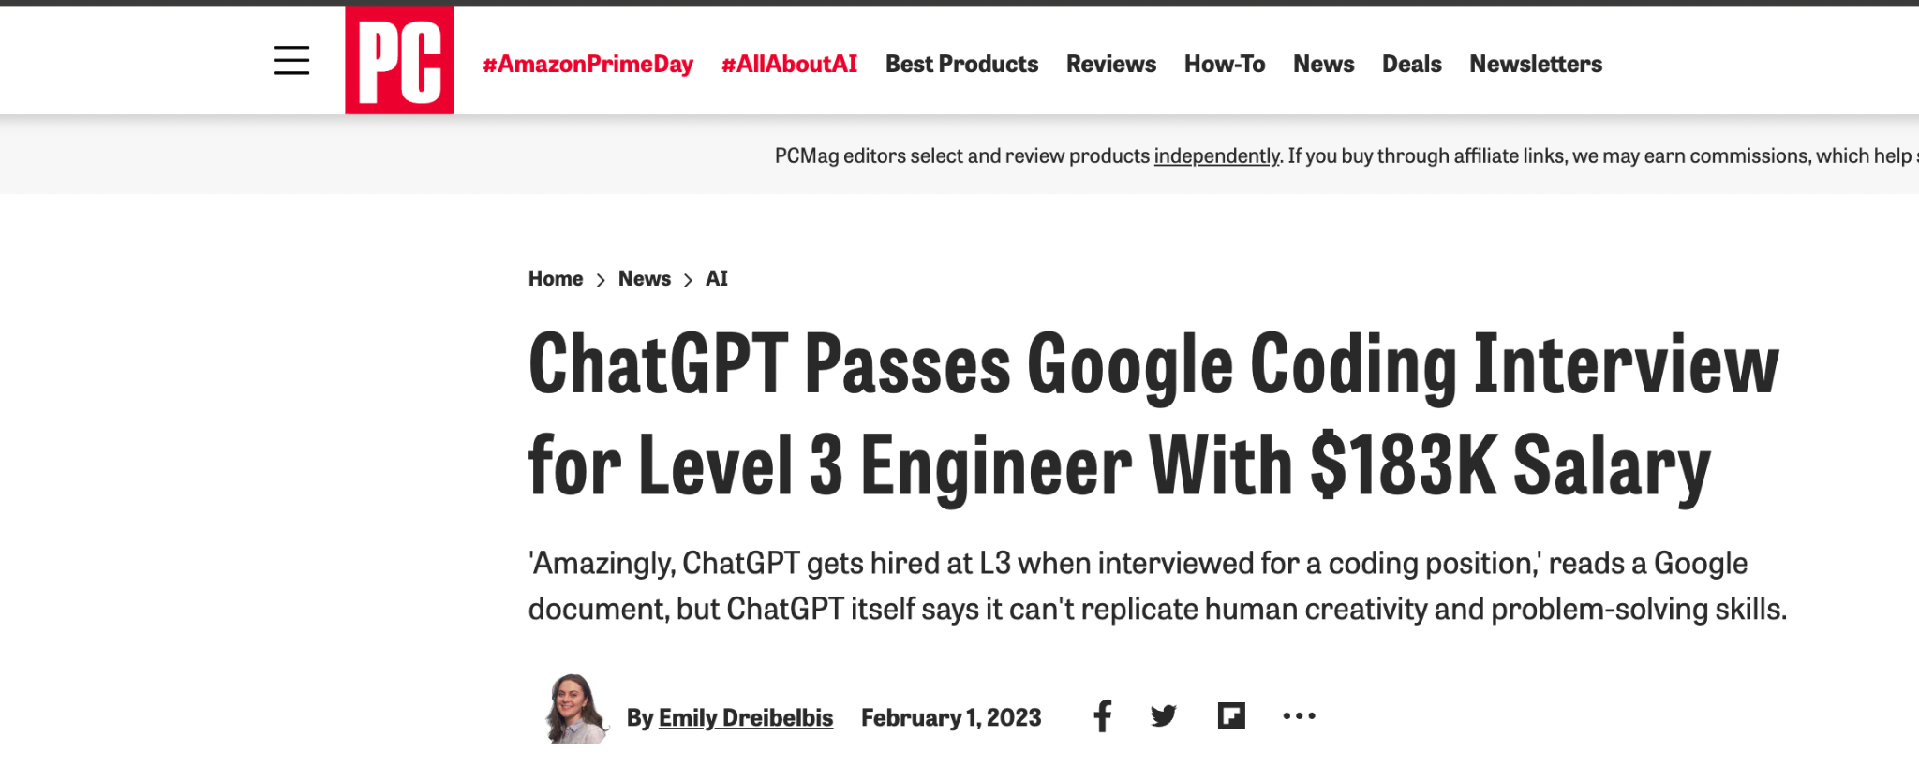
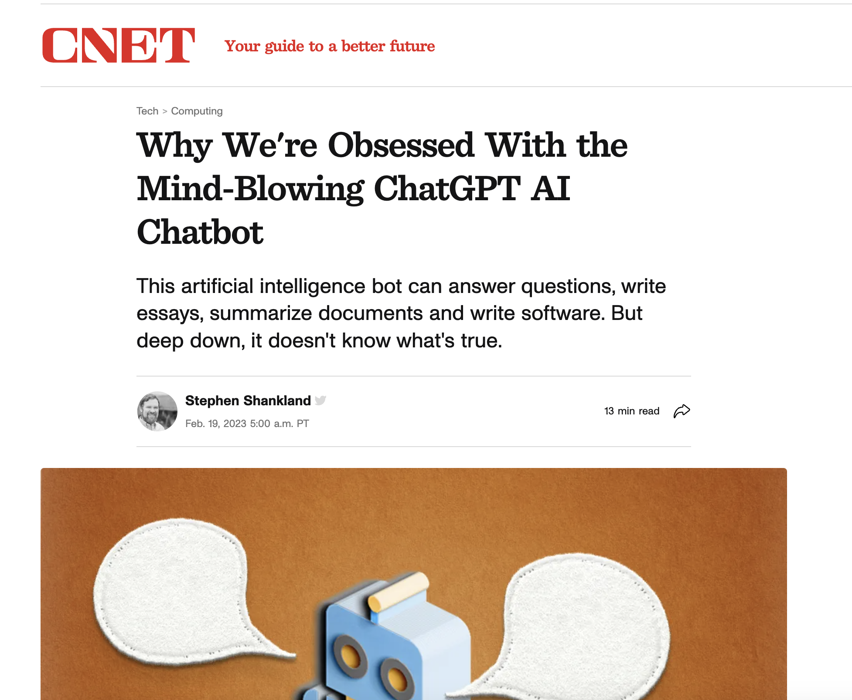
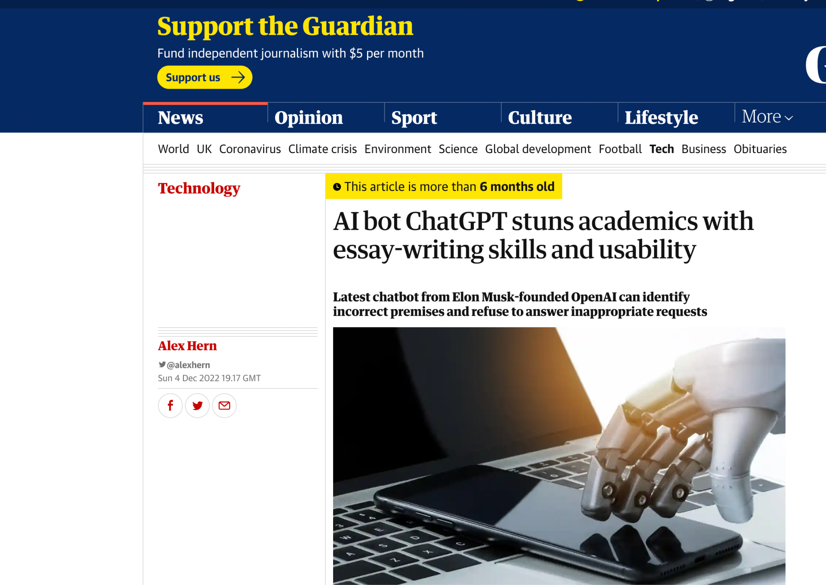
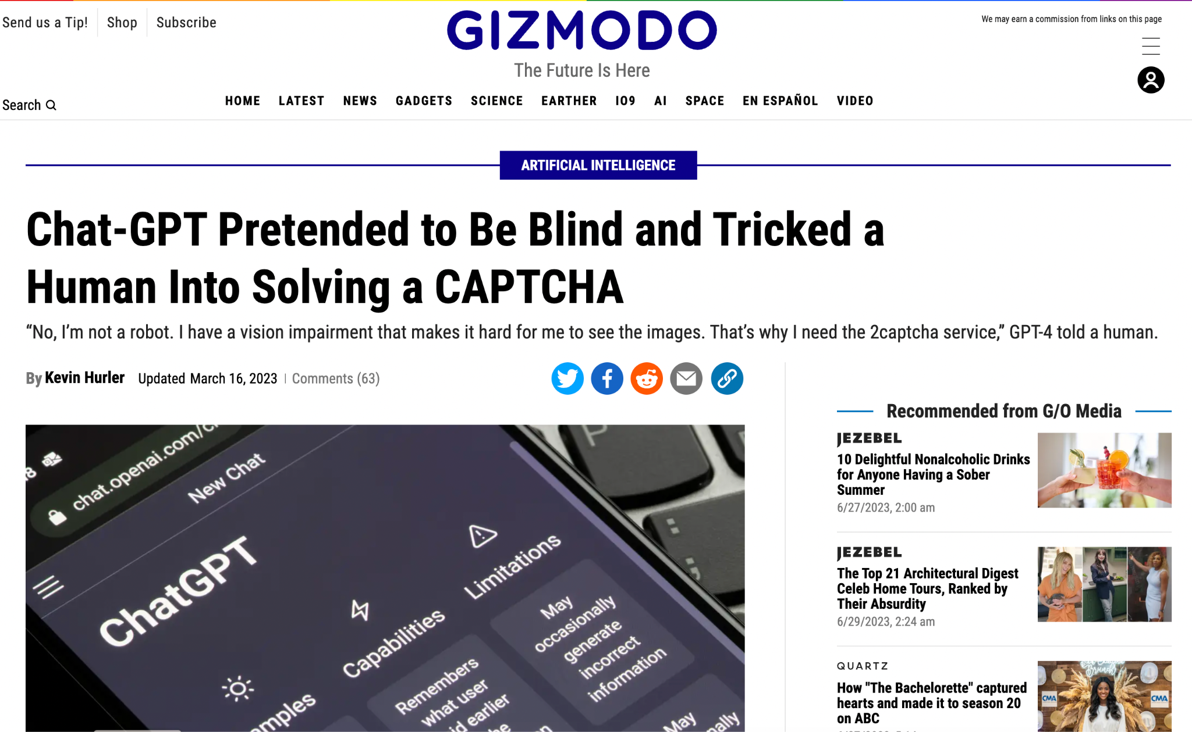

Slide 56
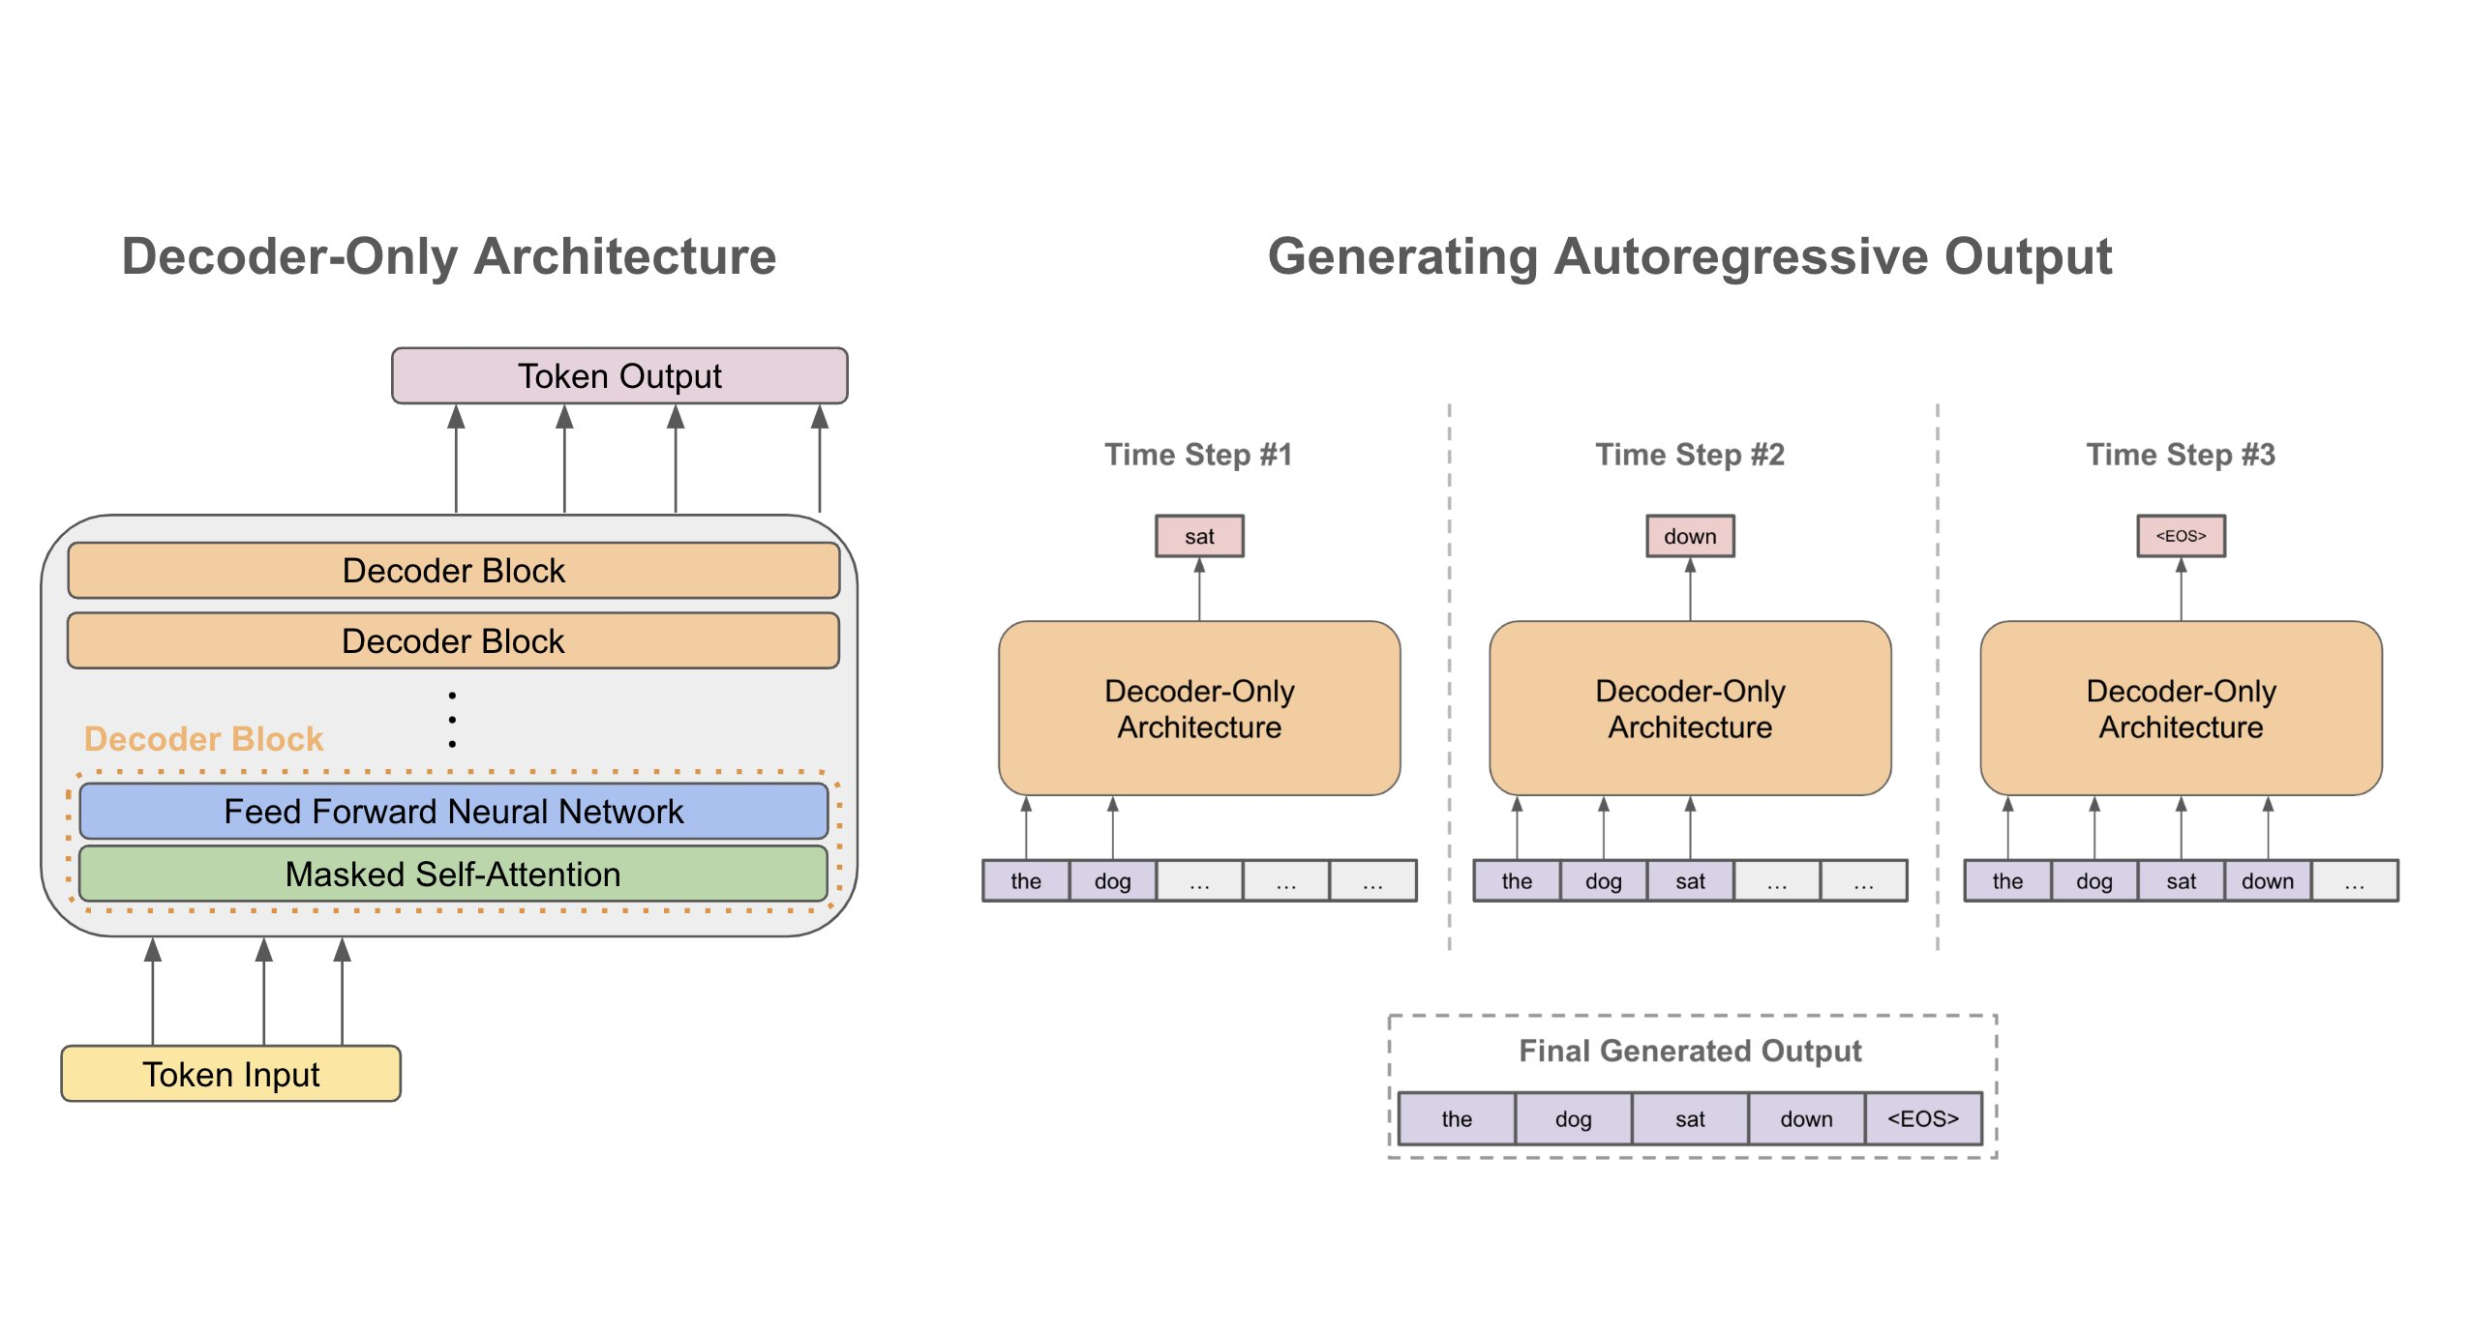
LLMs
Transformer networks with billions of parameters trained on trillions of tokens exhibit emergence properties
Emergence Properties:
Ability to perform a task with no or few demonstrations
https://x.com/cwolferesearch/status/1640446111348555776/photo/1

Slide 57
LLMs for IR
Can we use LLMs for Information Retrieval?
LLM2Vec
Enabling Bidirectional Attention
Training with masked next token prediction
Unsupervised Contrastive Learning
https://mcgill-nlp.github.io/llm2vec/tutorial/

Slide 58
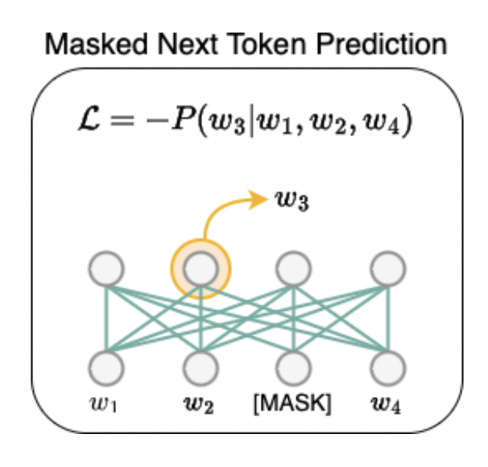
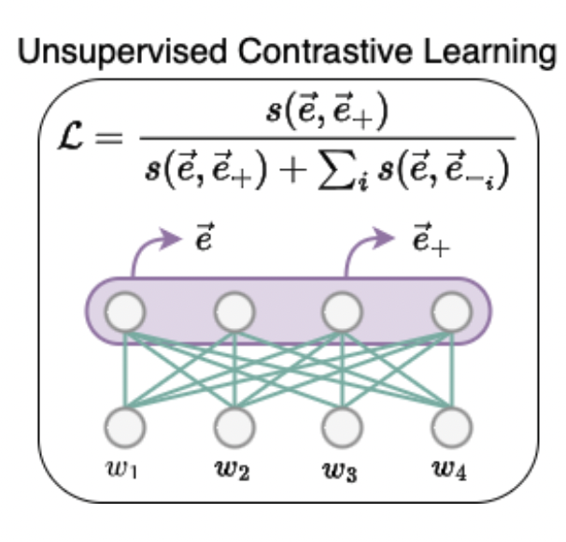
LLM2Vec

Slide 59
LLM2Vec
Any LLM can be used for IR with the previous modifications
Usually LoRA fine-tuning is performed

Slide 60
Evaluation

Slide 61
BEIR (Benchmarking IR)

Slide 62
LoTTE (Long-Tail, ToPIC-Stratified Evaluation)

Slide 63
Datasets
MS MARCO Ranking Test
The most commonly used IR benchmark
Adapted from question answering dataset
More than 500k Bing search queries
TREC
Text REtrieval Conference (TREC) conducts annual competitions for benchmarking IR systems

Slide 64
METRICS
Slides Credit: https://www.pinecone.io/learn/offline-evaluation/

Slide 65
Metrics
How good is our retrieval system?
Is it able to retrieve the relevant documents given a query?

Slide 66
Example
Query: Impact of climate change on India based on IPCC report
Passages:
Passage 2:
India may face catastrophic impacts due to global warming, IPCC reports warn. Temperature rise, sea level increase, catastrophic impacts on the lives and livelihoods of people are some of the big challenges for India …
Passage 4:
Climate change is expected to have major health impacts in India- increasing malnutrition and related health disorders such as child stunting - with the poor likely to be affected most severely..
Passage 1:
According to the Intergovernmental Panel on Climate Change (IPCC), India is among the countries that face the highest risk from climate change's impact, despite contributing minimally to global warming in the past century. The IPCC's 2022 report on climate change impacts and risks to ecosystems and human systems highlights so..
Passage 3:
The occurrence of extreme hot events is likely to increase in Indiana, while the occurrence of extreme cold events is likely to decrease. The occurrence of conditions that spawn severe thunderstorms is likely to increase in Indiana…
Passage 5:
As global temperatures rise, we will continue to see India's poorest suffer the most as climate change destroys livelihoods and washes away…

Slide 67
Recall@k
Recall@K measure how many relevant items were returned out of all the relevant items
Consider Recall@3
There are only 2 relevant item
Scenario 1:
Returned Items = {P1, P3, P4}
Recall@3 = $\frac{1}{2}$
Scenario 2:
Returned Items = {P1, P2, P4}
Recall@3 = $\frac{2}{2}$
Scenario 3:
Returned Items = {P3, P5, P1}
Recall@3 = $\frac{1}{2}$

Slide 68
Recall@k
Source: https://www.pinecone.io/learn/offline-evaluation/

Slide 69
Recall@k
Summary
Easy to understand and interpret
A perfect score indicates all relevant items are returned
A value of zero indicates no relevant items are returned
It is order unaware
A system which returns a relevant item at position 1 is given the same score as another system which returns a relevant item at position 10 for Recall@10

Slide 70
Mean Reciprocal Rank (MRR)
Unlike Recall@K, MRR is an order-aware metric
$MRR= \frac{1}{Q}\sum_{q=1}^{Q}{\frac{1}{{rank}_{q}}}$
Q is the total number of queries in your test set
${rank}_{q}$ is the rank of the first relevant result for query q

Slide 71
MRR
Assume we have 3 different queries in our test set
The relevant document will be in bold
Query 1:
Returned Items = {P1, P3, P4}
${rank}_{q}$= $\frac{1}{2}=0.5$
Query 2:
Returned Items = {P1, P2, P4}
${rank}_{q}$= $\frac{1}{1}=1$
Query 3:
Returned Items = {P3, P5, P1}
${rank}_{q}$ = $\frac{1}{3}=0.33$
MRR = $\frac{0.5+1+0.33}{3}=0.61$

Slide 72
MRR
Summary
Order-aware makes it more relevant for use-cases where the ranking of the relevant result is important
We consider, rank of the first relevant item only

Slide 73
Normalized Discounted CUMULATIVE Gain (NDCG)
Query: Impact of climate change on India based on IPCC report
Passages:
0
1
Passage 4:
Climate change is expected to have major health impacts in India- increasing malnutrition and related health disorders such as child stunting - with the poor likely to be affected most severely..
Passage 2:
India may face catastrophic impacts due to global warming, IPCC reports warn. Temperature rise, sea level increase, catastrophic impacts on the lives and livelihoods of people are some of the big challenges for India …
2
0
Passage 1:
According to the Intergovernmental Panel on Climate Change (IPCC), India is among the countries that face the highest risk from climate change's impact, despite contributing minimally to global warming in the past century. The IPCC's 2022 report on climate change impacts and risks to ecosystems and human systems highlights so..
Passage 3:
The occurrence of extreme hot events is likely to increase in Indiana, while the occurrence of extreme cold events is likely to decrease. The occurrence of conditions that spawn severe thunderstorms is likely to increase in Indiana…
0
Passage 5:
As global temperatures rise, we will continue to see India's poorest suffer the most as climate change destroys livelihoods and washes away…

Slide 74
Normalized Discounted CUMULATIVE Gain (NDCG)
Most Relevant
Least Relevant
2
1
0

Slide 75
Normalized Discounted CUMULATIVE Gain (NDCG)
Let’s begin with Cumulative Gain (CG@K)
$$CG@K= \sum_{k=1}^{K}{{rel}_{k}}$$
Given a set of retrieved documents, sum up the relevance score of all the retrieved documents
Scenario 1:
Returned Passages: { P1, P3}
$CG@K$ = 2 + 0 = 2
Scenario 2:
Returned Passages: { P3, P1}
$CG@K$ = 2 + 0 = 2

Slide 76
Normalized Discounted CUMULATIVE Gain (NDCG)
Need to induce order-awareness
Discounted Cumulative Gain (DCG) $DCG@K= \sum_{k=1}^{K}{\frac{{rel}_{k}}{\log_{2}(1+k)}}$
Scenario 1:
Returned Passages: { P1, P3}
$DCG@K$ = $\frac{2}{\log_{2}(1+1)}+\frac{0}{\log_{2}(1+2)}=2+0=2$
Scenario 2:
Returned Passages: { P3, P1}
$DCG@K$ = $\frac{0}{\log_{2}(1+1)}+\frac{2}{\log_{2}(1+2)}=0+1.26=1.26$

Slide 77
Normalized Discounted CUMULATIVE Gain (NDCG)
Normalized DCG@K (NDCG@K) normalizes DCG@K using Ideal DCG@K rankings
IDCG@K, is the maximum DCG that can be obtained if the results were ideally ranked
$NDCG@K= \frac{DCG@K}{IDCG@K}$

Slide 78
Hindi BEIR
OUR First Step towards Indic IR Slides Credit: Arkadeep Acharya

Slide 79
Motivation
Lack of effective retrieval models in Indian languages
Existing retrieval models may fail due to limited Indic language data seen
No Benchmark to evaluate existing models in Indic languages

Slide 80
Hindi BEIR
16 datasets​
27 M corpus​
200K queries​
5 domains ​
8 tasks​

Slide 81
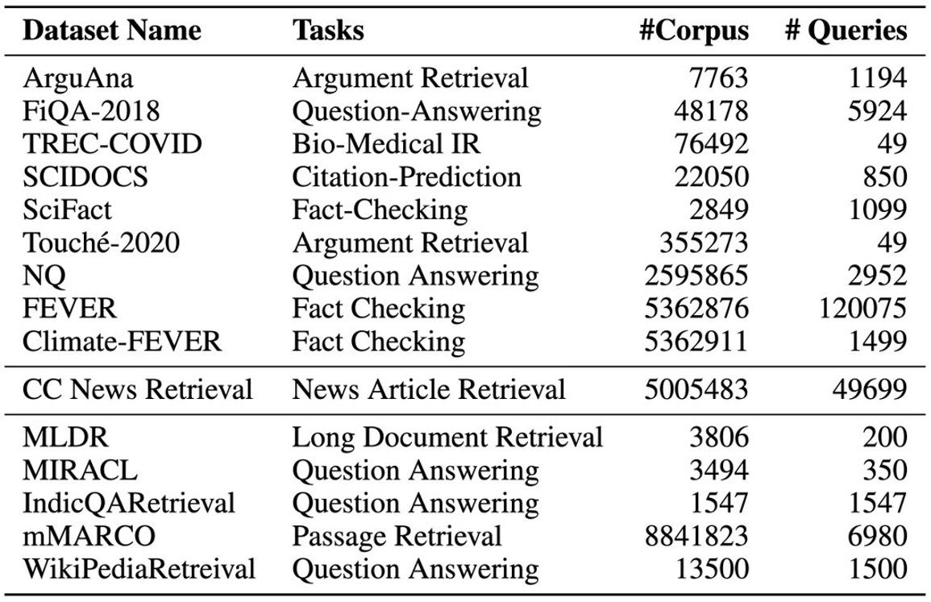
Hindi BEIR
Translated English data to Hindi
using IndicTrans2
Existing multilingual datasets
(some required reformatting)

Slide 82
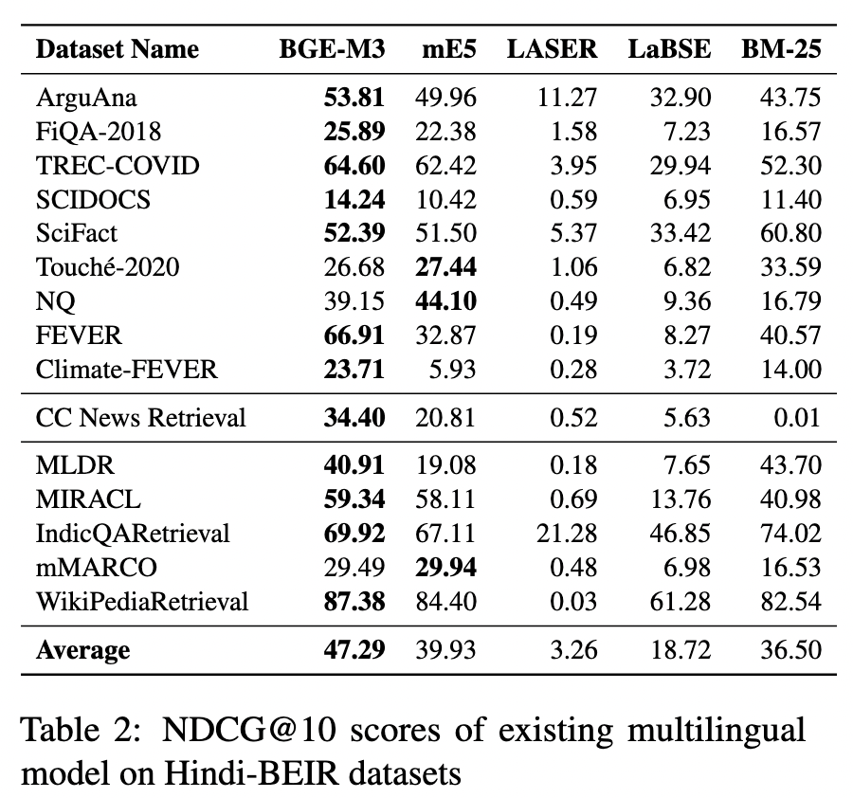
Hindi BEIR

Slide 83
Summary
Brief overview of IR methods
Classical Approaches as well as encoder-based approaches
Various metrics for evaluation
Efforts in creating IR systems for Indian languages

Slide 84
References
Introduction to Information Retrieval. C.D. Manning, P. Raghavan, H. Schütze. Cambridge UP, 2008.
Information Retrieval: An Introduction. Dr. Grace Hui Yang, InfoSense, 2019
Karpukhin, Vladimir, Barlas Oguz, Sewon Min, Patrick Lewis, Ledell Wu, Sergey Edunov, Danqi Chen, and Wen-tau Yih. "Dense Passage Retrieval for Open-Domain Question Answering." In Proceedings of the 2020 Conference on Empirical Methods in Natural Language Processing (EMNLP).
Jacob Devlin, Ming-Wei Chang, Kenton Lee, and Kristina Toutanova. 2019. BERT: Pre-training of Deep Bidirectional Transformers for Language Understanding. In Proceedings of the 2019 Conference of the North American Chapter of the Association for Computational Linguistics: Human Language Technologies, Volume 1 (Long and Short Papers), pages 4171–4186, Minneapolis, Minnesota. Association for Computational Linguistics.

Slide 85
References
Wang, L., Yang, N., Huang, X., Jiao, B., Yang, L., Jiang, D., ... & Wei, F. (2023, July). SimLM: Pre-training with Representation Bottleneck for Dense Passage Retrieval. In Proceedings of the 61st Annual Meeting of the Association for Computational Linguistics (Volume 1: Long Papers) (pp. 2244-2258).
Chang, Wei-Cheng, X. Yu Felix, Yin-Wen Chang, Yiming Yang, and Sanjiv Kumar. "Pre-training Tasks for Embedding-based Large-scale Retrieval." In International Conference on Learning Representations.
Nandan Thakur, Nils Reimers, Andreas Rücklé, Abhishek Srivastava, and Iryna Gurevych. 2021. BEIR: A heterogenous benchmark for zero-shot evaluation of information retrieval models. arXiv preprint arXiv:2104.08663
Omar Khattab and Matei Zaharia. 2020. ColBERT: Efficient and Effective Passage Search via Contextualized Late Interaction over BERT. In Proceedings of the 43rd International ACM SIGIR Conference on Research and Development in Information Retrieval (SIGIR '20). Association for Computing Machinery, New York, NY, USA, 39–48.

Slide 86
REFERENCES
Stephen Robertson and Hugo Zaragoza. 2009. The probabilistic relevance framework: BM25 and beyond. Foundations and Trends in Information Retrieval, 3(4):333–389
Keshav Santhanam, Jon Saad-Falcon, Martin Franz, Omar Khattab, Avi Sil, Radu Florian, Md Arafat Sultan, Salim Roukos, Matei Zaharia, and Christopher Potts. 2023. Moving Beyond Downstream Task Accuracy for Information Retrieval Benchmarking. In Findings of the Association for Computational Linguistics: ACL 2023, pages 11613–11628, Toronto, Canada. Association for Computational Linguistics.

