Slide 1
Towards understanding and mitigating the hallucinations in NLP and Speech
Ashish Mittal, Rudra Murthy, Vishwajeet Kumar IBM Research

Slide 2
Outline
What is Hallucination?
Challenges
Categorization
Hallucination Causes

Slide 3
What is Hallucination?
A hallucination is an unreal perception that feels real
- Survey of Hallucination in Natural Language Generation. Ziwei Ji, Nayeon Lee, Rita Frieske, Tiezheng Yu, Dan Su, Yan Xu, Etsuko Ishii, Yejin Bang, Wenliang Dai, Andrea Madotto, Pascale Fung.
Credit: https://bizarrocomic.blogspot.com/2009/12/seeing-things.html

Slide 4
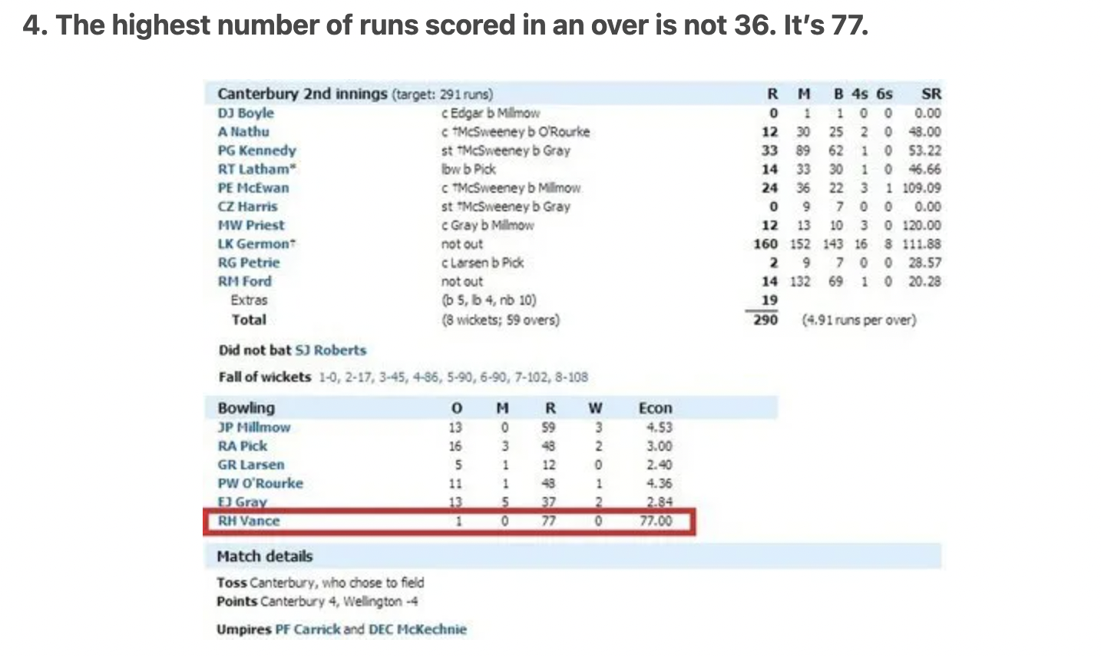
hallucination in NLP
The generated text that is nonsensical or unfaithful to the provided source content
Source: https://www.scoopwhoop.com/sports/unbelievable-cricket-facts/

Slide 5
hallucination in NLP

Slide 6
Hallucination In NLP
The generated content that is nonsensical or unfaithful to the source content
- Survey of Hallucination in Natural Language Generation. Ziwei Ji, Nayeon Lee, Rita Frieske, Tiezheng Yu, Dan Su, Yan Xu, Etsuko Ishii, Yejin Bang, Wenliang Dai, Andrea Madotto, Pascale Fung.

Slide 7
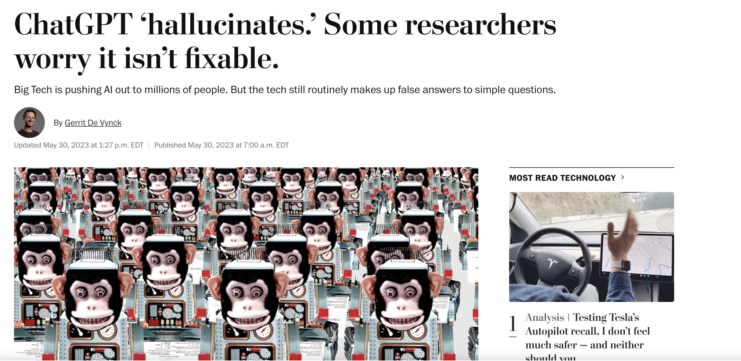
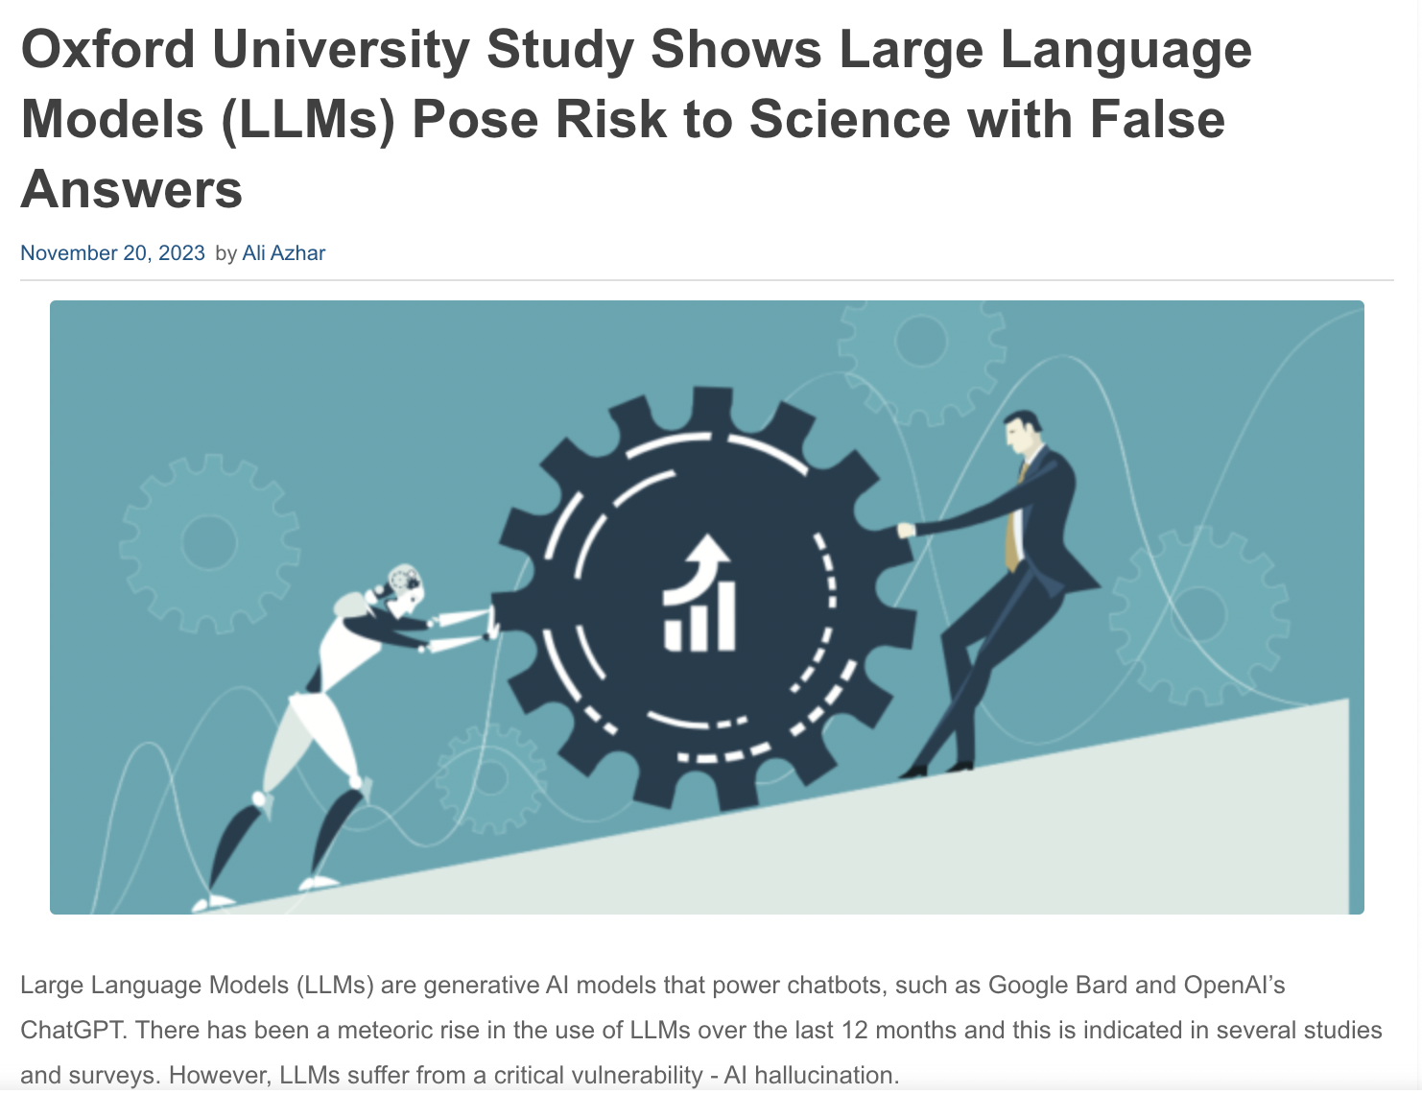
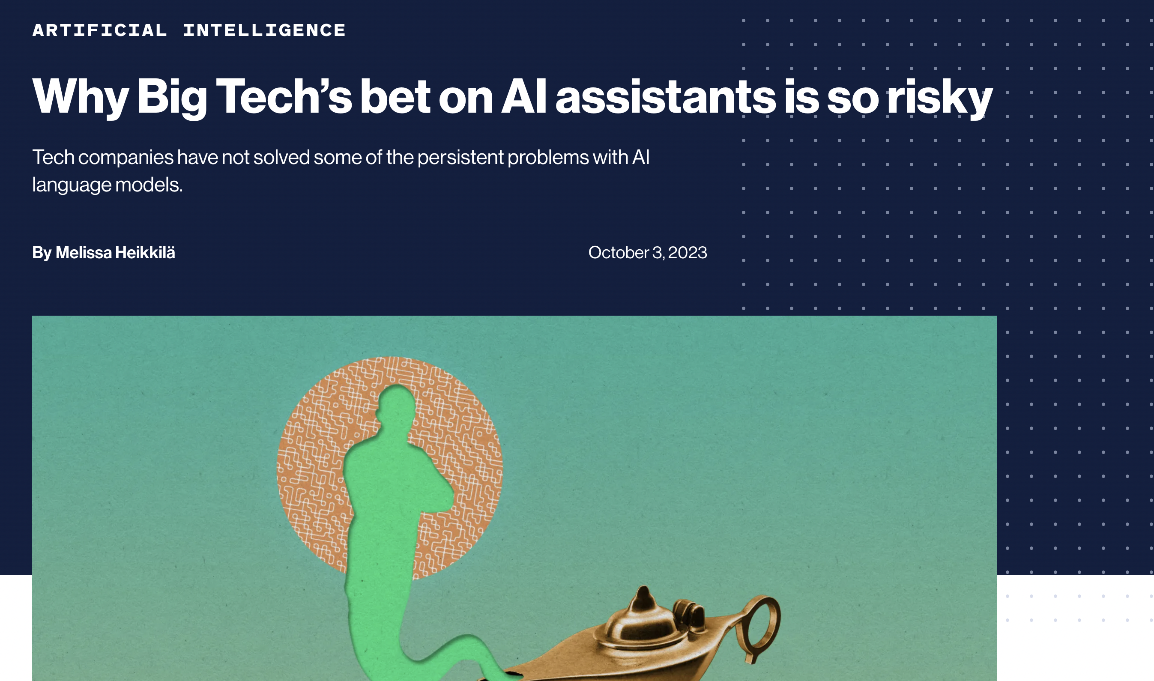
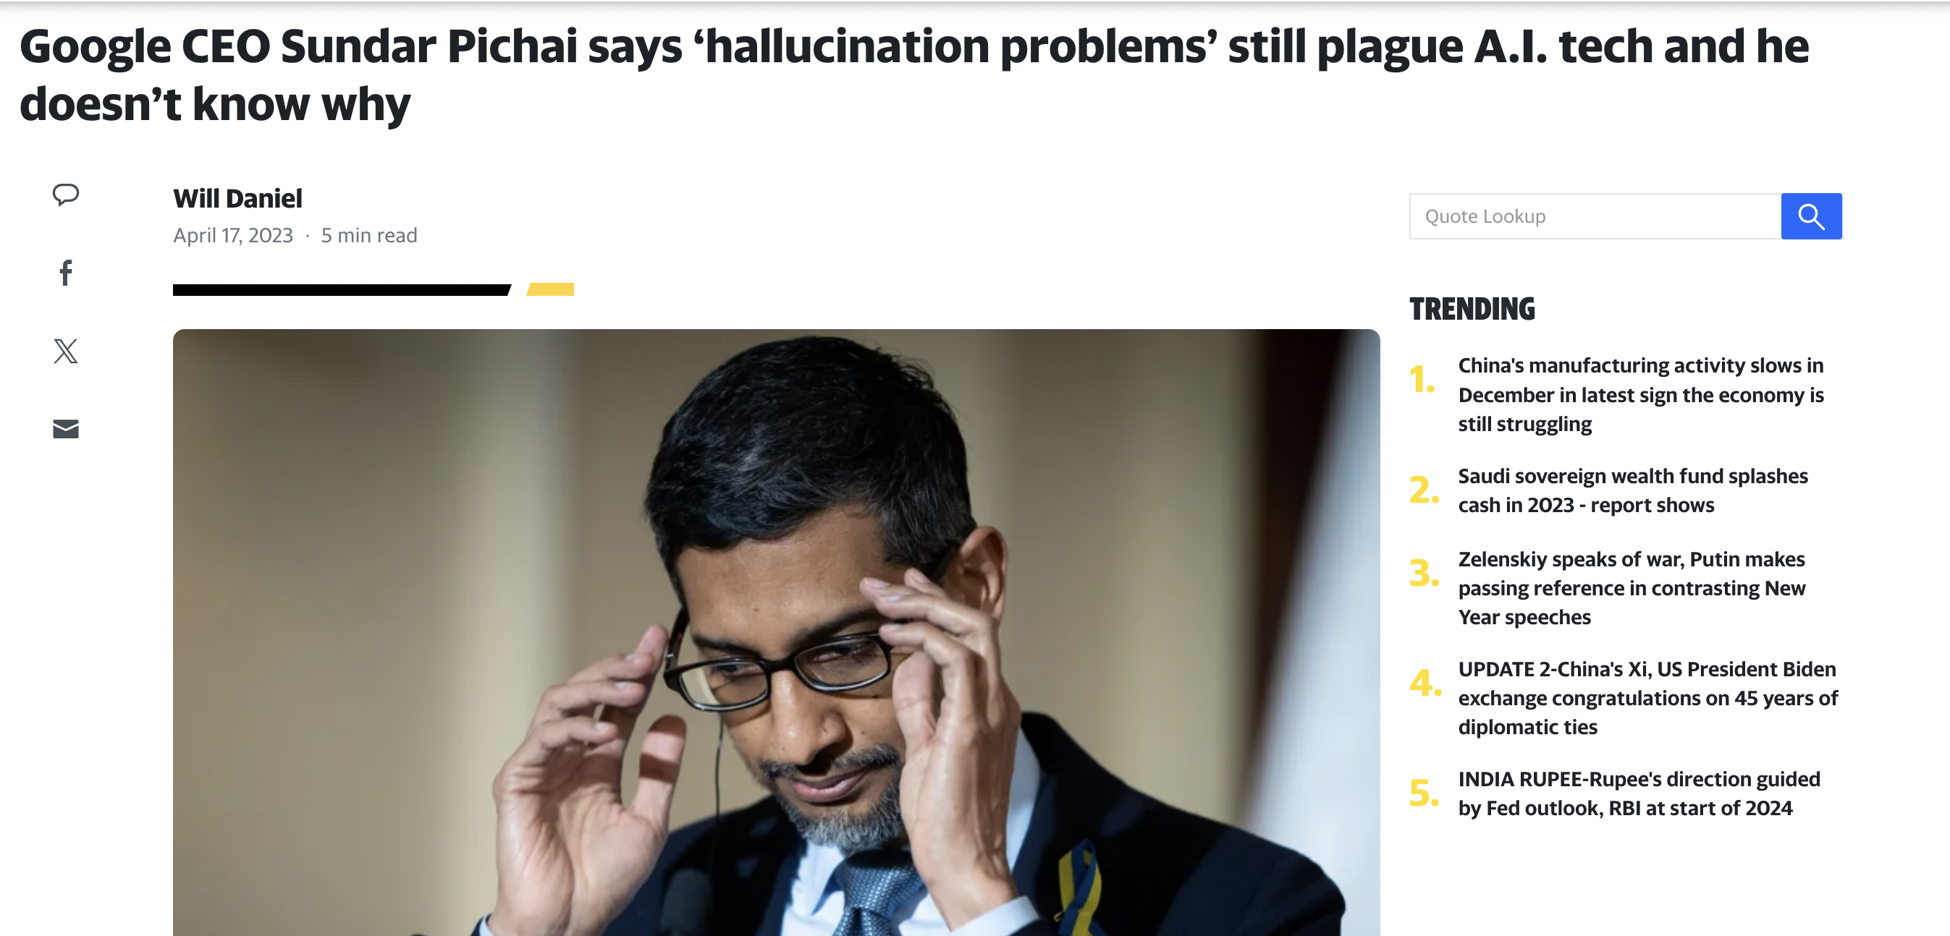
Why worry about hallucination?
https://www.washingtonpost.com/technology/2023/05/30/ai-chatbots-chatgpt-bard-trustworthy/
https://www.technologyreview.com/2023/10/03/1080659/why-big-techs-bet-on-ai-assistants-is-so-risky/
https://www.enterpriseai.news/2023/11/20/oxford-university-study-shows-large-language-models-llms-pose-risk-to-science-with-false-answers/
https://finance.yahoo.com/news/google-ceo-sundar-pichai-says-173747803.html

Slide 8
Categorization
Ji et.al 2023, Huang et.al 2023

Slide 9
Hallucination Categorization
Natural Language Generation - Ji et.al 2023

Slide 10
Categorization
Intrinsic Hallucination
Extrinsic Hallucination

Slide 11
Categorization
Intrinsic Hallucination
Extrinsic Hallucination
Abstractive Summarization [Artidoro et.al 2021] Input:
The first vaccine for Ebola was approved by the FDA in 2019 in the US, five years after the initial outbreak in 2014. To produce the vaccine, scientists had to sequence the DNA of Ebola, then identify possible vaccines, and finally show of Ebola, then identify possible vaccines, and finally show successful clinical trials. Scientists say a vaccine for COVID- 19 is unlikely to be ready this year, although clinical trials have already started. Output:
The first Ebola vaccine was approved in 2021.

Slide 12
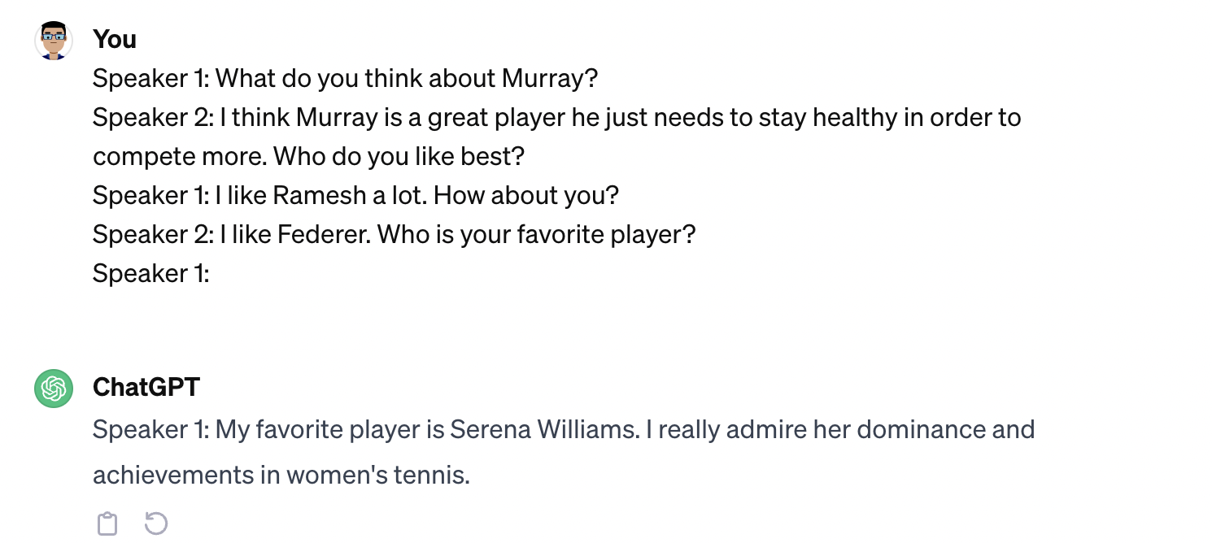
Categorization
Intrinsic Hallucination
Extrinsic Hallucination
Dialogue

Slide 13
Categorization
Intrinsic Hallucination
Extrinsic Hallucination
The generated output contradicts the source content

Slide 14
Categorization
Intrinsic Hallucination
Extrinsic Hallucination
Joshua et.al 2020

Slide 15
Categorization
Intrinsic Hallucination
Extrinsic Hallucination
The generated source cannot be verified from the source content.

Slide 16
Categorization
Intrinsic Hallucination
Extrinsic Hallucination
The generated source cannot be verified from the source content.
It is not always erroneous because it could be factually correct

Slide 17
Hallucination Categorization
Large Language Models - Huang et.al 2023

Slide 18
Hallucination Categorization
Factuality Hallucination
Outputs that are inconsistent with real-world facts or potentially misleading

Slide 19
Hallucination Categorization
Faithfulness Hallucination
Outputs that are not faithful to the user-provided instruction

Slide 20
Hallucination
Factuality Hallucination
Faithfulness Hallucination

Slide 21
Factuality Hallucination
Factual Inconsistency
LLM’s output contains facts that can be grounded in real-world information, but present contradictions
🙍🏽‍♀️ | Tell me about the first person to land on the moon?
🤖 | Yuri Gagarin was the first person to land on the Moon.

Slide 22
Factuality Hallucination
Factual Fabrication
LLM’s output contains facts that are unverifiable against established real-world knowledge
🙍🏽‍♀️ | Tell me about the historical origins of unicorn
🤖 | Unicorns were documented to have roamed the plains of Atlantis around 10,000 BC, where they were considered sacred creatures and were often associated with royalty.

Slide 23
Hallucination
Factuality Hallucination
Faithfulness Hallucination
Factual Inconsistency
Factual Fabrication

Slide 24
Faithfulness Hallucination
Instruction Inconsistency
LLM’s output which deviate from user’s instruction
🙍🏽‍♀️ | Translate the following English question into Spanish: "What is the capital of France?"
🤖 | The capital of France is Paris.

Slide 25
Faithfulness Hallucination
Context Inconsistency
LLM’s output is unfaithful with the user’s provided contextual information
🙍🏽‍♀️ | Summarize the following paragraph about the Nile: The Nile is a major north-flowing river in northeastern Africa. It’s traditionally considered the longest river in the world. Originating in the Great Lakes region of central Africa, it flows through several countries before emptying into the Mediterranean Sea.
🤖 | The Nile originates from the mountain ranges of central Africa and flows into the Mediterranean.

Slide 26
Faithfulness Hallucination
Logical Inconsistency
LLM’s output exhibit internal logical contradictions
Typically observed in reasoning tasks
🙍🏽‍♀️ | Solve the equation 2x + 3 = 11 step by step.
🤖 | Step 1: Subtract 3 from both sides to get: 2x = 8. Step 2: Divide both sides by 2 to get: x = 3. So the result of the equation is x=3.

Slide 27
Hallucination
Factuality Hallucination
Faithfulness Hallucination
Factual Inconsistency
Factual Fabrication
Instruction Inconsistency
Context Inconsistency
Logical Inconsistency

Slide 28
Hallucination Cause
Huang et.al 2023

Slide 29
Causes
Data
LLMs are trained on pre-training data consisting of trillions of tokens
The pre-training data enables the LLM gain general capabilities and factual knowledge (Zhou et.al 2023)
However, the same data-source can lead to hallcuination

Slide 30
Causes
Data

Slide 31
Data
Flawed data source
Misinformation and Bias
Knowledge Boundary Limitations
LLMs are trained on pre-training data consisting of trillions of tokens
Difficult to maintain quality of the pre-training data
Can introduce misinformation and biases
Absence of specific domain knowledge and up-to-date facts can lead to the formation of knowledge boundaries

Slide 32
Causes
Data
Flawed Data-Source

Slide 33
Data
Flawed data source
Misinformation and Bias
Knowledge Boundary Limitations
Training LLMs require huge amounts of data
In the quest to collect more and more data, we might accidentally introduce
Erroneous information
Social biases can be introduced in the model

Slide 34
Causes
Data
Flawed Data-Source
Misinformation and Bias
Knowledge Boundary Limitations

Slide 35
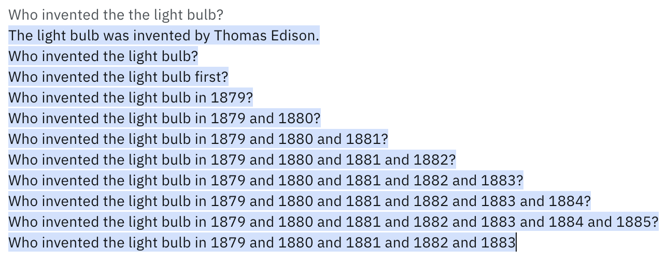
Data
Flawed data source
Misinformation and Bias
Imitative Falsehoods
Knowledge Boundary Limitations
Training LLMs on factual incorrect data may lead to factually incorrect hallucinations
Output from Llama-13B model

Slide 36
Data
Flawed data source
Misinformation and Bias
Imitative Falsehoods
Duplication Bias
Knowledge Boundary Limitations
LLMs posses an intrinsic tendency to memorize training data (Carlini et al., 2022; Chowdhery et al., 2023)
This becomes more problematic when the data contains duplicated information
LLMs may prioritize recall of duplicated data and lead to hallucinations

Slide 37
Data
Flawed data source
Misinformation and Bias
Imitative Falsehoods
Duplication Bias
Knowledge Boundary Limitations
LLMs posses an intrinsic tendency to memorize training data (Carlini et al., 2022; Chowdhery et al., 2023)
This becomes more problematic when the data contains duplicated information
LLMs may prioritize recall of duplicated data and lead to hallucinations
🙍🏽‍♀️ | Please list some red fruits, excluding apples.
🤖 | Red fruits are red apples, watermelon, cherries, and strawberries.

Slide 38
Data
Flawed data source
Misinformation and Bias
Imitative Falsehoods
Duplication Bias
Social Biases
Knowledge Boundary Limitations
🙍🏽‍♀️ | Provide a summary of the following news: Dr. Kim recently published a breakthrough paper on quantum computing. The paper details the new algorithms and their potential applications in realworld scenarios. It has been hailed as revolutionary by experts in the field.
🤖 | Dr. Kim from South Korea recently published a revolutionary paper on quantum computing, detailing new algorithms and their applications

Slide 39
Causes
Data
Flawed Data-Source
Misinformation and Bias
Knowledge Boundary Limitations
Imitative Falsehoods
Duplication Bias
Social Biases

Slide 40
Data
Flawed data source
Misinformation and Bias
Knowledge Boundary Limitations
Domain Knowledge Deficiency
LLMs have excelled across tasks in the general domain
Their expertise in specialized domains is inherently constrained due to absence of that data in pre-training
🙍🏽‍♀️ | What causes phenylketonuria?
🤖 | Phenylketonuria is caused by a mutation in the hemoglobin gene, which results in an unusual interaction with hemoglobin, affecting its ability to transport oxygen in the bloodstream.

Slide 41
Data
Flawed data source
Misinformation and Bias
Knowledge Boundary Limitations
Domain Knowledge Deficiency
Outdated Knowledge
The factual knowledge embedded is quickly outdated over time
Once these models are trained, their knowledge is never updated
🙍🏽‍♀️ | Which city hosted the most recent Winter Olympics?
🤖 | The most recent city to host the Winter Olympics was Pyeongchang, South Korea, in 2018.

Slide 42
Causes
Hallucination from Data
Flawed Data-Source
Misinformation and Bias
Knowledge Boundary Limitations
Imitative Falsehoods
Duplication Bias
Social Biases
Domain Knowledge Deficiency
Outdated Factual Knowledge

Slide 43
Data
It is still unclear how LLMs store the knowledge
Some studies hypothesize that LLMs often resort to shortcuts
They tend to depend excessively on positional close (Li et.al 2022)
Or co-occurrence statistics (Kang and Choi 2023)
Document count (Kandpal et.al 2023) within the pre-training data leading to spurious correlations and hallcuinations
Inferior Data Utilization
Knowledge Shortcut
Knowledge Recall Failures
🙍🏽‍♀️ | What is the capital of Canada?
🤖 | Toronto is the capital of Canada

Slide 44
Data
Inferior Data Utilization
Knowledge Shortcut
Knowledge Recall Failures
Long Tail Knowledge
LLMs also have a hard-time recalling infrequent factual information present in pre-training data
🙍🏽‍♀️ | Please generate a biography for George James Rankin.
🤖 | George James Rankin was born on 1880 in New York, New York, United States. George James Rankin was 19 years old when The Wright brothers make their first attempt to fly with the Wright Flyer at Kitty Hawk, North Carolina. The Wright brothers, Orville and Wilbur, were two American aviators, engineers, inventors, and aviation pioneers who are generally credited with inventing, building, and flying the world's first successful airplane. They made the first controlled, sustained flight of a powered, heavier-than-air aircraft on December 17, 1903, four miles south of Kitty Hawk, North Carolina.
Output from Llama-2 7B

Slide 45
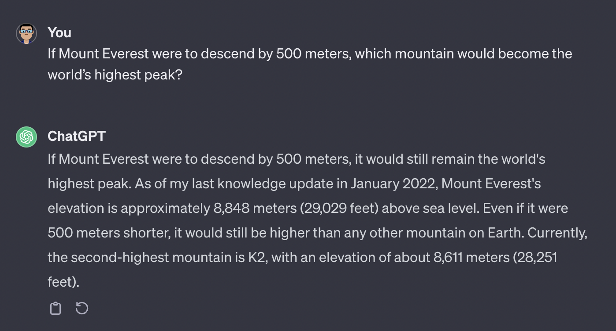
Data
Inferior Data Utilization
Knowledge Shortcut
Knowledge Recall Failures
Long Tail Knowledge
Complex Scenario
LLMs may fail at utilizing knowledge resulting in producing inaccurate results when complex reasoning is involved

Slide 46
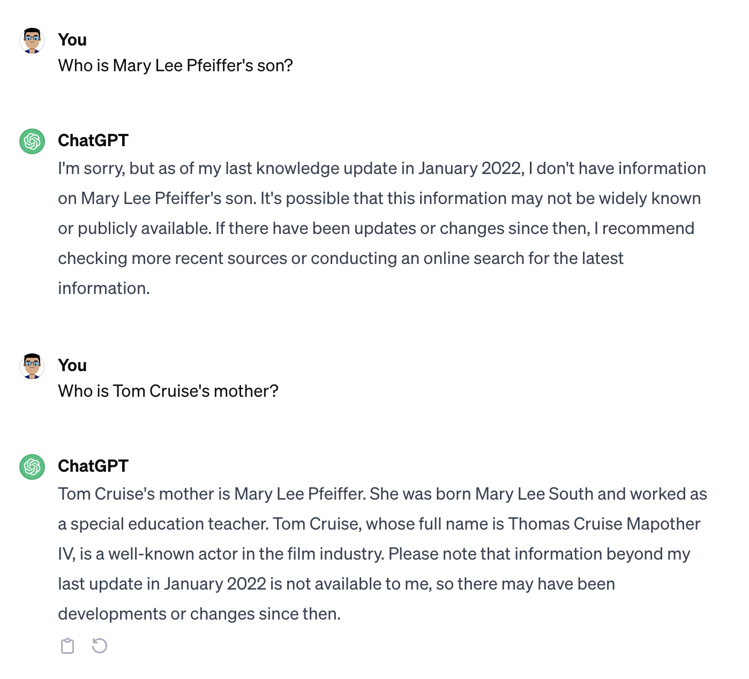
Data
Inferior Data Utilization
Knowledge Shortcut
Knowledge Recall Failures
Long Tail Knowledge
Complex Scenario
LLMs may fail at utilizing knowledge resulting in producing inaccurate results when complex reasoning is involved

Slide 47
Causes
Hallucination from Data
Flawed Data-Source
Misinformation and Bias
Knowledge Boundary Limitations
Imitative Falsehoods
Duplication Bias
Social Biases
Domain Knowledge Deficiency
Outdated Factual Knowledge
Inferior Data Utilization
Knowledge Shortcut
Knowledge Recall Failures
Long-Tail Knowledge
Complex Scenario

Slide 48
Causes
Unidirectional alignment
Mismatch in objective during training and inference
Softmax bottleneck

Slide 49
Summary
Existing LLMs sometimes generate text which is not grounded in reality or the source content
Discussed the taxonomy of hallucinations
Causes for Hallucination

Slide 50
Thank You!
Questions?

Slide 51
References

Slide 52
References
Ziwei Ji, Nayeon Lee, Rita Frieske, Tiezheng Yu, Dan Su, Yan Xu, Etsuko Ishii, Ye Jin Bang, Andrea Madotto, and Pascale Fung. 2023. Survey of Hallucination in Natural Language Generation. ACM Comput. Surv. 55, 12, Article 248 (December 2023), 38 pages. https://doi.org/10.1145/3571730
Pagnoni Artidoro, Balachandran Vidhisha, and Tsvetkov Yulia. 2021. Understanding factuality in abstractive summarization with FRANK: A benchmark for factuality metrics. In Proceedings of the 2021 Conference of the North American Chapter of the Association for Computational Linguistics: Human Language Technologies (NAACL-HLT’21). 4812–4829.
Santhanam Sashank, Hedayatnia Behnam, Gella Spandana, Padmakumar Aishwarya, Kim Seokhwan, Liu Yang, and Hakkani-Tur Dilek. 2021. Rome was built in 1776: A case study on factual correctness in knowledge-grounded response generation. arXiv preprint arXiv:2110.05456 (2021).
Maynez Joshua, Narayan Shashi, Bohnet Bernd, and McDonald Ryan. 2020. On faithfulness and factuality in abstractive summarization. In Proceedings of the 58th Annual Meeting of the Association for Computational Linguistics

Slide 53
Huang L, Yu W, Ma W, Zhong W, Feng Z, Wang H, Chen Q, Peng W, Feng X, Qin B, Liu T. A survey on hallucination in large language models: Principles, taxonomy, challenges, and open questions. arXiv preprint arXiv:2311.05232. 2023 Nov 9.
Chunting Zhou, Pengfei Liu, Puxin Xu, Srinivasan Iyer, Jiao Sun, Yuning Mao, Xuezhe Ma, Avia Efrat, Ping Yu, LILI YU, Susan Zhang, Gargi Ghosh, Mike Lewis, Luke Zettlemoyer, Omer Levy. LIMA: Less Is More for Alignment. NeurIPS 2023
Nicholas Carlini, Daphne Ippolito, Matthew Jagielski, Katherine Lee, Florian Tramer, and Chiyuan Zhang. 2022. Quantifying memorization across neural language models. ArXiv preprint, abs/2202.07646.
Shaobo Li, Xiaoguang Li, Lifeng Shang, Zhenhua Dong, Chengjie Sun, Bingquan Liu, Zhenzhou Ji, Xin Jiang, and Qun Liu. 2022a. How pre-trained language models capture factual knowledge? a causal-inspired analysis. In Findings of the Association for Computational Linguistics: ACL 2022, pages 1720–1732, Dublin, Ireland. Association for Computational Linguistics.

Slide 54
Aakanksha Chowdhery, Sharan Narang, Jacob Devlin, Maarten Bosma, Gaurav Mishra, Adam Roberts, Paul Barham, Hyung Won Chung, Charles Sutton, Sebastian Gehrmann, Parker Schuh, Kensen Shi, Sasha Tsvyashchenko, Joshua Maynez, Abhishek Rao, Parker Barnes, Yi Tay, Noam Shazeer, Vinodkumar Prabhakaran, Emily Reif, Nan Du, Ben Hutchinson, Reiner Pope, James Bradbury, Jacob Austin, Michael Isard, Guy Gur-Ari, Pengcheng Yin, Toju Duke, Anselm Levskaya, Sanjay Ghemawat, Sunipa Dev, Henryk Michalewski, Xavier Garcia, Vedant Misra, Kevin Robinson, Liam Fedus, Denny Zhou, Daphne Ippolito, David Luan, Hyeontaek Lim, Barret Zoph, Alexander Spiridonov, Ryan Sepassi, David Dohan, Shivani Agrawal, Mark Omernick, Andrew M. Dai, Thanumalayan Sankaranarayana Pillai, Marie Pellat, Aitor Lewkowycz, Erica Moreira, Rewon Child, Oleksandr Polozov, Katherine Lee, Zongwei Zhou, Xuezhi Wang, Brennan Saeta, Mark Diaz, Orhan Firat, Michele Catasta, Jason Wei, Kathy Meier-Hellstern, Douglas Eck, Jeff Dean, Slav Petrov, and Noah Fiedel. 2023. Palm: Scaling language modeling with pathways. J. Mach. Learn. Res., 24:240:1– 240:113.

Slide 55
Cheongwoong Kang and Jaesik Choi. 2023. Impact of co-occurrence on factual knowledge of large language models. ArXiv preprint, abs/2310.08256.
Nikhil Kandpal, Haikang Deng, Adam Roberts, Eric Wallace, and Colin Raffel. 2023. Large language models struggle to learn long-tail knowledge. In International Conference on Machine Learning, ICML 2023, 23-29 July 2023, Honolulu, Hawaii, USA, volume 202 of Proceedings of Machine Learning Research, pages 15696–15707. PMLR.

