Slide 1
Indian Language Computing
Practical Challenges and Research Opportunities
Rudra Murthy
Staff Research Scientist,
IBM Bangalore
Slides Credit: Dr. Anoop Kunchukuttan, Dr. Jyotsna Khattri, AI4Bharat, OdiaGenerative AI team

Slide 2
Outline
Indic NLP
Multilinguality and Transfer Learning
Large Language Models
Introduction
Alignment
Challenges and Opportunities in Indic NLP
Efforts in Indic NLP
Challenges and Opportunities

Slide 3
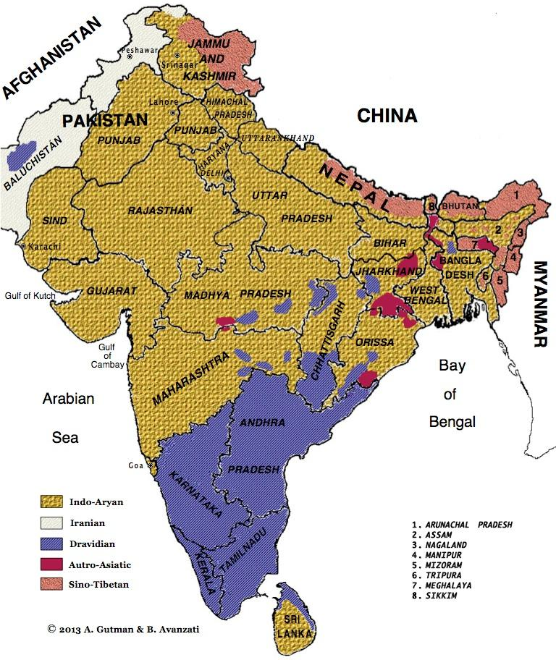
Multilinguality is a key theme
5+1 language families
Indo-Aryan (77% population)*
Dravidian (20.61%)
Austro-Asiatic (1.2%)
Tibeto-Burman (0.8%)
Andaman languages (2 families?)
+ English (West-Germanic)
22 scheduled languages
11 languages with more than 25 million speakers
29 languages with more than 1 million speakers
Only India has 2 languages (+English) in the
world’s 10 most spoken languages
7-8 Indian languages in the top 20 most spoken language
*https://en.wikipedia.org/wiki/List_of_languages_by_number_of_native_speakers_in_India

Slide 4
Transfer Learning (Silver and Mercer 1998, Pan and Yang 2010)
Functional Transfer Learning
Representational Transfer Learning
Store and re-process knowledge gained while learning one task (assisting task) to learn a different but related task
Multilingual learning is a type of transfer learning where information gained while learning a task in one language is used to learn the same task in a different language*

Slide 5
Functional Transfer Learning
Task 1 Data
Model
Task 1 & 2 Trained Model
Task 2 Data

Slide 6
Representational Transfer Learning
Model
Model
Task 1 Data
Task 1 Trained Model
Task 1 Data
Task 1 Trained Model
Copy weights
Model
Model
Task 2 Trained Model
Task 2 Trained Model
Task 2 Data
Task 2 Data
Two variations of Representational Transfer Learning

Slide 7
Why Multilingual (Transfer) Learning?
Key Similarities between related languages
ಮುಂಬೈ ಮಹಾರಾಷ್ಟ್ರ ರಾಜ್ಯದ ರಾಜಧಾನಿ
muMbai mahArAShTra rAjyada rAjadhAni
Kannada
Person and Location names do not change across languages (Green et.al 2011)
Reduce requirement on training data by borrowing data from a related language
मुंबई महाराष्ट्र राज्य की राजधानी है
muMbaI mahArAShTra rAjya kI rAjadhAnI hai
Hindi
Related languages share significant vocabulary and basic word-order
മഹാരാഷ്ട്ര സംസ്ഥാനത്തിന്റെ തലസ്ഥാനമാണ് മുംബൈ*
mahaarashtra samsthaanathinte thalasthaanamaanu mumbai
Malayalam
*Translation obtained from Google Translate
Notes:
Since related languages share vocabulary and word-order, can we exploit labeled data from related language to overcome lack of labeled data

Slide 8
Simple Measures of Bridging Lexical Divergence
Help Unsupervised Neural Machine Translation for Low-Resource Languages
Related Languages Help each other
Jyotsana Khatri, Rudra Murthy, Tamali Banerjee, Pushpak Bhattacharyya. JMT 2021

Slide 9
Unsupervised NMT
Unsupervised NMT = Language model pretraining + Iterative Back-Translation
Language model pretraining
XLM (Conneau et al. (2019))
MASS (Song et al. (2019))
BART (Lewis et al. (2020))
mBART (Liu et al. (2020)) ...
Conneau, Alexis, and Guillaume Lample. "Cross-lingual language model pretraining." Advances in Neural Information Processing Systems 32 (2019): 7059-7069.
Song, Kaitao, Xu Tan, Tao Qin, Jianfeng Lu, and Tie-Yan Liu. "MASS: Masked Sequence to Sequence Pre-training for Language Generation." In International Conference on Machine Learning, pp. 5926-5936. PMLR, 2019.
Lewis, Mike, Yinhan Liu, Naman Goyal, Marjan Ghazvininejad, Abdelrahman Mohamed, Omer Levy, Veselin Stoyanov, and Luke Zettlemoyer. "BART: Denoising Sequence-to-Sequence Pre-training for Natural Language Generation, Translation, and Comprehension." In Proceedings of the 58th Annual Meeting of the Association for Computational Linguistics, pp. 7871-7880. 2020.
Liu, Yinhan, Jiatao Gu, Naman Goyal, Xian Li, Sergey Edunov, Marjan Ghazvininejad, Mike Lewis, and Luke Zettlemoyer. "Multilingual denoising pre-training for neural machine translation." Transactions of the Association for Computational Linguistics 8 (2020): 726-742.

Slide 10
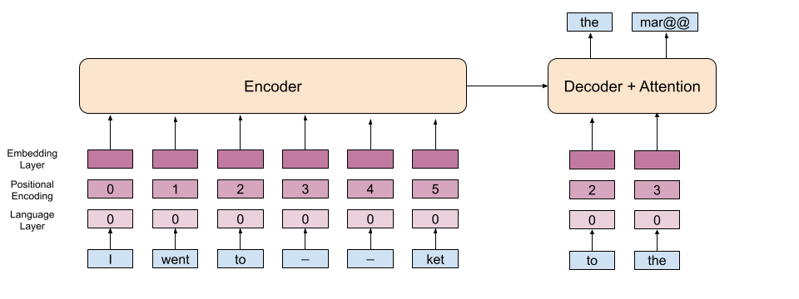
MASS Pre-Training
Song, Kaitao, Xu Tan, Tao Qin, Jianfeng Lu, and Tie-Yan Liu. "MASS: Masked Sequence to Sequence Pre-training for Language Generation." In International Conference on Machine Learning, pp. 5926-5936. PMLR, 2019.

Slide 11
Contributions
Lexical Divergence plays a significant role in the success of U-NMT
We explore following approaches
Baseline unsupervised NMT (MASS pretraining + iterative back-translation)
Script conversion (Transliteration to a common script)
Unsupervised bilingual embedding based initialization to bring the vocabulary of the two languages closer
Dictionary word substitution using a bilingual dictionary.

Slide 12
Script Conversion
Joint pre-training is beneficial for language pairs that use the same script.
The unification of scripts is beneficial in case of multilingual training where the same model parameters are shared across different languages. (Dabre et al. (2021); Ramesh et al. (2021))
This heuristic should benefit language pairs that have significant vocabulary overlap but use different scripts.
Dabre R, Shrotriya H, Kunchukuttan A, Puduppully R, Khapra MM, Kumar P (2021) Indicbart: A pre-trained model for natural language generation of indic languages. arXiv preprint arXiv:210902903
Ramesh G, Doddapaneni S, Bheemaraj A, Jobanputra M, AK R, Sharma A, Sahoo S, Diddee H, Kakwani D, Kumar N, et al. (2021) Samanantar: The largest publicly available parallel corpora collection for 11 indic languages. arXiv preprint arXiv:210405596a

Slide 13
Initialization using Bilingual Embeddings
It has been shown that initialization using bilingual embeddings is beneficial for UNMT between distant languages (Banerjee et al. 2021).
Utilizing the same for MASS-pretraining

Slide 14
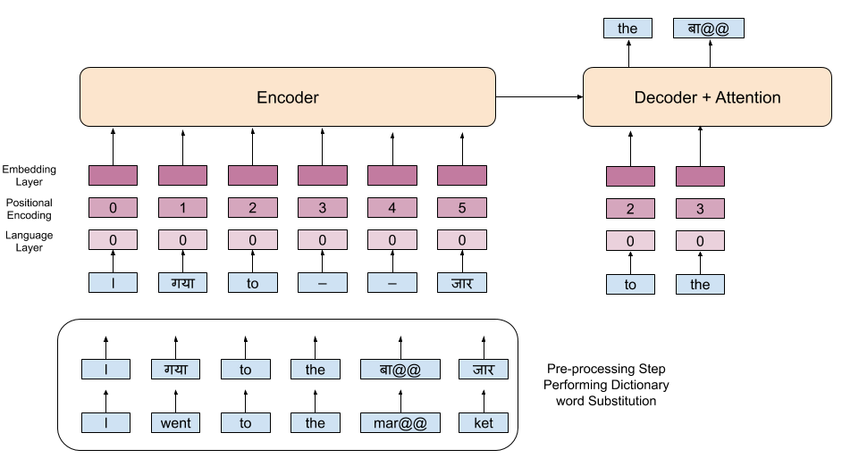
MASS Pre-training with Dictionary Substitution

Slide 15
MASS Pre-training with Dictionary Substitution
Randomly replace whole words in the sentence with the corresponding word translation obtained from a ground truth bilingual dictionary rather than masking.
Alternate training the model using MASS objective with and without dictionary word substitution.
It is a variation of the approaches proposed in Duan et al. 2020 and Yang et al. 2020
Duan X, Ji B, Jia H, Tan M, Zhang M, Chen B, Luo W, Zhang Y (2020) Bilingual dictionary based neural machine translation without using parallel sentences. In: Proceedings of the 58th Annual Meeting of the Association for Computational Linguistics, Association for Computational Linguistics
Yang Z, Hu B, Han A, Huang S, Ju Q (2020) Code-switching pre-training for neural machine translation. In: Proceedings of the 2020 Conference on Empirical Methods in Natural Language Processing, Association for Computational Linguistics

Slide 16
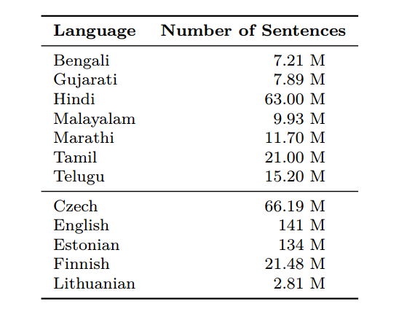
Monolingual Data

Slide 17
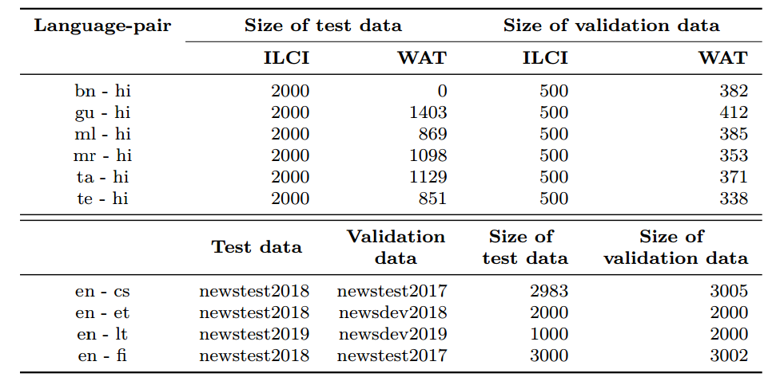
Test Data

Slide 18
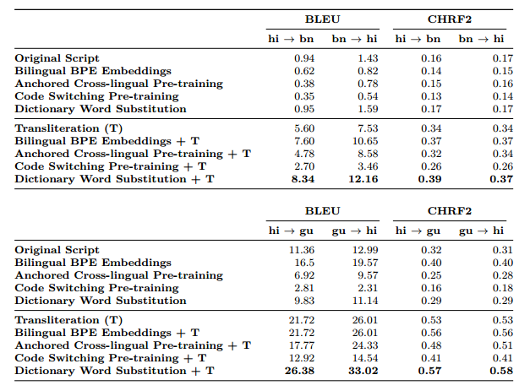
Languages with High Lexical Overlap

Slide 19
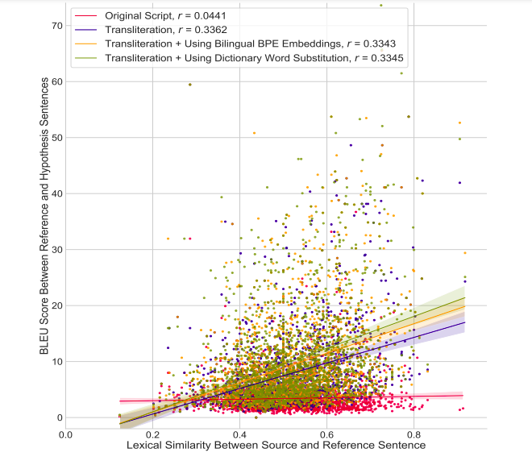
Lexical Similarity vs BLEU Score
Plot shows the correlation between Lexical Similarity between Source and Reference sentences (calculated using LCSR score) and Translation accuracy between Reference and Hypothesis sentences (calculated using BLEU score) for Hindi → Bengali.
r value with original script is very low.

Slide 20
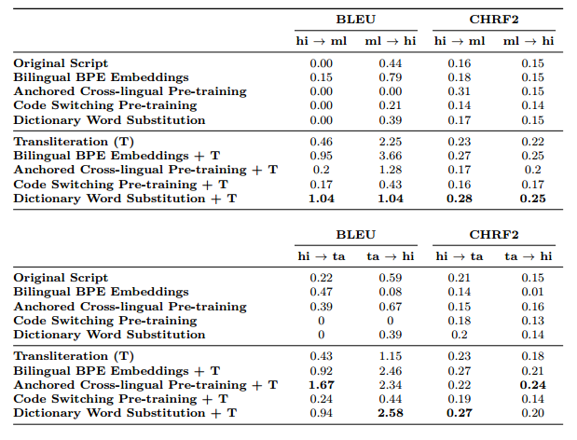
Languages with Low Lexical Overlap

Slide 21
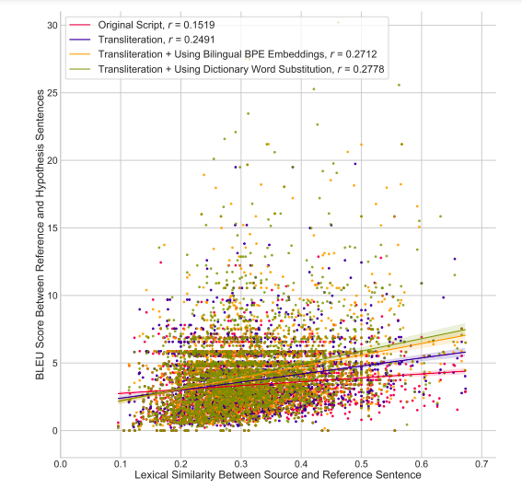
Lexical Overlap vs BLEU Score
Plot shows the correlation between Lexical Similarity between Source and Reference sentences (calculated using LCSR score) and Translation accuracy between Reference and Hypothesis sentences (calculated using BLEU score) for Hindi → Malayalam.
r value with original script is very low.
Overall BLEU score is lower than Hindi->Bengali (because of the difference in lexical overlap).

Slide 22
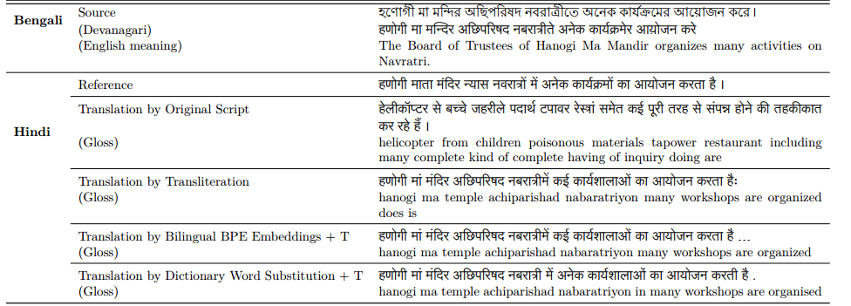
Qualitative Analysis
Fluent but inadequate translations

Slide 23
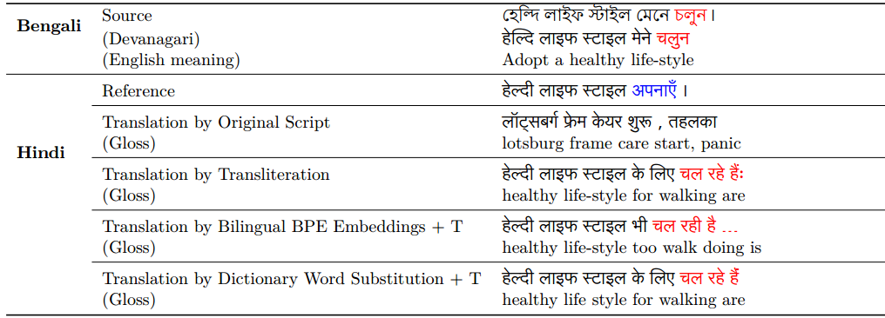
Qualitative Analysis
Meaning drift due to transliteration
The Bengali sentence contains the verb চলুন (Chaluna) indicating the meaning to go. When preceded with the verb েমেন চলুন (mene chaluna) it acquires the meaning maintain. The Hindi translation for the verb chaluna is चलो (chalo). [This happens because of transliteration and bilingual embeddings]

Slide 24
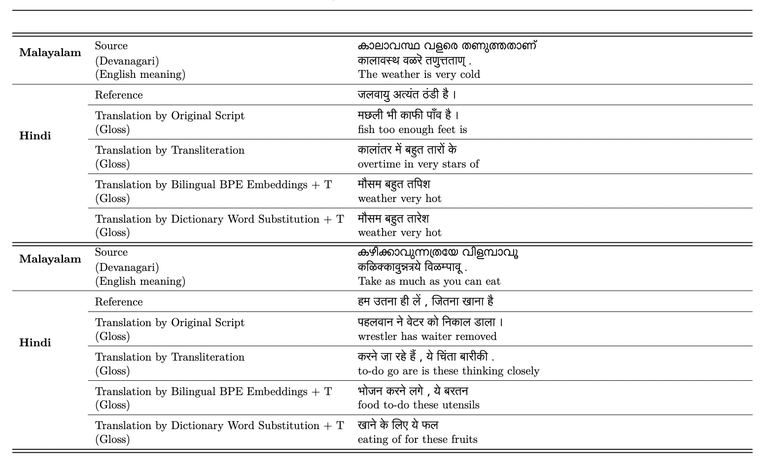
Qualitative Analysis

Slide 25
Role of Language Relatedness in Multilingual Fine-tuning of Language Models: A Case Study in Indo-Aryan Languages
Do related languages help each other?
Tejas Indulal Dhamecha, Rudra Murthy, Samarth Bharadwaj, Karthik Sankaranarayanan, and Pushpak Bhattacharyya
Findings in EMNLP 2021

Slide 26
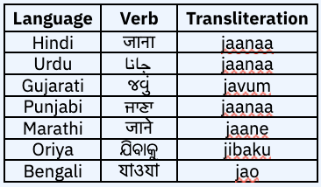
Motivation
Indo-Aryan languages are widely spoken
Many Indo-Aryan languages lack large amounts of monolingual corpora or labelled data for various NLP tasks​
Indo-Aryan languages exhibit high language relatedness which should alleviate labelled data sparsity problem. ​
For example, the verb to go is similar in various Indo-Aryan Languages​

Slide 27
Research Questions
Research Question 1​
Does multilingual fine-tuning with a set of related languages yield improvements over monolingual fine-tuning (FT) on downstream tasks?​
Research Question 2​
Starting from monolingual FT, as each related language is gradually added for multilingual FT, to ultimately a multilingual FT with all related languages, how does the performance vary? In other words, should one use all related languages' data or only a subset of languages' data?​
Research Question 3​
Does having a common script benefit better language transfer for languages with high lexical similarity but different scripts?​

Slide 28
Tasks
IndicGLUE
Textual Entailment task
on copa-translated dataset (Hi, Gu, Mr)​
wnli-translated dataset (Hi, Gu, Mr) ​
Named Entity Recognition task on wikiann-ner dataset (Hi, Bn, Gu, Mr, Or, Pa) ​
Title Prediction task on wiki-section-title dataset (Hi, Bn, Gu, Mr, Or, Pa) ​
Part-of-Speech Tagging task on Universal Dependency datasets (Hi, Mr, Ur)

Slide 29
Approach
Monolingual Fine-Tuning​ Here, the pre-trained LM is fine-tuned on the labelled data of a single language​
Multilingual Fine-Tuning​ Here, the pre-trained LM is fine-tuned on the combined labelled data of multiple languages​
Gradation of Multilinguality​ Here, we experiment by adding each related language to the training set of the target language separately. The language that yields highest performance boost is selected for adding to the training set. Thus, a new training set consisting of two languages is obtained. This is repeated until all the related languages are added to the training set, resulting in the all-language multilingual FT. Task of choice: NER on IA-Original model.

Slide 30
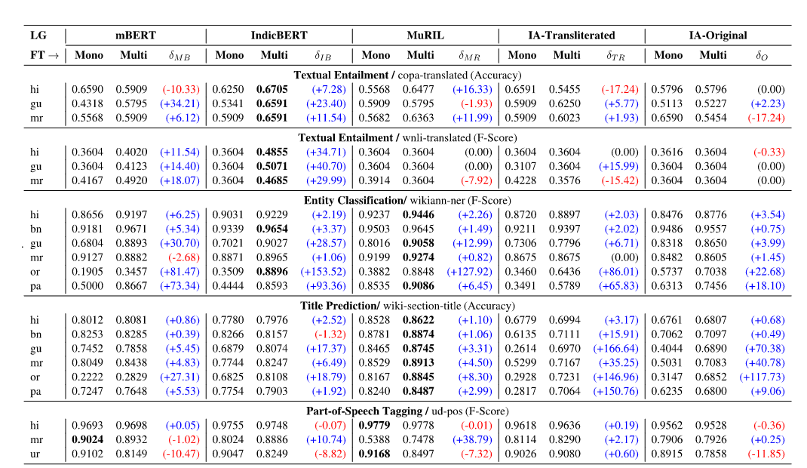
Results
Research Question 1​
Does multilingual fine-tuning with a set of related languages yield improvements over monolingual fine-tuning (FT) on downstream tasks?​
Multilingual fine-tuning with related languages can yield huge (up to 40% on absolute scale) improvement for low-resource languages (such as Oriya and Punjabi), and statistically significant (up to 10%) improvements on high resource languages (such as Hindi and Bengali), depending on the task.​

Slide 31
Results
Research Question 3
Does having a common script benefit better language transfer for languages with high lexical similarity but different scripts?​
Effectiveness of multilingual fine-tuning is significantly enhanced when coupled with common-script representation via transliteration.​

Slide 32
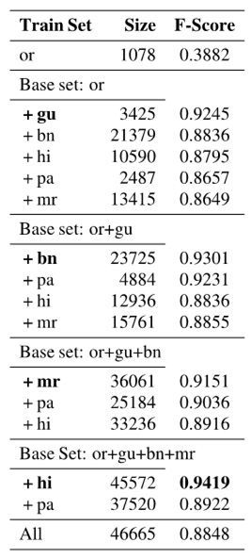
Results
Research Question 2
Starting from monolingual FT, as each related language is gradually added for multilingual FT, to ultimately a multilingual FT with all related languages, how does the performance vary? In other words, should one use all related languages' data or only a subset of languages' data?​​
Within the set of related languages, likely, there exists a subset of languages that yields the best performance.​

Slide 33
Summary
Related Languages help each other
Due to computational bottleneck we explore multilingual fine-tuning and not multilingual pre-training

Slide 34
On Utilizing Constituent Language Resources to Improve Downstream Tasks in Hinglish
English and Hindi helping Hinglish
Vishwajeet Kumar, Rudra Murthy Venkataramana, Tejas Dhamecha,
Findings of EMNLP 2022

Slide 35
What is Code-mixing?
Code-mixing# is the phenomenon of using vocabularies from multiple languages in a single utterance
[Kaafi mashaqqat]_{URDU} [ke baad bhi kaam ho na saka]_{HINDI} .
[Problem]_{ENGLISH} [ye hai ki]_{HINDI} [time]_{ENGLISH} [kam hai]_{HINDI}
[I am sorry but]_{ENGLISH} [eTAi satyi]_{BENGALI}
[elections]_{ENGLISH} [lo oodina]_{TELUGU} [contestants]_{ENGLISH} [ki oka]_{TELUGU} [gift]_{ENGLISH}
# I use the term code-mixing and code-switching interchangeably in this talk

Slide 36
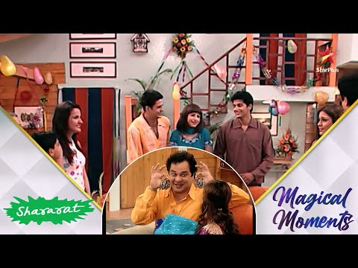
Code-mixing Examples

Slide 37
Why is code-mixing challenging?
Low-resourceness
Unlabelled data (for LM pre-training)
Labelled data (downstream task fine-tuning)
Script Difference
Spelling Variations
…

Slide 38
Why is code-mixing challenging?
# As of 22/11/2022 9:00 PM Google Translate

Slide 39
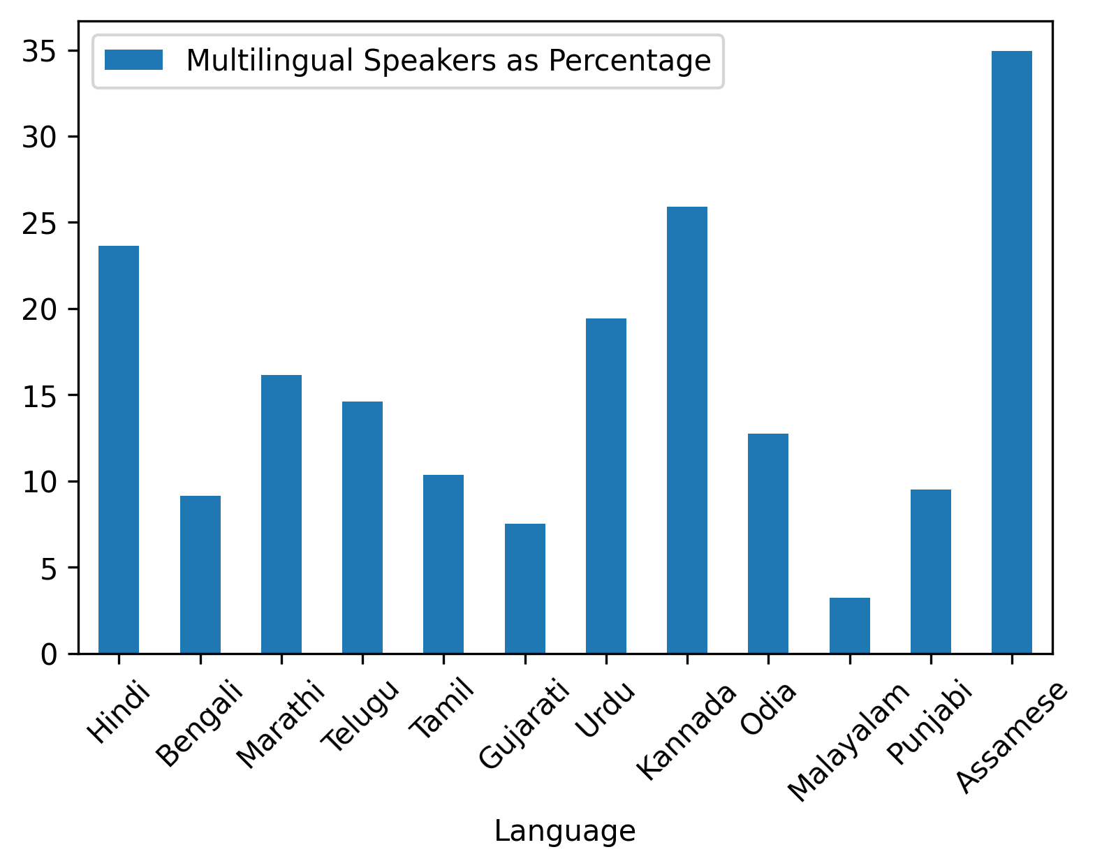
Code-Mixing and Multilingualism
Bilingualism/Multilingualism is very prevalent in India
Roughly, 24% of Hindi speakers speak more than one language
English and Hindi are the common second languages
# Source: https://en.wikipedia.org/wiki/Multilingualism_in_India#cite_note-timesofindia-3

Slide 40
Motivation
Labelled data in Hinglish is very low
However, we have lots of labelled data in Hindi and English
Can we use Hindi and English data to improve Hinglish performance?

Slide 41
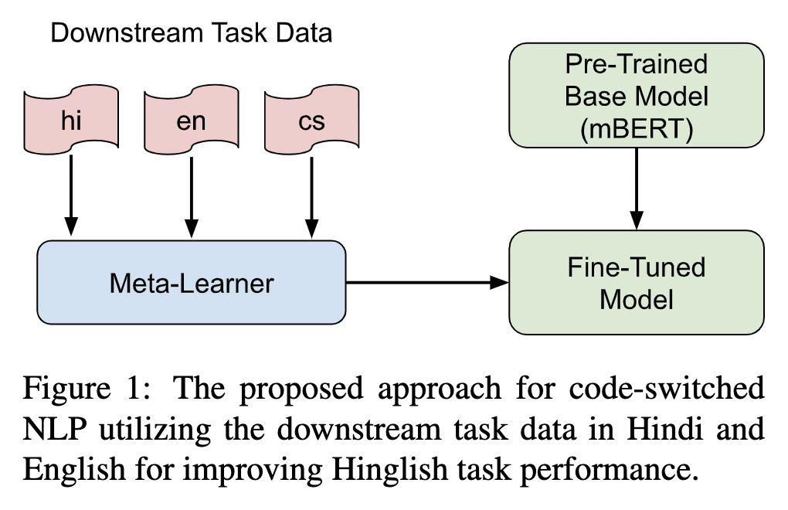
Approach

Slide 42
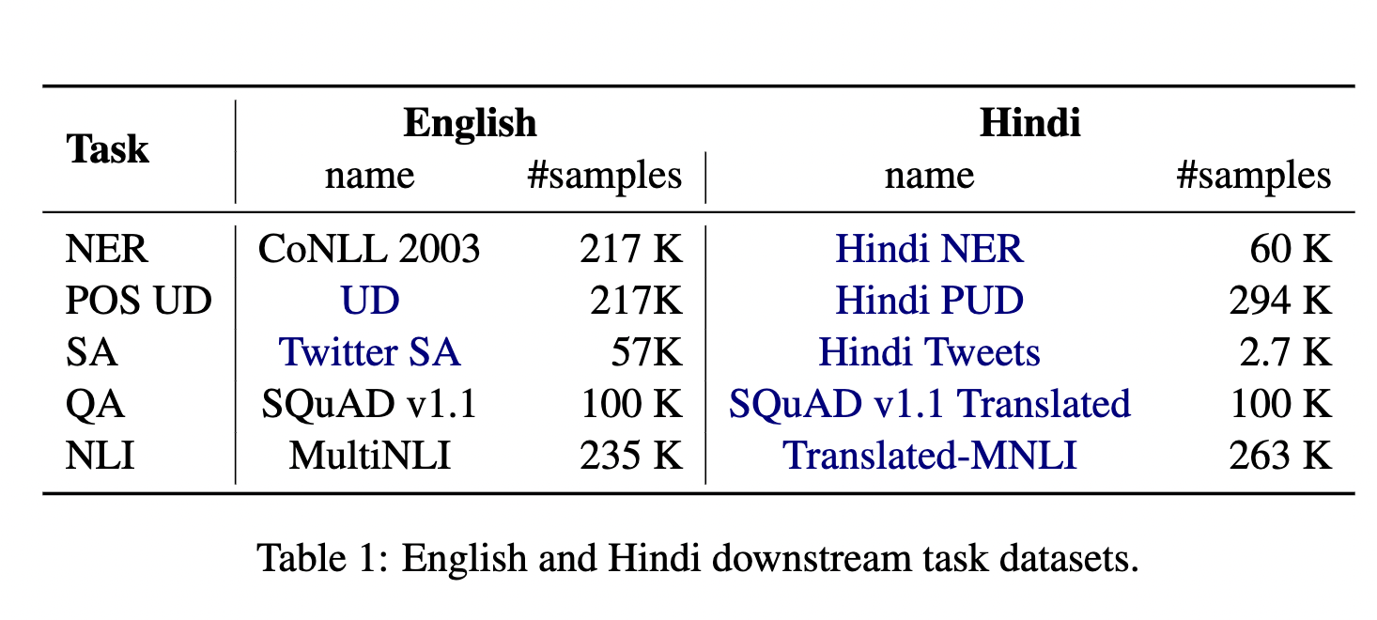
Assisting Datasets

Slide 43
Results
 | NER | POS | SA | QA | NLI
CS (mBERT) | 76.96 | 87.68 | 57.51 | 62.23 | 57.74
CS (mBERT): Our Replication | 76.25 +- 1.76 | 88.61 +- 0.35 | 59.69 +- 0.69 | 62.83 +- 2.26 | 59.50 +- 1.62
EN → CS | 77.22 +- 1.09 | 87.50 +- 1.38 | 59.40 +- 0.91 | 79.20 +- 0.04* | 57.48 +- 0.44
HI → CS | 76.38 +- 0.60 | 87.97 +- 0.38 | 58.00 +- 0.77 | 79.14 +- 2.15* | 56.90 +- 0.80
EN + HI → CS | 76.83 +- 0.52 | 88.23 +- 0.20 | 58.90 +- 0.56 | 74.15 +- 3.61* | 57.48 +- 0.50
EN + HI + CS (τ = 1) | 69.05 +- 4.49 | 87.53 +- 0.36 | 61.96 +- 0.78* | 58.77 +- 0.89 | 49.63 +- 6.59
EN + HI + CS (τ = ∞) | 71.56 +- 2.08 | 88.76 +- 0.42 | 59.54 +- 0.61 | 76.05 +- 5.34* | 56.58 +- 3.15
Meta-Trained | 78.33 +- 0.37* | 89.40 +- 0.20* | 61.13 +- 0.68* | 78.02 +- 1.27* | 60.92 +- 1.11
Meta-learning gives better performance than multi-task or transfer learning

Slide 44
Results
 | NER | POS | SA | QA | NLI
CS (mBERT) | 76.96 | 87.68 | 57.51 | 62.23 | 57.74
CS (mBERT): Our Replication | 76.25 +- 1.76 | 88.61 +- 0.35 | 59.69 +- 0.69 | 62.83 +- 2.26 | 59.50 +- 1.62
Tarunesh. et-al 2021 | - | - | 59.39 +- 0.81 | - | 59.74 +- 0.96
HIT | 74.5 | - | - | - | -
HingCS | 81.80 | 90.81 | 66.73 | - | -
Meta-Trained | 78.33 +- 0.37* | 89.40 +- 0.20* | 61.13 +- 0.68* | 78.02 +- 1.27* | 60.92 +- 1.11
Constituent Language’s data helps in Question Answering task
Hyper-parameter tuning makes a big difference

Slide 45
Summary
Constituent Languages help in Code-mixing

Slide 46
Large Language Models

Slide 47
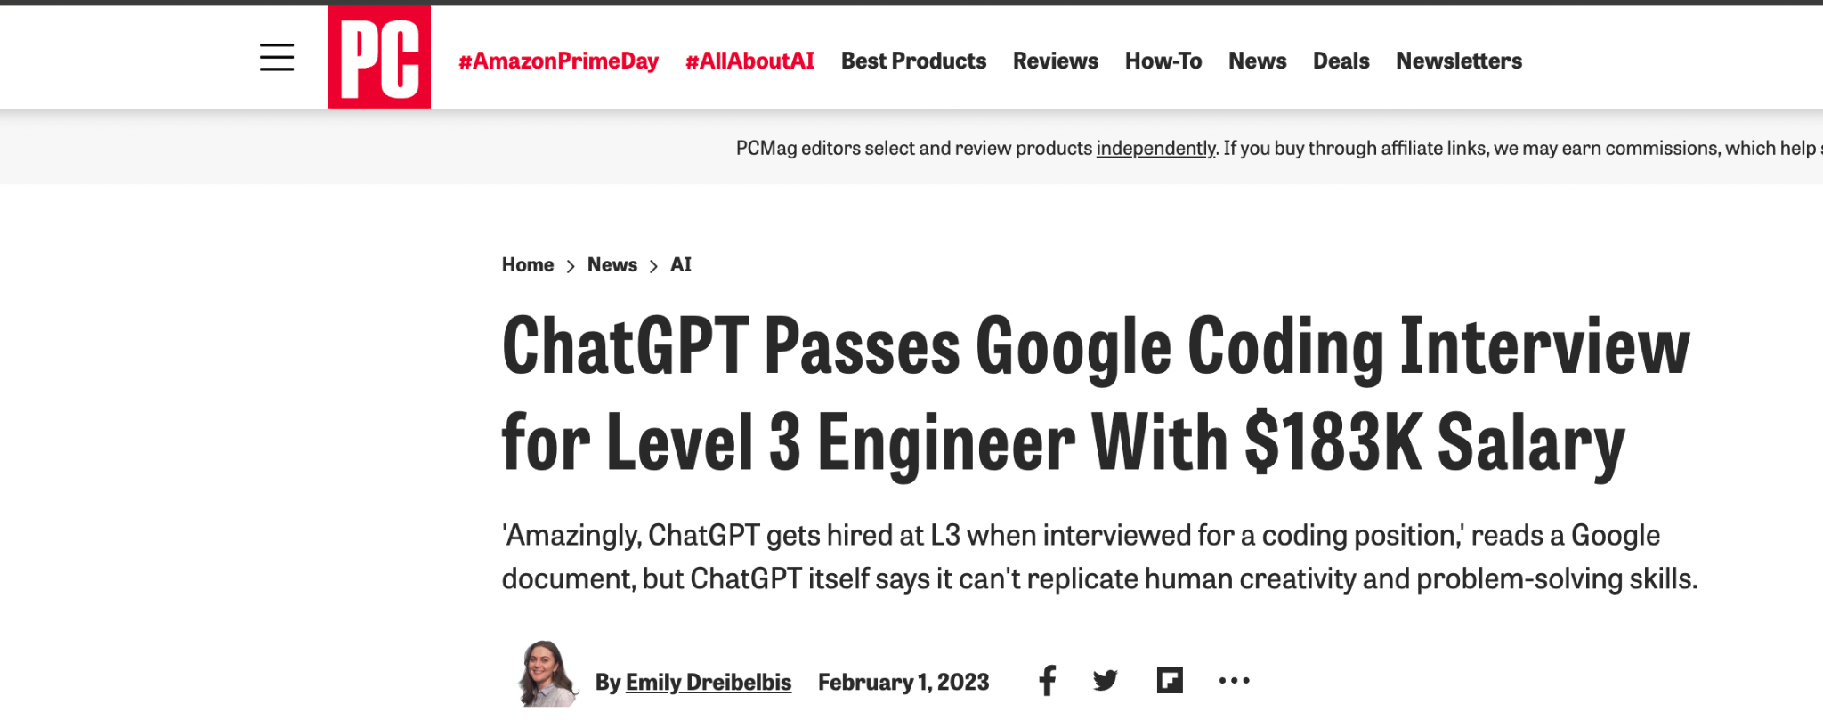
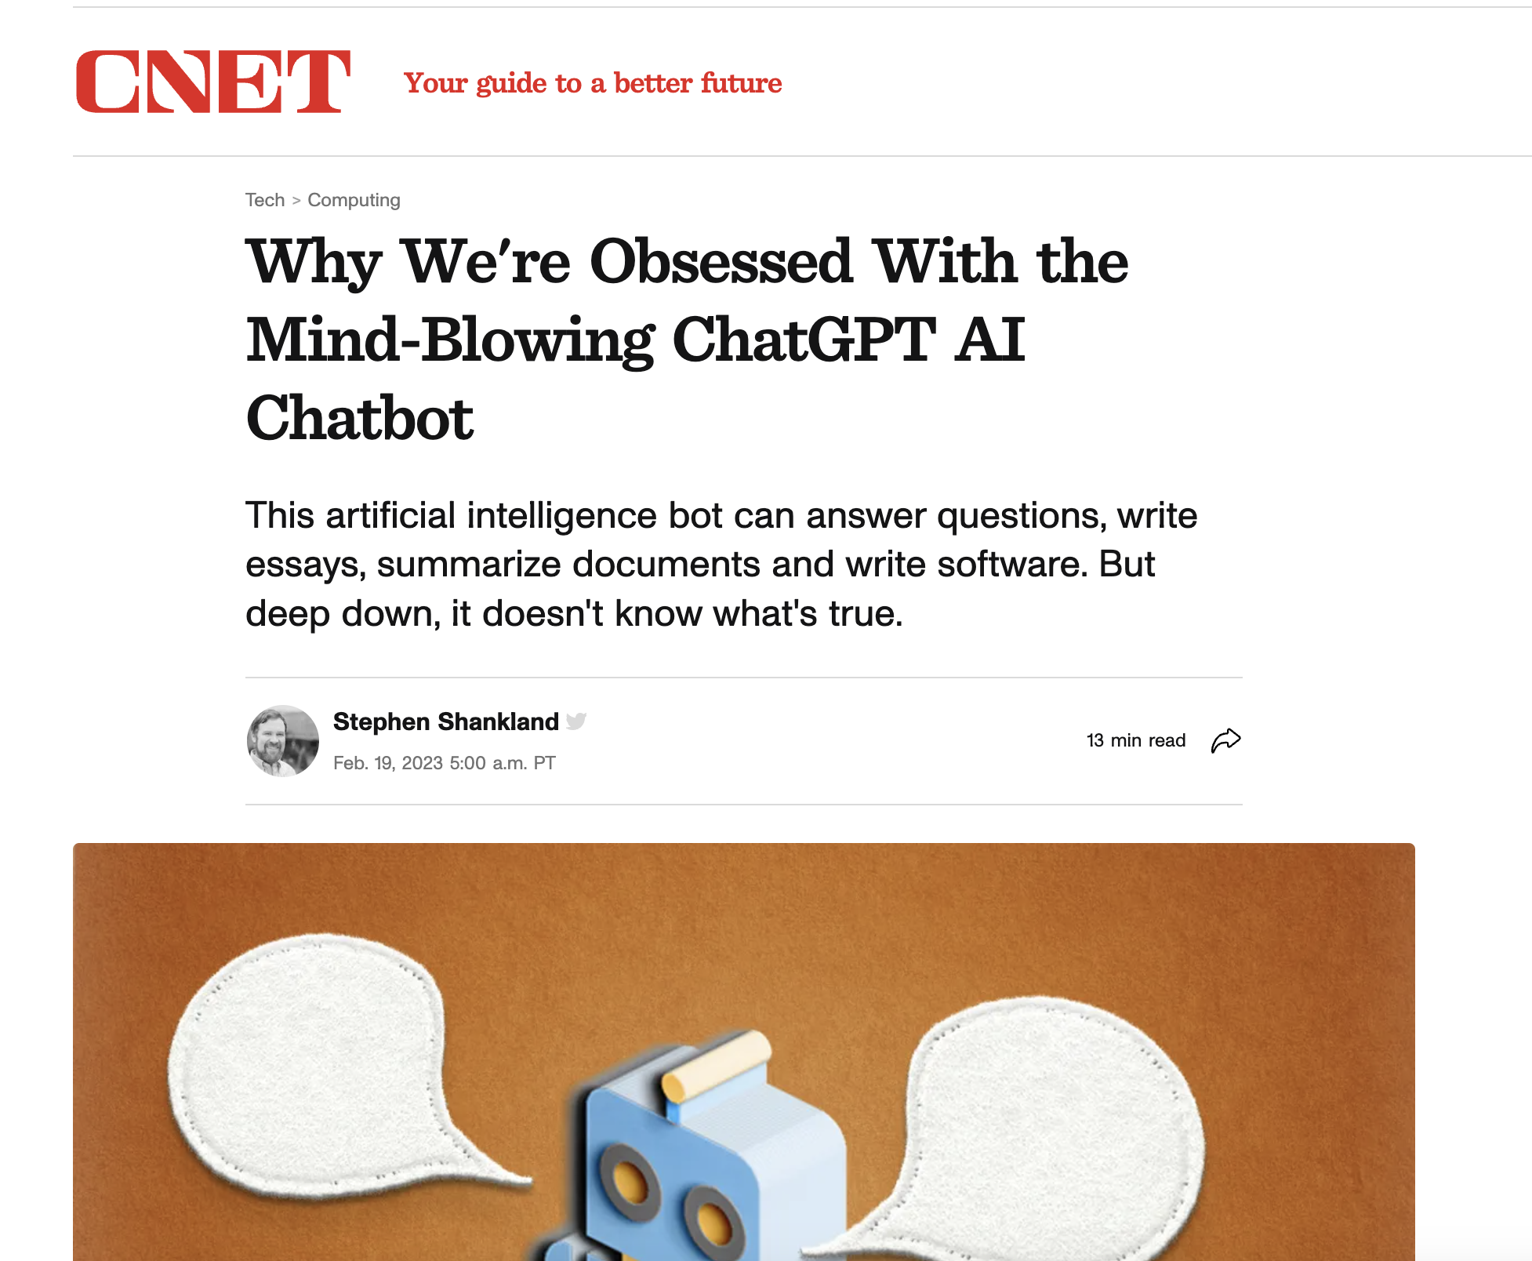
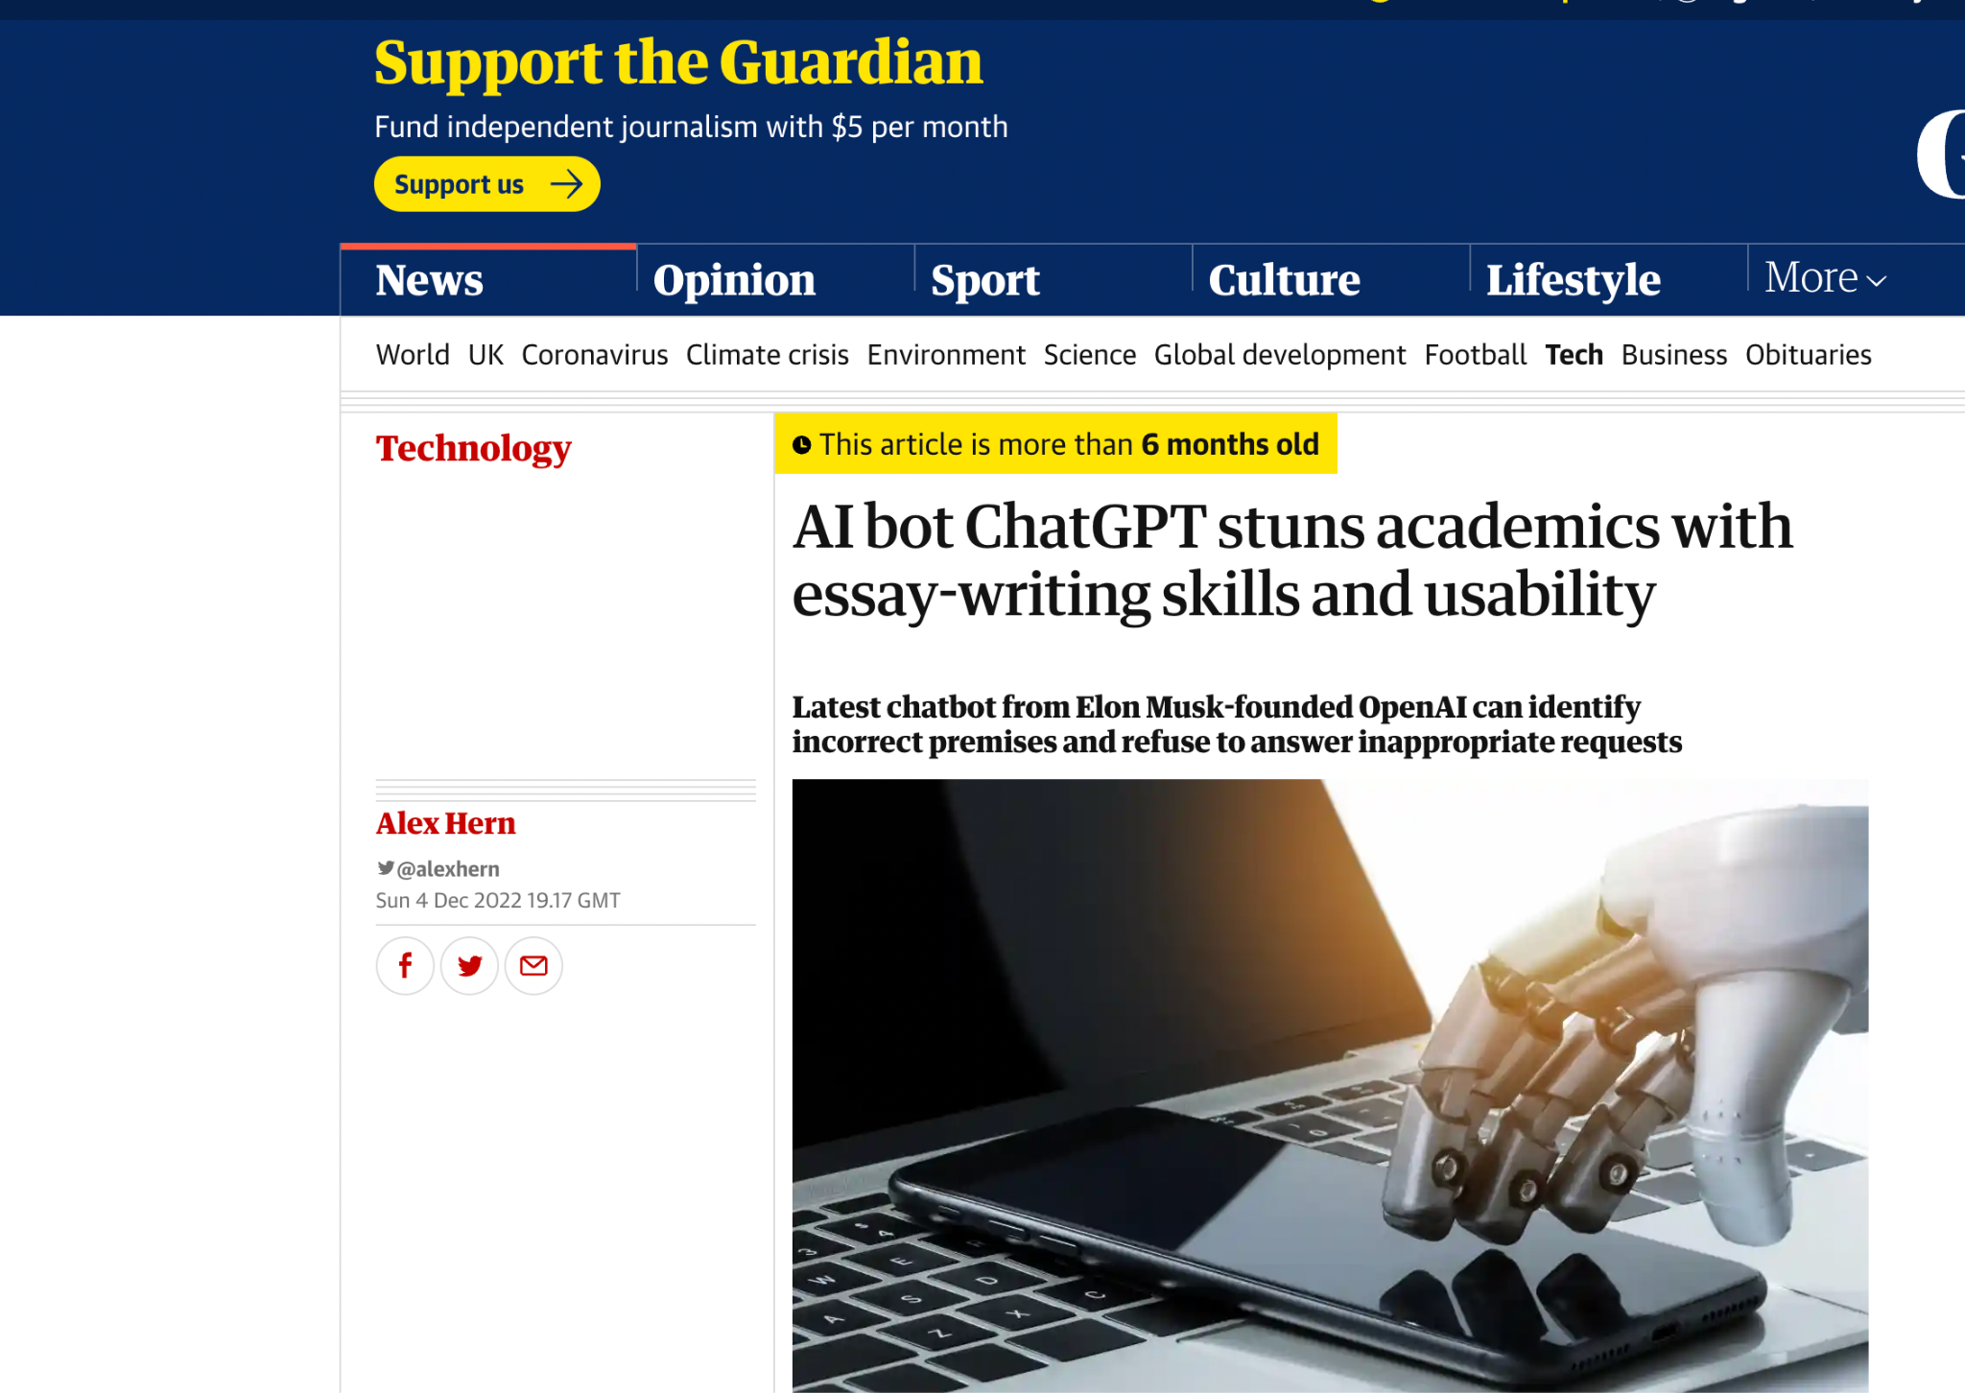
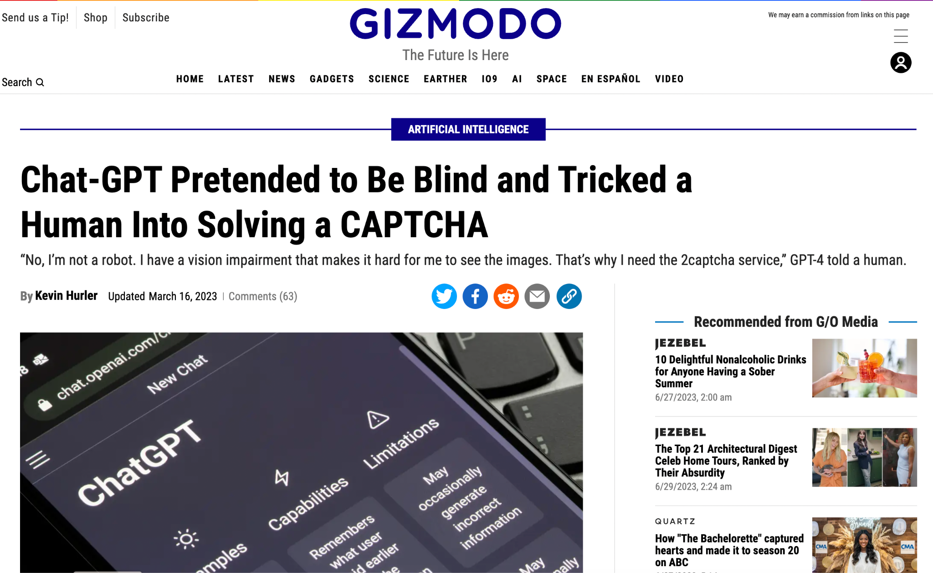

Slide 48
NLP: Timeline
Source: https://medium.com/nlplanet/a-brief-timeline-of-nlp-bc45b640f07d

Slide 49
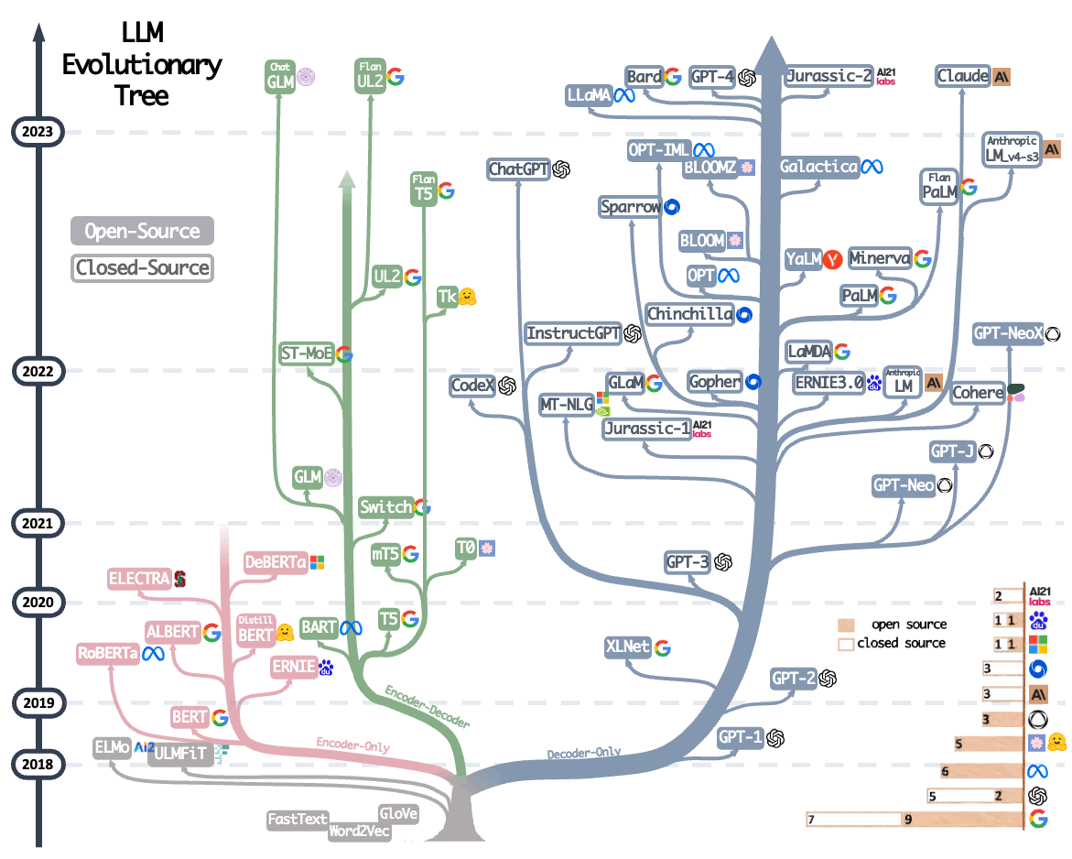
The era of LLMs
Source: https://arxiv.org/abs/2304.13712

Slide 50
The era of LLMs (Contd.)
Source: https://github.com/Hannibal046/Awesome-LLM
Notes:
One striking point of these LLMs are the zero-shot and few-shot capabilities

Slide 51
NLP: Pre LLM era
The movie was very good | Positive
The movie was a bit lacklustre | Negative
Manual Curation of Labelled data
Dataset Creation
Dataset
Inference
Training a ML model
There was no plot in the movie
Machine Learning Model
Negative

Slide 52
NLP: LLM Era (Incontext Learning)
Given a movie review, predict the sentiment.
Input: The movie was very good
Output: Positive
Input: The movie was a bit lacklustre
Output: Negative
Input: There was no plot in the movie
Output:
LLM
Negative

Slide 53
Large Language Models (LLM)

Slide 54
Language Models
Maximize the probability of a sequence
For example, what’s the probability of the sequence I liked the movie
P( I liked the movie )
I | liked | the | movie | … | </s>
Auto-Regressive LM
<s> | I | liked | the | movie | ….

Slide 55
A few terminologies…

Slide 56
Zero-Shot Setting
Instruction
Given a movie review. The task is to predict the sentiment of the review. Return “positive” if the sentiment of the review is “positive”, return “negative” if the sentiment of the review is “negative” else return “neutral”
Input: The plot in the movie is too abysmal.
Output:
The model generates the completion (answer)

Slide 57
One-Shot Setting
Instruction
Given a movie review. The task is to predict the sentiment of the review. Return “positive” if the sentiment of the review is “positive”, return “negative” if the sentiment of the review is “negative” else return “neutral”
Input: A Creatively Bland Adaptation That Strips off Intrigue From the Original
Output: Negative
Input: The plot in the movie is too abysmal.
Output:
In-context example
The model generates the completion (answer)

Slide 58
Few-Shot Setting
Instruction
Given a movie review. The task is to predict the sentiment of the review. Return “positive” if the sentiment of the review is “positive”, return “negative” if the sentiment of the review is “negative” else return “neutral”
Input: A Creatively Bland Adaptation That Strips off Intrigue From the Original
Output: Negative
Input: …
Output: …
Input: The plot in the movie is too abysmal.
Output:
In-context examples
The model generates the completion (answer)

Slide 59
… Back to LLMs

Slide 60
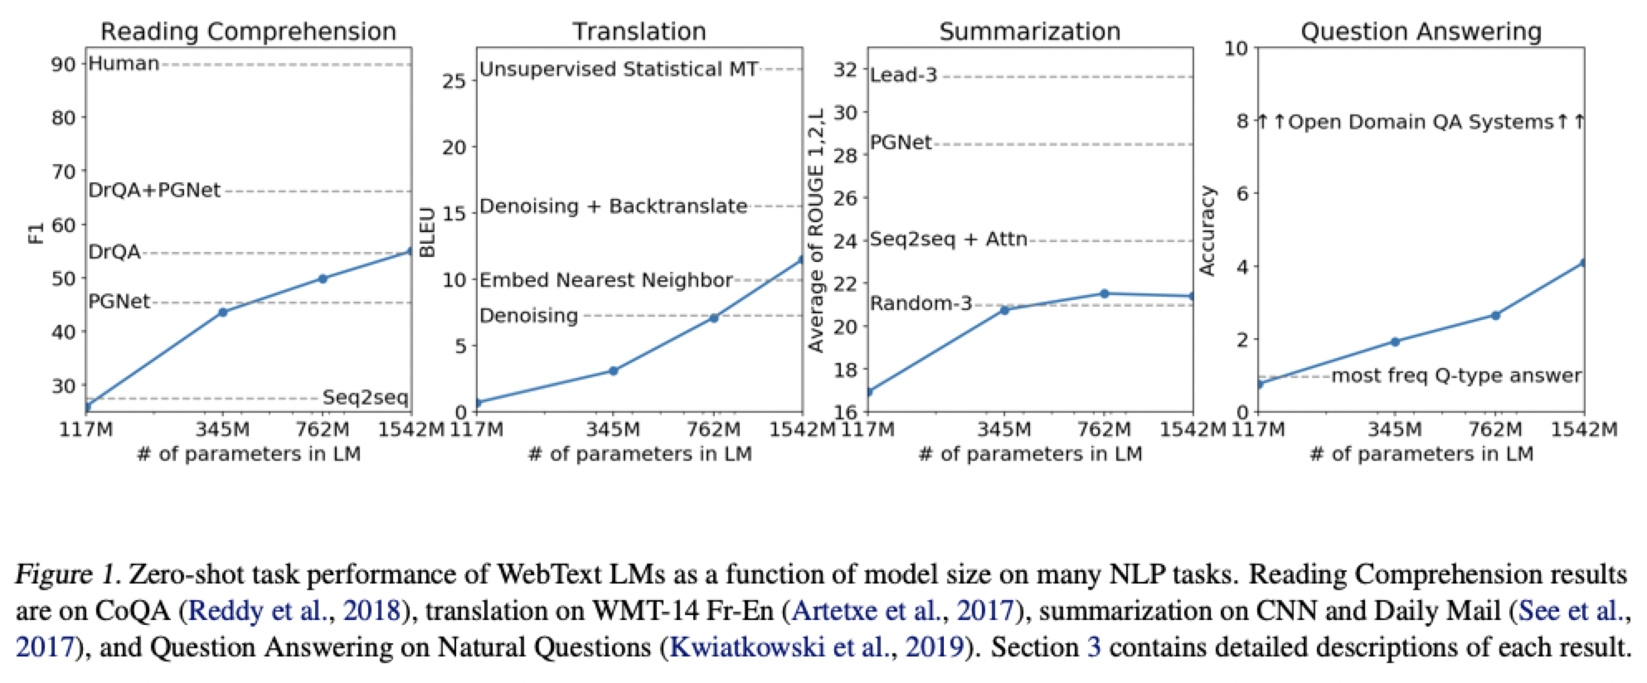
Large Language Models (Radford et.al 2019)
LLMs are able to perform tasks like reading comprehension and translation without fine-tuning

Slide 61
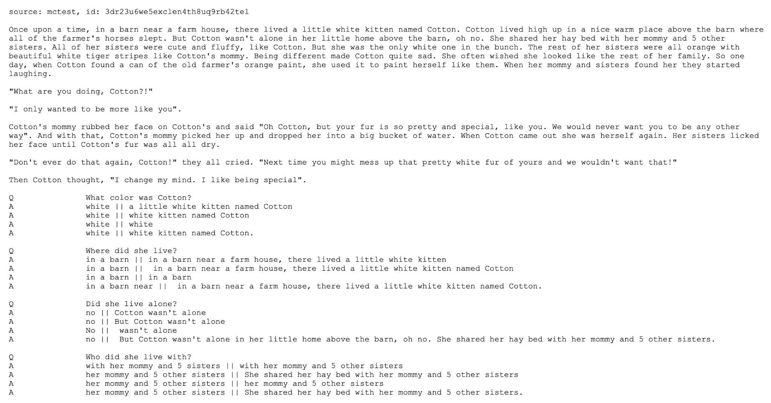
Reading Comprehension

Slide 62
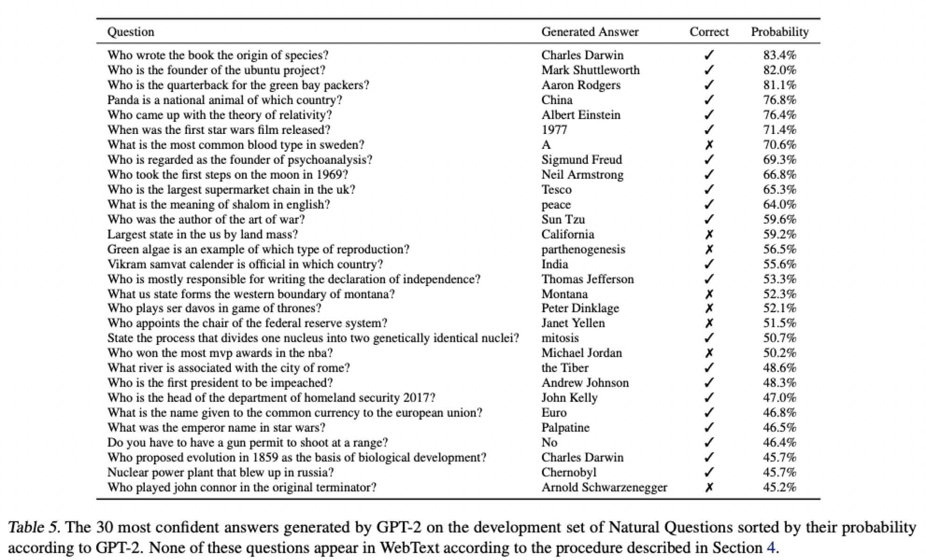
Large Language Models (Radford et.al 2019)
Ability of the LLMs to perform tasks like question answering without explicitly fine-tuning for it
LLMs are able to answer questions without explicit fine-tuning

Slide 63
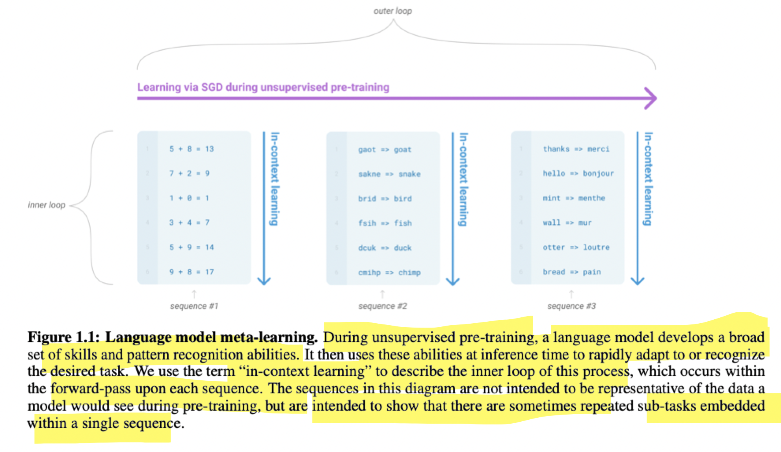
Why are LLMs few-shot learners? (Brown et.al 2020)
Language-Model meta-learning:
A model picks up the ability to perform certain tasks during pre-training.
When you provide in-context examples during inference, the model understands the task needed to be performed and generates the correct output

Slide 64
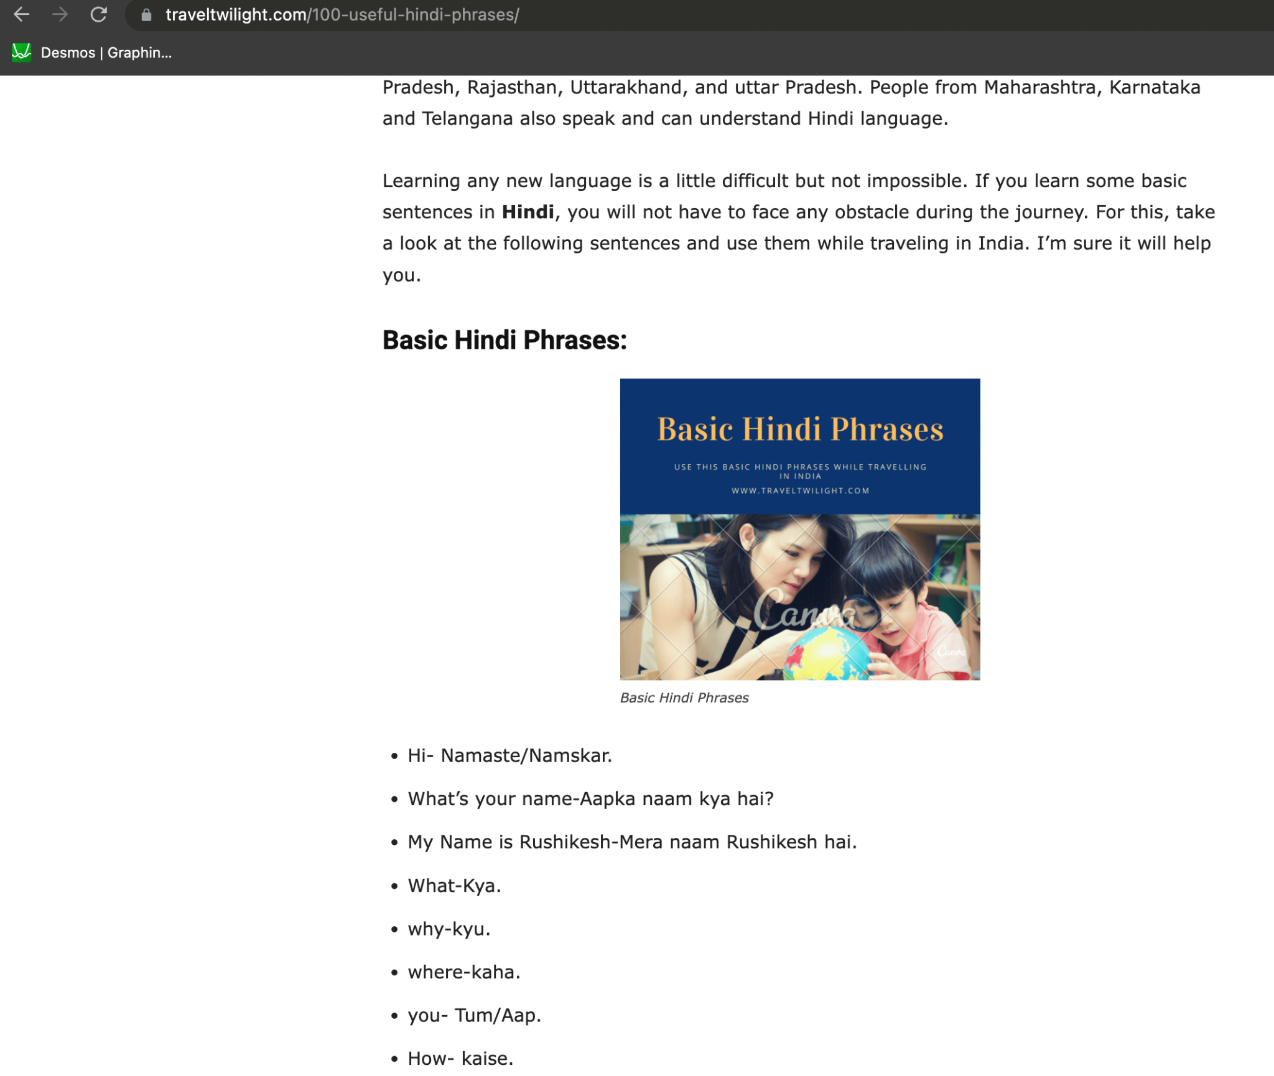
Why are LLMs few-shot learners? (Brown et.al 2020)
https://www.traveltwilight.com/100-useful-hindi-phrases/
Many such websites are available, where one can find examples of English and Hindi translations.
So, a LLM pre-trained on such data will get the ability to perform simple translations

Slide 65
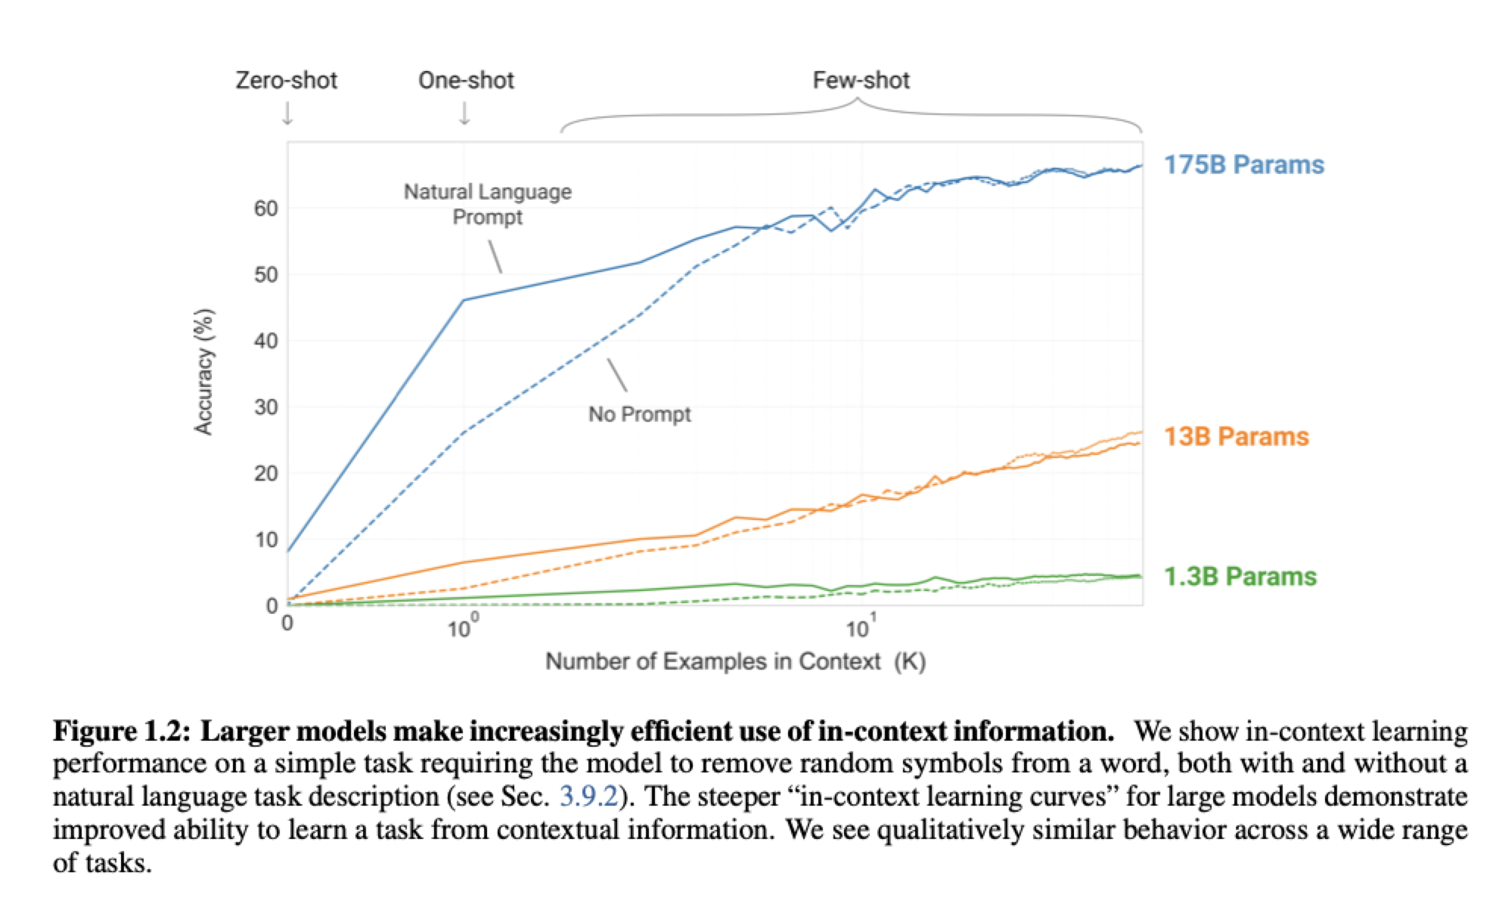
LLMs are Few-Shot Learners (Brown et.al 2020)
Performance increases with increase in few-shot examples
Performance increases with increase in number of parameters

Slide 66
Resource Requirement

Slide 67
GPT-3
Earlier graph shows more model capacity means better performance
What is the ideal model size and number of tokens for training?

Slide 68
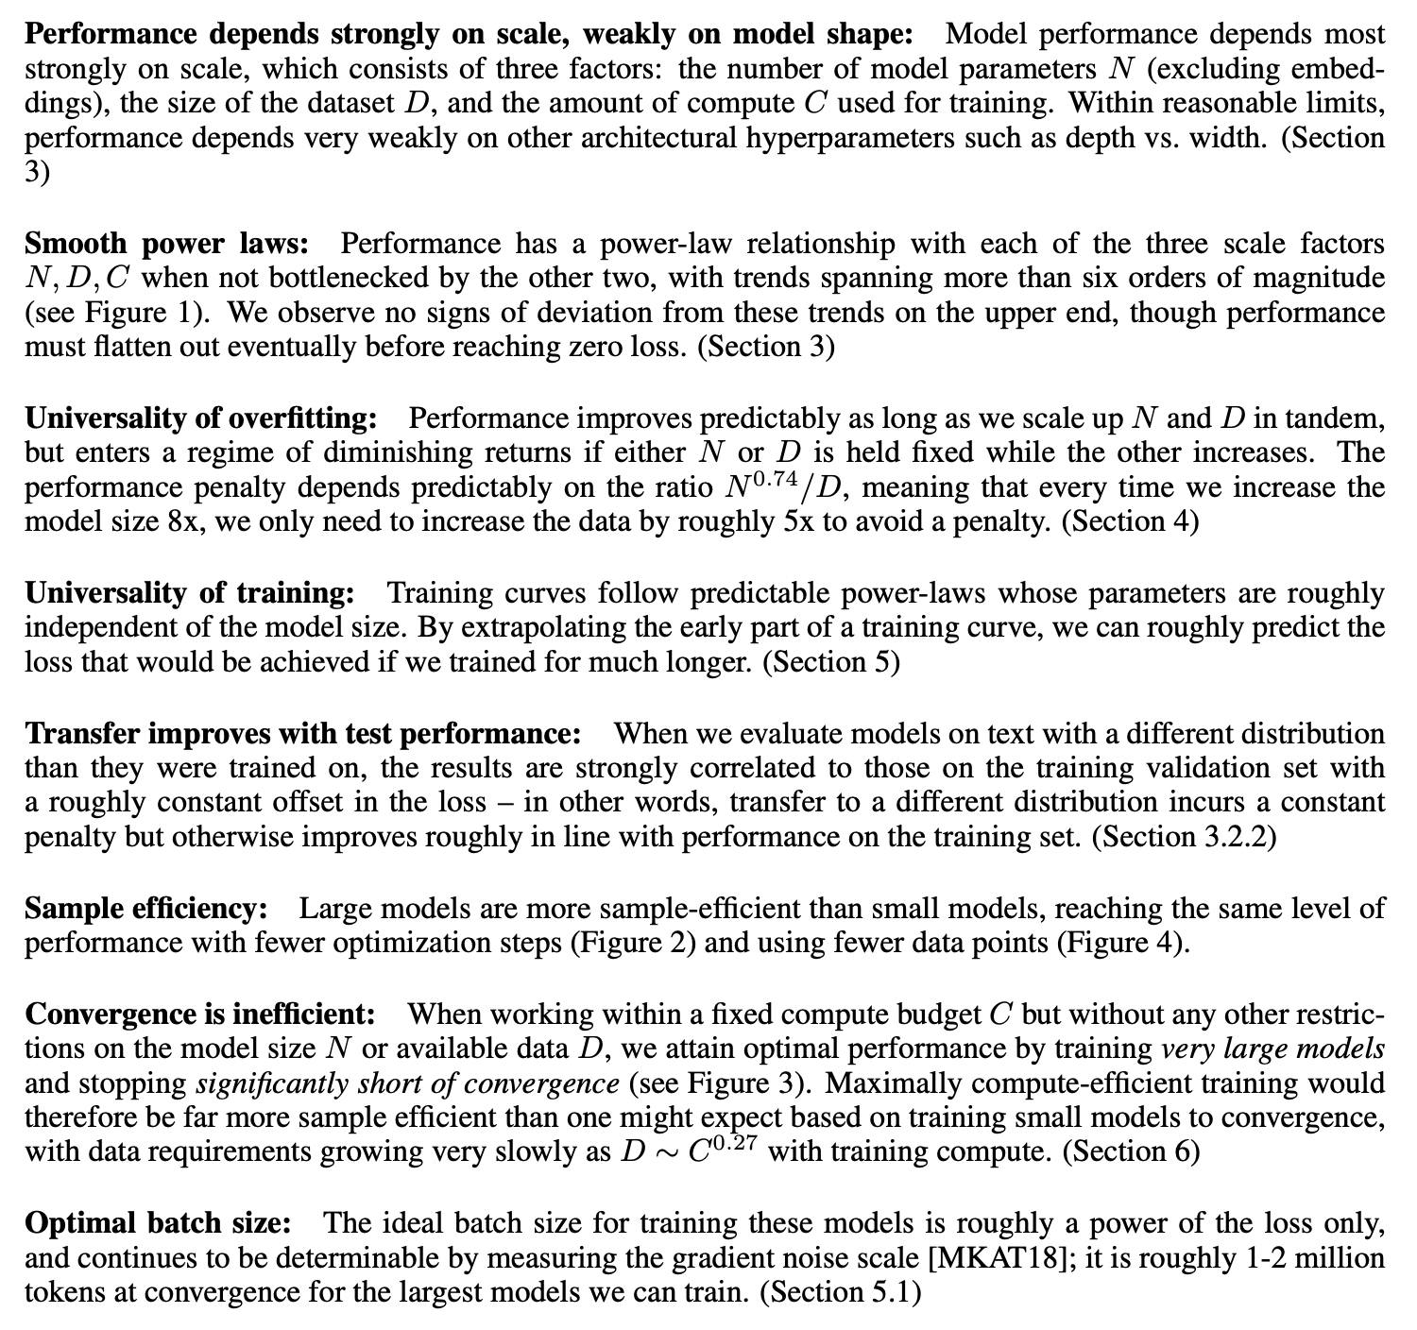
Power Law (Kaplan et.al 2020)
A power law relationship exists between number of parameters in an Auto-Regressive LM and it’s performance
If you increase the model capacity by x% then you get k performance increase.
Scaling the model capacity again by x% will result in k performance increase

Slide 69
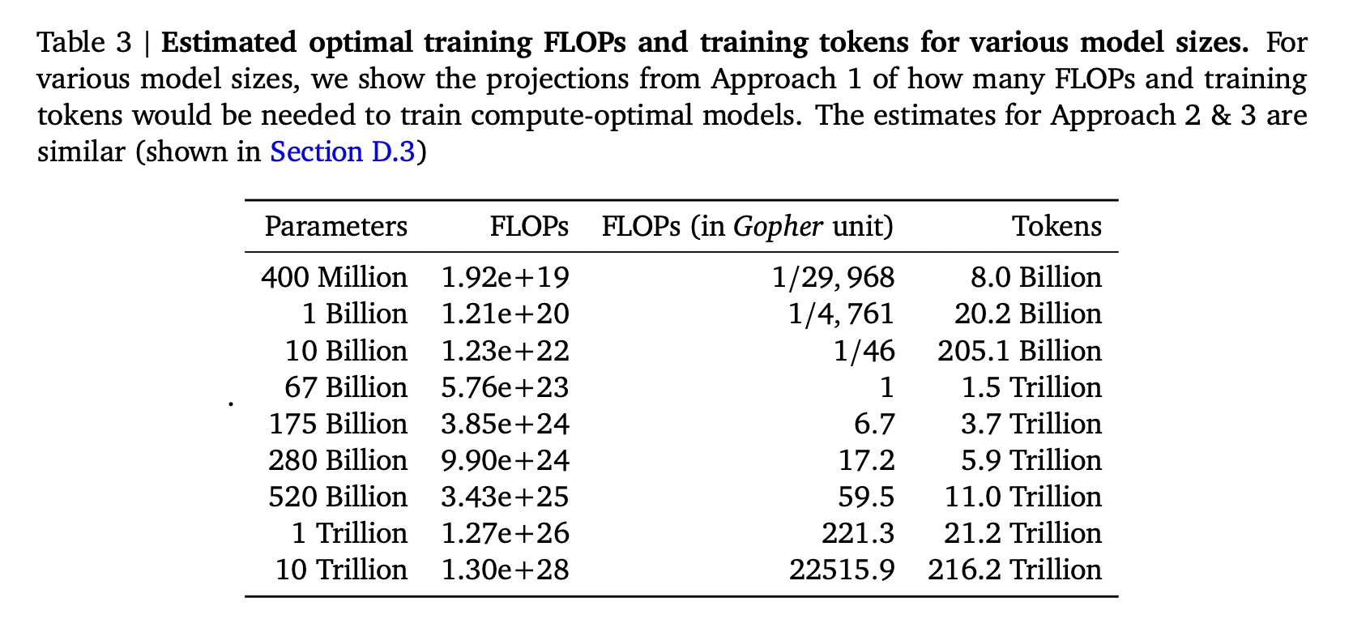
Chinchilla Suggestions

Slide 70
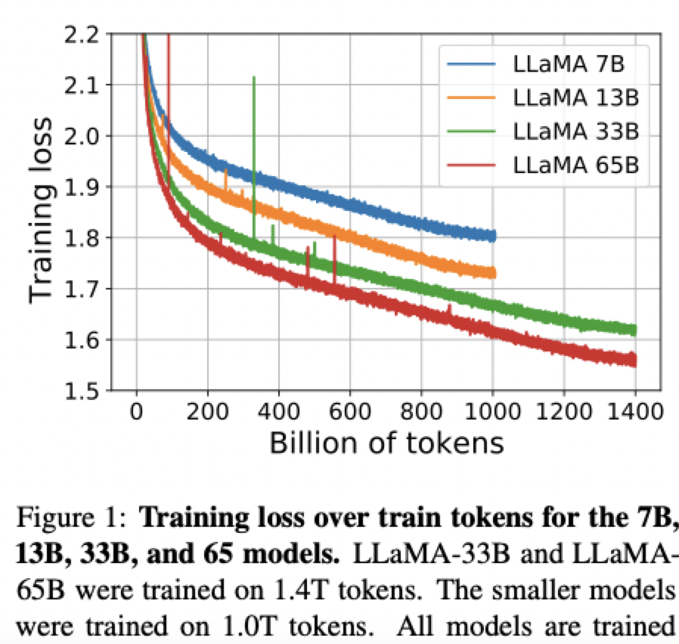
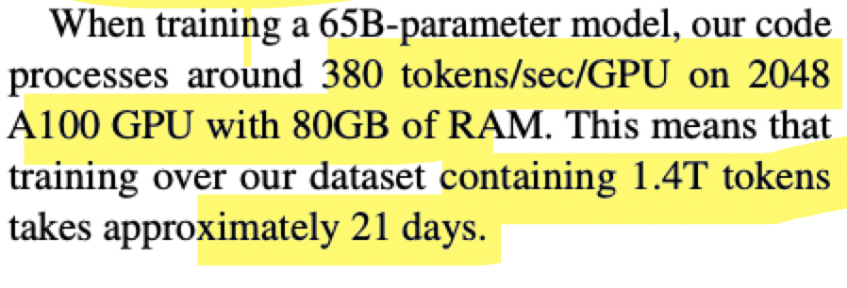
The Llama Way

Slide 71
Summarizing Resource Requirement
What’s the resource requirement if we want to train a LLM for Indian languages?
Assume we want to train a 7B parameter model
Need high quality data with at least 1T tokens
Diverse domains
MPT-7B was trained on 440 x A100-40GB GPUs for 10 days costing ~$ 200K

Slide 72
Need for Alignment

Slide 73
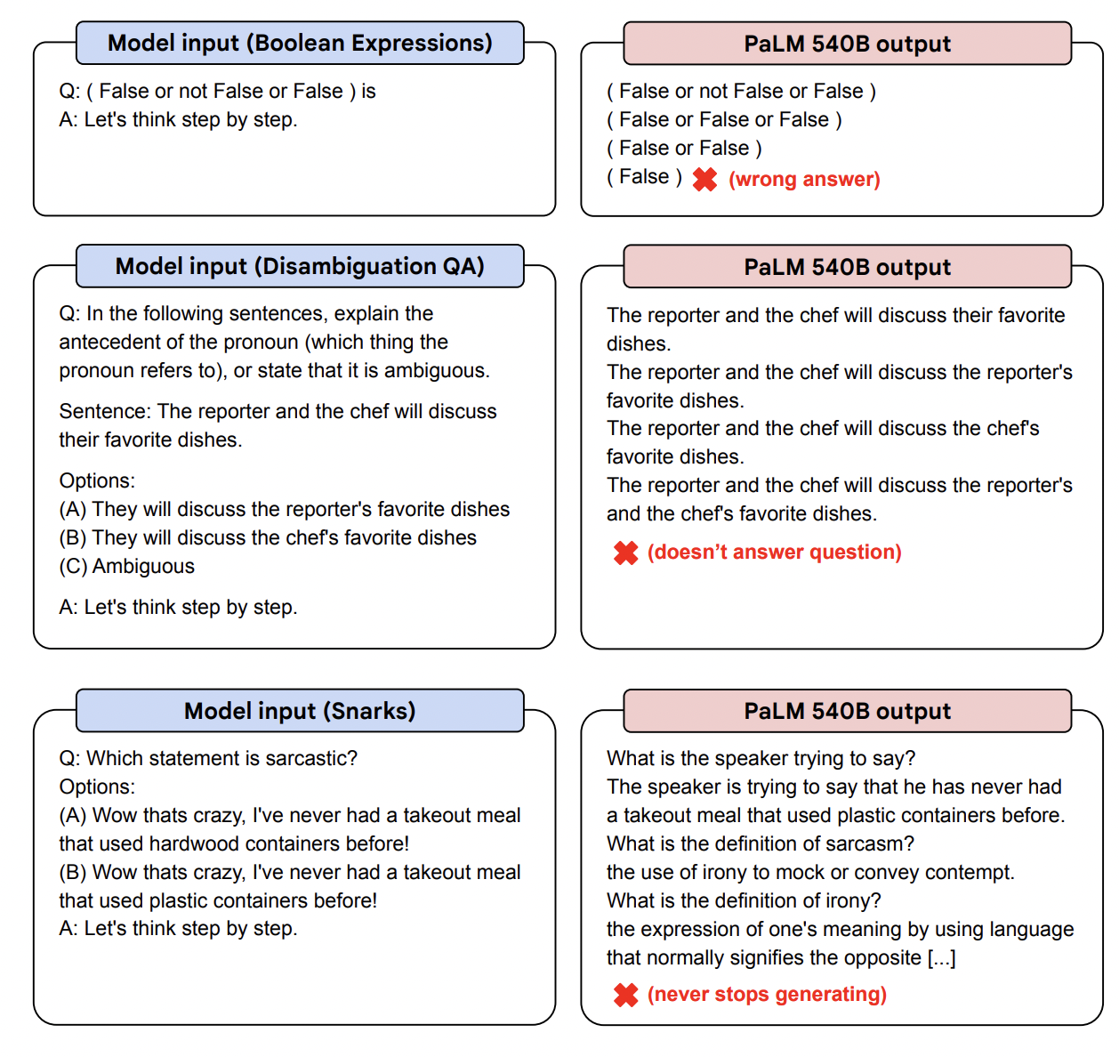
Vanilla LLMs are bad Instruction followers
Sentiment Analysis
What is the sentiment of the text "The performance of the actors were abysmal"?
Falcon 4B Output
1 Answer | Add Yours
The sentiment of the text is that the performance of the actors was abysmal.
The text is a review of a play. The reviewer is saying that the actors were terrible.
The text is a review of a play. The reviewer is saying that the actors were terrible.
❌(model keeps repeating generations)

Slide 74
Vanilla LLMs are not Instruction followers
LLMs may have knowledge encoded in the parameter space.
They don’t know how to retrieve the encoded knowledge
Instruction fine-tuning enables the model gain this ability

Slide 75
Instruction Fine-Tuning (Aligning LLMs)
Human Guidance
Imitation Learning
Repurpose Existing Datasets
Alpaca
FLAN
Self-Instruct
Data Creation
SuperNatural Instructions
CoT Reasoning
…
DataBricks Dolly
Open Assistant
*The dataset list is incomplete

Slide 76
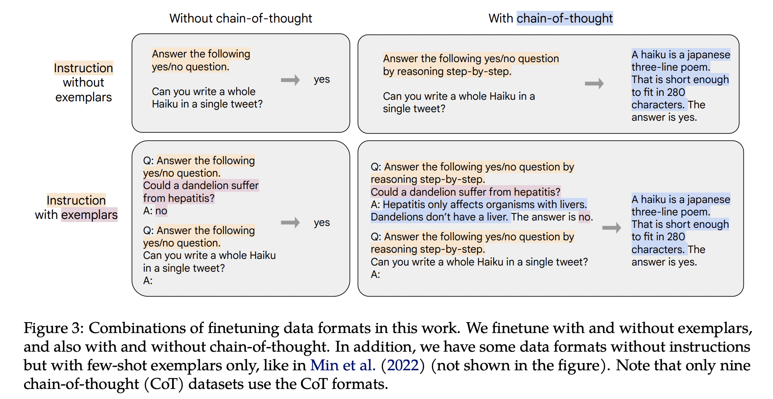
Instruction Fine-Tuning (Aligning LLMs) Strategies

Slide 77
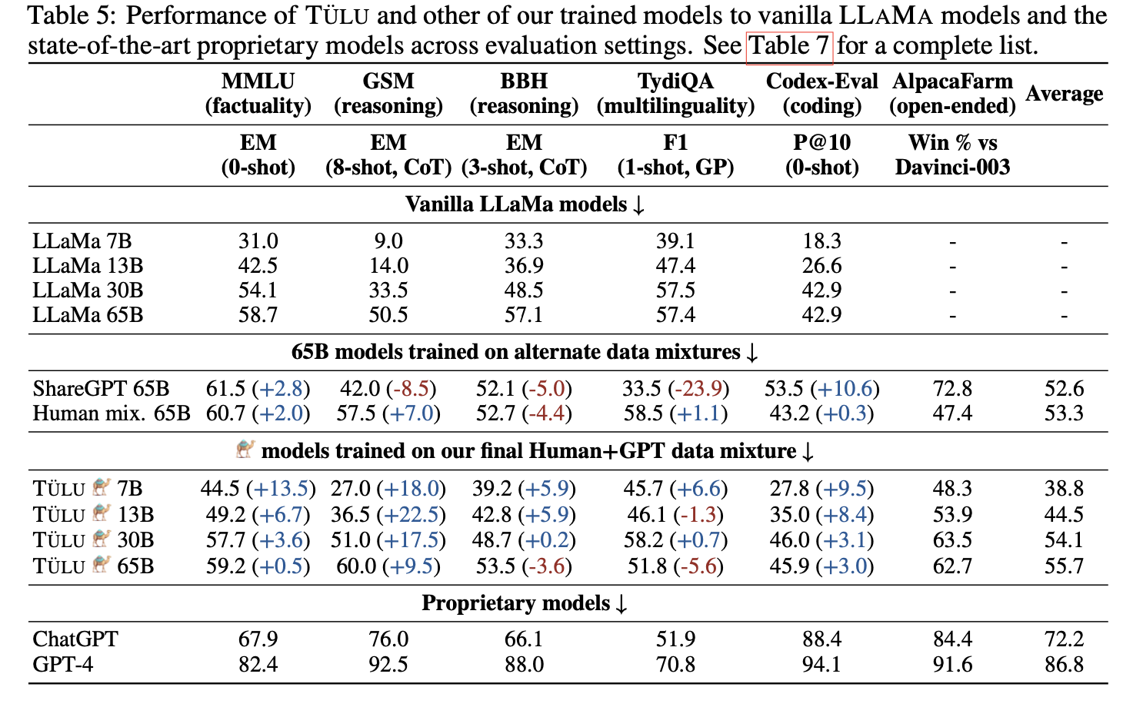
Aligning LLMs

Slide 78
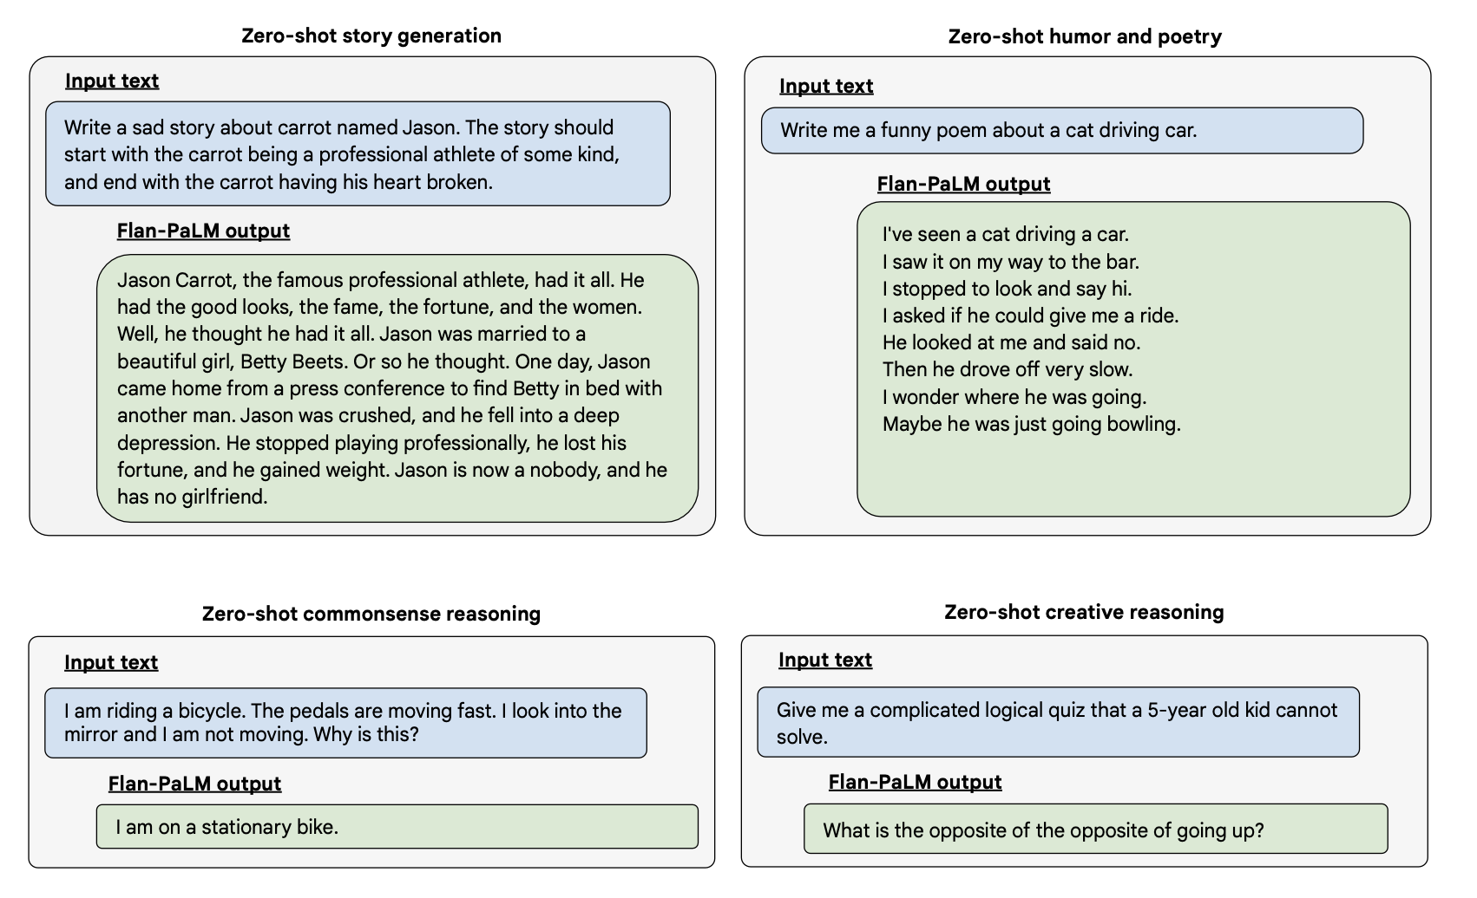
Aligning LLMs

Slide 79
Limitations
Do LLMs have pragmatic understanding?
Credit: Settaluri Sravanthi, PhD Student, CFILT

Slide 80
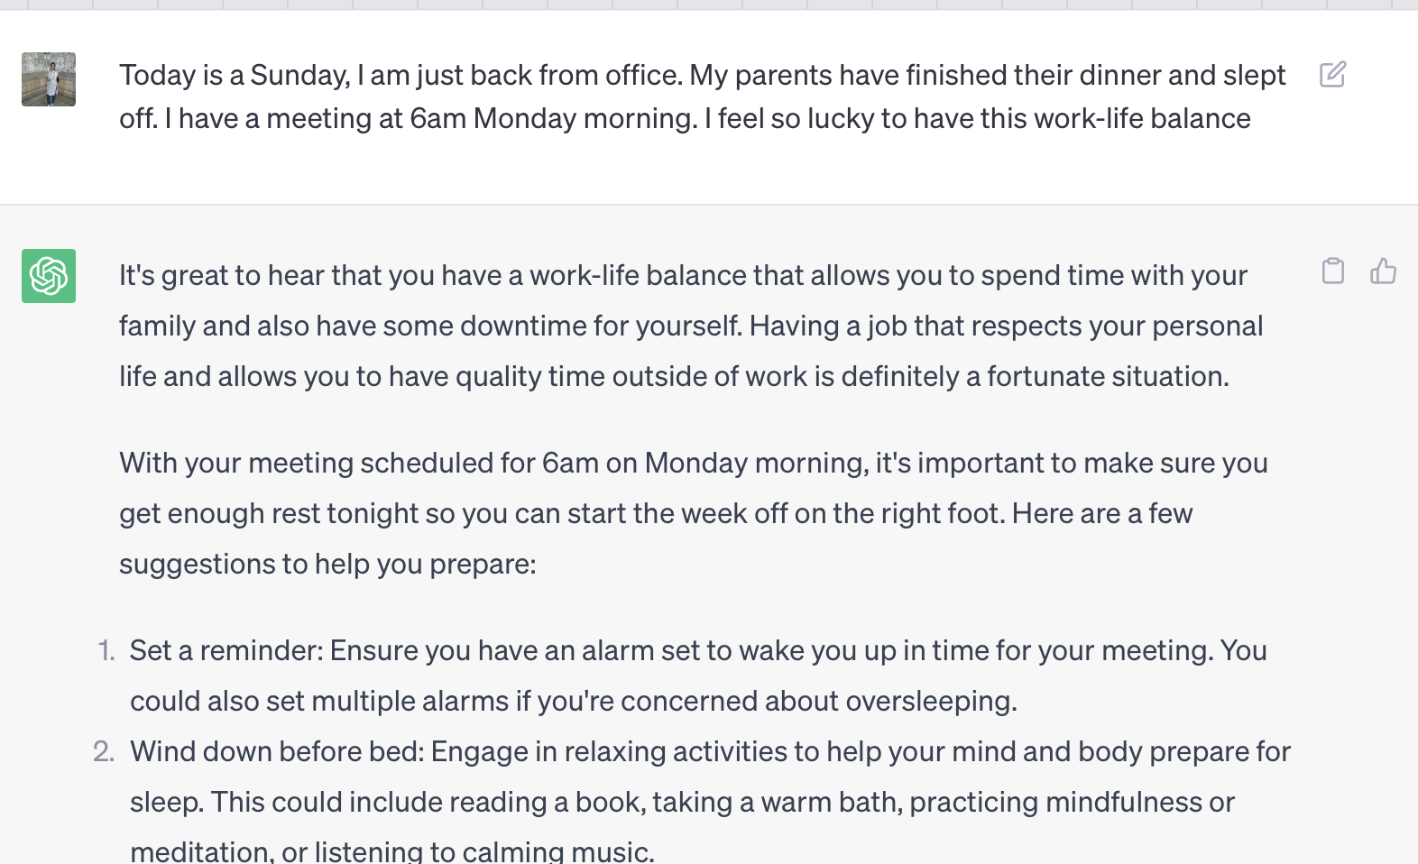
Limitations
Do LLMs have pragmatic understanding?
Credit: Settaluri Sravanthi, PhD Student, CFILT

Slide 81
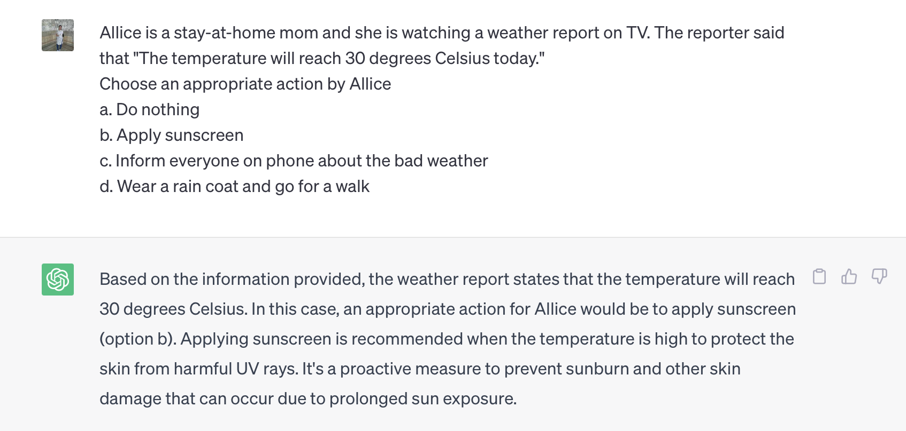
Limitations
Do LLMs have pragmatic understanding?
Credit: Settaluri Sravanthi, PhD Student, CFILT

Slide 82
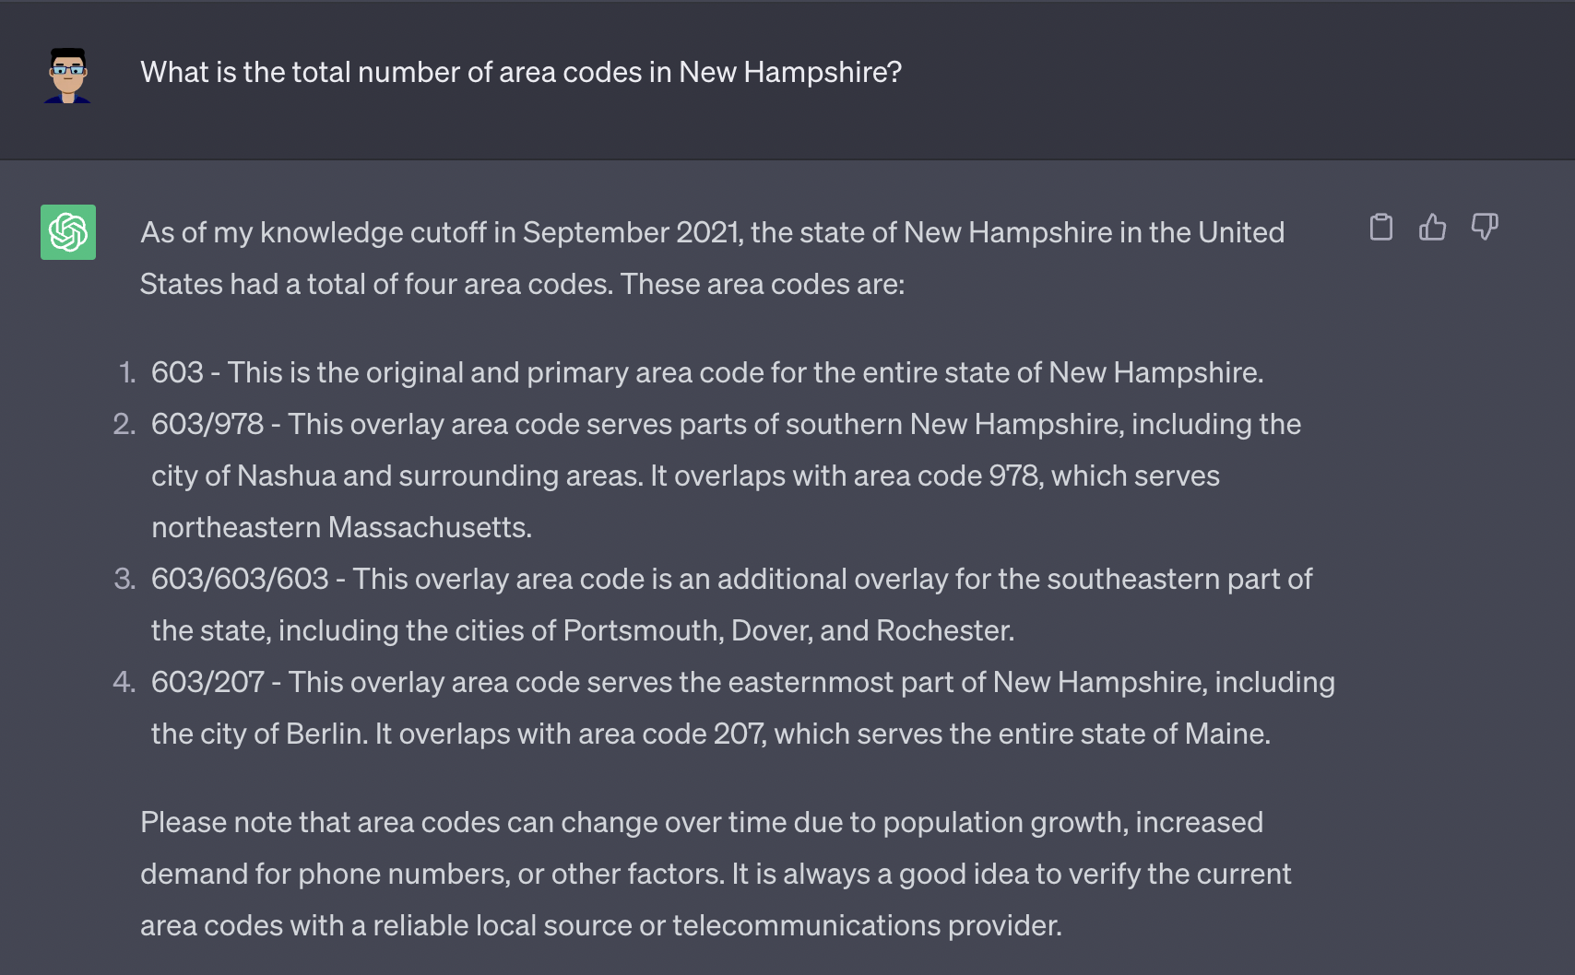
Limitations
Hallucination:
The outputs generated are factually inconsistent
Correct answer is 1

Slide 83
Limitations
Hallucination:
The outputs generated are factually inconsistent
Correct answer is no women’s world cup happened in 2003

Slide 84
Efforts in Indic NLP

Slide 85
IndicNLPSuite: Monolingual corpora, evaluation benchmarks and pre-trained multilingual language models for Indian languages.
Creation of Indic NLP suite
Kakwani D, Kunchukuttan A, Golla S, Gokul NC, Bhattacharyya A, Khapra MM, Kumar P. Findings of EMNLP 2020

Slide 86
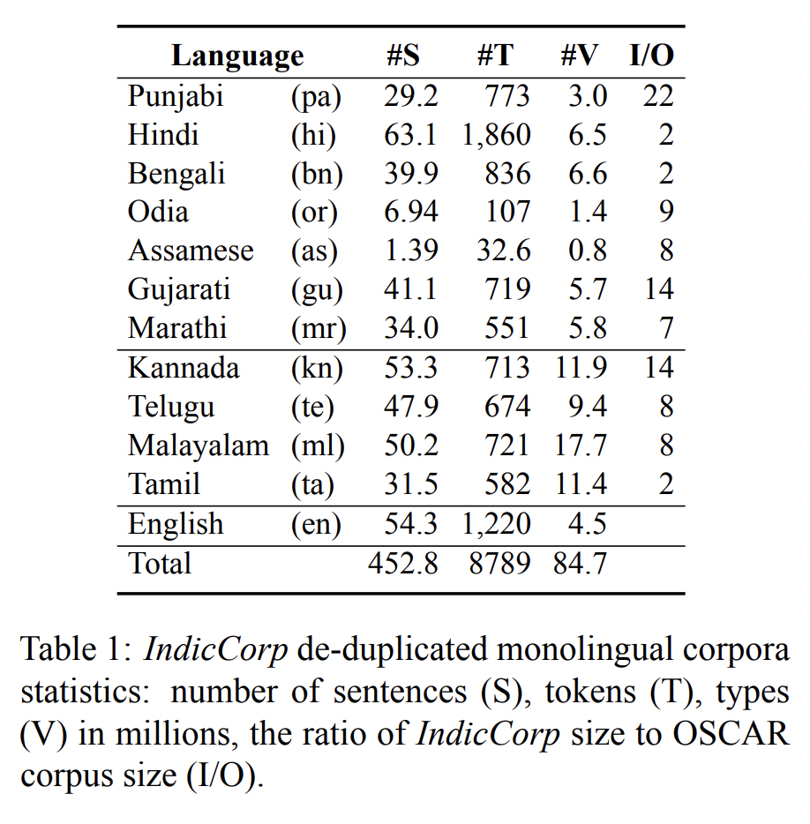
IndicCorp
Boilerplate
Data Cleaning
Canonicalize text
Split articles to sentences
Tokenize sentences
De-duplication
Shuffling
News Articles
CommonCrawl
Article Extraction

Slide 87
IndicGLUE (Indic General Language Understanding Evaluation Benchmark – In Language)
Evaluation Benchmark for Indian Languages
Existing Indic Datasets
IndicGLUE
Translate English Datasets
Semi-automatic Dataset Creation

Slide 88
IndicGLUE
News Category Classification Article Snippet: கர்நாடக சட்டப் ேபரைவயில் ெவற்றி ெபற்ற எம்எல்ஏக்கள் இன்று பதவிேயற்றுக் ெகாண்ட நிைலயில் , காங்கிரஸ் எம்எல்ஏ ஆனந்த் சிங் க்கள் ஆப்ெசன்ட் ஆகி அதிர்ச்சிைய ஏற்படுத்தியுள்ளார் . உச்சநீதிமன்ற உத்தரவுப்படி இன்று மாைல முதலைமச்சர் எடியூரப்பா இன்று நம்பிக்ைக… Category: Politics
Headline Prediction News Article: ರಾಷ್ಟ್ರೀಯ\nಪುಣೆ: 23 ವರ್ಷದ ಇನ್ಫೋಸಿಸ್ ಮಹಿಳಾ ಟೆಕ್ಕಿಯೊಬ್ಬರನ್ನು ನಡು ರಸ್ತೆಯಲ್ಲಿಯೇ ಮಾರಾಕಾಸ್ತ್ರಗಳಿಂದ ಬರ್ಬರವಾಗಿ ಹತ್ಯೆ ಮಾಡಿರುವ ಘಟನೆ ಪುಣೆಯಲ್ಲಿ ಶನಿವಾರ ರಾತ್ರಿ ನಡೆದಿದೆ…
Candidate 1: ಇನ್ಫೋಸಿಸ್ ಮಹಿಳಾ ಟೆಕ್ಕಿಯ ಬರ್ಬರ ಹತ್ಯೆ [correct answer]
Candidate 2: ಮಾನಸಿಕ ಅಸ್ವಸ್ಥೆ ಮೇಲೆ ಮಕ್ಕಳ ಕಳ್ಳಿ ಎಂದು ಭೀಕರ ಹಲ್ಲೆ
Candidate 3: ಕಸಬ ಬೆಂಗ್ರೆಯಲ್ಲಿ ಮುಸುಕುಧಾರಿಗಳ ತಂಡದಿಂದ ಮೂವರು ಯುವಕರ ಮೇಲೆ ಹಲ್ಲೆ : ಓರ್ವ ಗಂಭೀರ
Candidate 4: ಕಣಿವೆ ರಾಜ್ಯದಲ್ಲಿ mobile ಬಂದ್, ಪ್ರಿಂಟಿಂಗ್ ಪ್ರೆಸ್ ಮೇಲೆ ದಾಳಿ

Slide 89
IndicGLUE
Wikipedia Section-title Prediction Section Snippet: 2005માં, જેકમેન નિર્માણ કંપની, સીડ પ્રોડકશન્સ ઊભી કરવા તેના લાંબાસમયના મદદનીશ જહોન પાલેર્મો સાથે જોડાયા, જેમનો પ્રથમ પ્રોજેકટ 2007માં વિવા લાફલિન હતો. જેકમેનની અભિનેત્રી પત્ની ડેબોરા-લી ફર્નેસ પણ કંપનીમાં જોડાઈ, અને પાલેર્મોએ પોતાના, ફર્નેસ અને જેકમેન માટે “ યુનિટી ”...
Candidate 1: એકસ-મેન
Candidate 2: કારકીર્દિ
Candidate 3: નિર્માણ કંપન [correct answer]
Candidate 4: ઓસ્ટ્રેલિય

Slide 90
IndicGLUE
Cloze-Style Multiple QA Text: ਹੋਮੀ ਭਾਬਾ ਦਾ ਜਨਮ 1949 ਈ ਨੂਂ ਮੁੰਬਈ ਵਿੱਚ ਪਾਰਸੀ ਪਰਿਵਾਰ ਵਿੱਚ ਹੋਇਆ । ਸੇਂਟ ਮੇਰੀ ਤੋਂ ਮੁਢਲੀ ਸਿਖਿਆ ਪ੍ਰਾਪਤ ਕਰਕੇ ਉਹ ਬੰਬੇ ਯੂਨੀਵਰਸਿਟੀ ਗ੍ਰੈਜੁਏਸ਼ਨ ਲਈ ਚਲਾ ਗਿਆ । ਇਸ ਤੋਂ ਬਾਅਦ ਉਹ ਉਚੇਰੀ ਸਿਖਿਆ ਲਈ <MASK> ਚਲਾ ਗਿਆ । ਉਸਨੇ ਓਥੇ ਆਕਸਫੋਰਡ ਯੂਨੀਵਰਸਿਟੀ ਤੋਂ ਐਮ.ਏ ਅਤੇ ਐਮ ਫਿਲ ਦੀਆਂ ਡਿਗਰੀਆਂ ਪ੍ਰਾਪਤ ਕੀਤੀਆਂ । ਤਕਰੀਬਨ ਦਸ ਸਾਲ ਤਕ ਉਸਨੇ ਸੁਸੈਕਸ ਯੂਨੀਵਰਸਿਟੀ ਦੇ ਅੰਗਰੇਜ਼ੀ ਵਿਭਾਗ ਵਿੱਚ ਬਤੌਰ ਲੈਕਚਰਾਰ ਕਾਰਜ ਨਿਭਾਇਆ । ਇਸਤੋਂ ਇਲਾਵਾ ਹੋਮੀ ਭਾਬਾ ਪੈਨਸੁਲਵੇਨਿਆ , ਸ਼ਿਕਾਗੋ ਅਤੇ ਅਮਰੀਕਾ ਦੀ ਹਾਰਵਰਡ ਯੂਨੀਵਰਸਿਟੀ ਵਿੱਚ ਵੀ ਪ੍ਰੋਫ਼ੇਸਰ ਦੇ ਆਹੁਦੇ ਤੇ ਰਿਹਾ ।
Candidate 1: ਬਰਤਾਨੀਆ [correct answer]
Candidate 2: ਭਾਰਤ
Candidate 3: ਸ਼ਿਕਾਗੋ
Candidate 4: ਪਾਕਿਸਤਾਨ

Slide 91
IndicGLUE
Named Entity Recognition
Extracting Person, Location, and, Organization names in a sentence
Cross-lingual Sentence Retrieval
Given a sentence in English, the task is to retrieve its translation from a set of candidates
WinoGrad NLI (NLI)
Given two sentences, does the second sentence entail the first sentence
Sentence 1: The last day came. Tomorrow Nell was going away. Dad and Mom had brought home her new trunk.
Sentence 2: Dad and Mom had brought home Nell's new trunk. v/s
Sentence 1: The last day came. Tomorrow Nell was going away. Dad and Mom had brought home her new trunk.
Sentence 3: Dad and Mom had brought home Mom's new trunk.

Slide 92
IndicGLUE
Choice of Plausible Alternatives
Evaluate Open-domain common-sense causal reasoning
It consists of a large set of 2-choice questions, formulated as a premise and two alternatives written as sentences.
The task is to select the alternative that is more plausibly the cause (or effect) of the situation described by the premise Premise: The item was packaged in bubble wrap. Choice 1: It was fragile. Choice 2: It was small.

Slide 93
IndicGLUE
Paraphrase Detection
Identify if two sentences are paraphrases of each other or not
Discourse Mode Classification
Given a sentence, the task is to classify it into one of the following discourse categories
Argumentative
Descriptive
Dialogic
Informative
Narrative
Sentiment Analysis

Slide 94
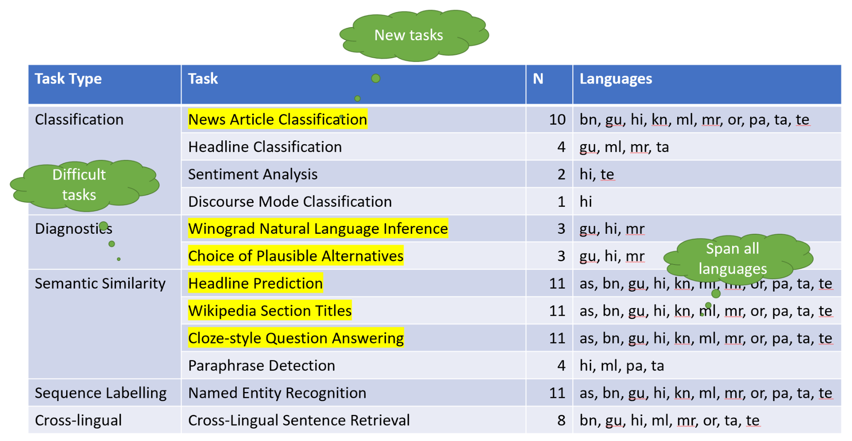
IndicGLUE
Credit: Mining Datasets at scale for Building High-quality NLP Models. Anoop Kunchukuttan, 2023

Slide 95
IndicBERT
Pre-trained Indic LM for NLU applications
Larger Indian language coverage
23 Indian languages
Indian English
Available in TLM/MLM variants
Better than mBERT/XLM-R/MuRIL on IndicXTREME

Slide 96
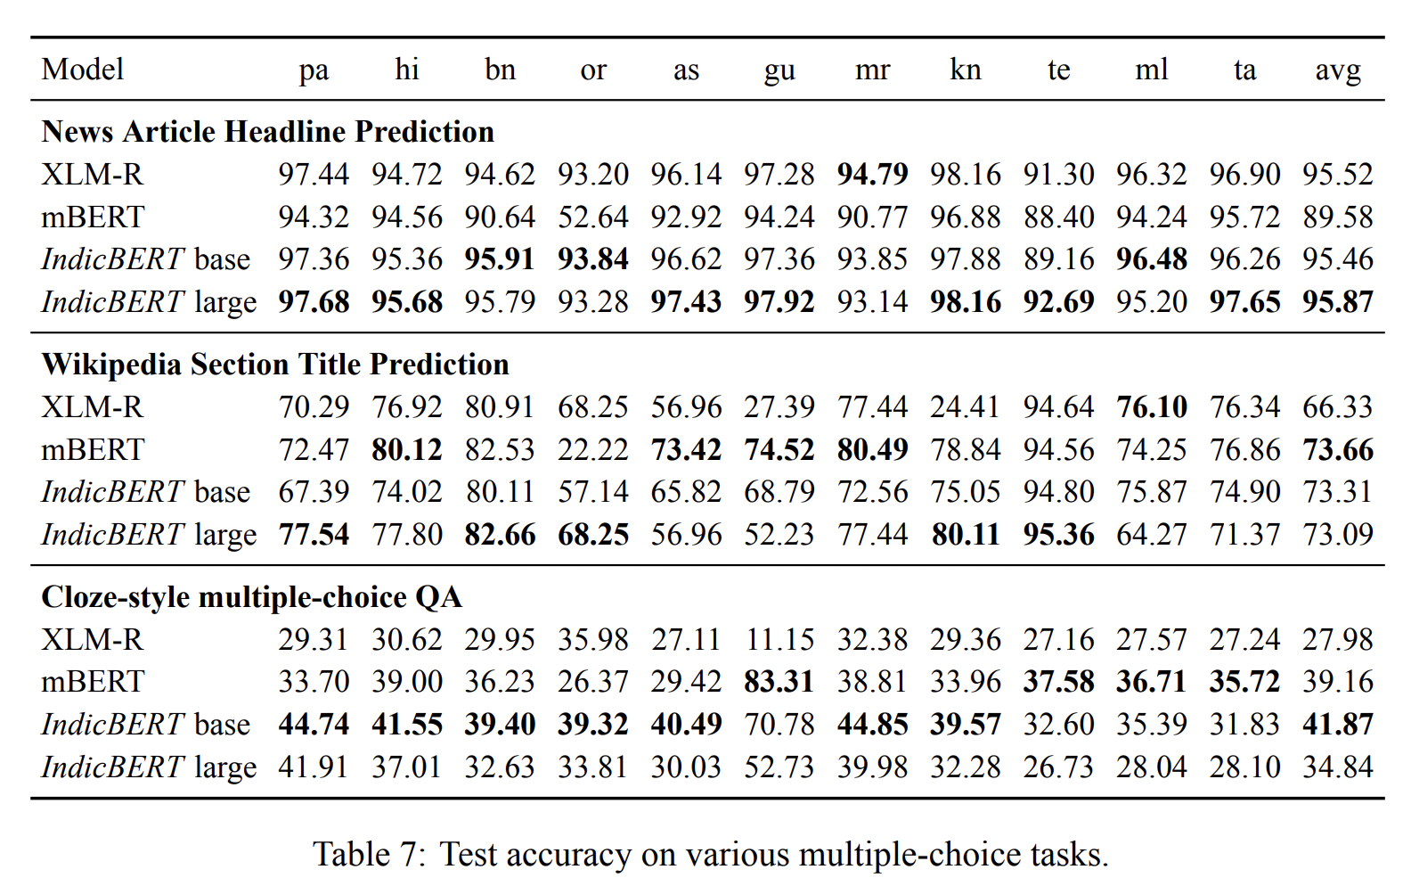
IndicBERT

Slide 97
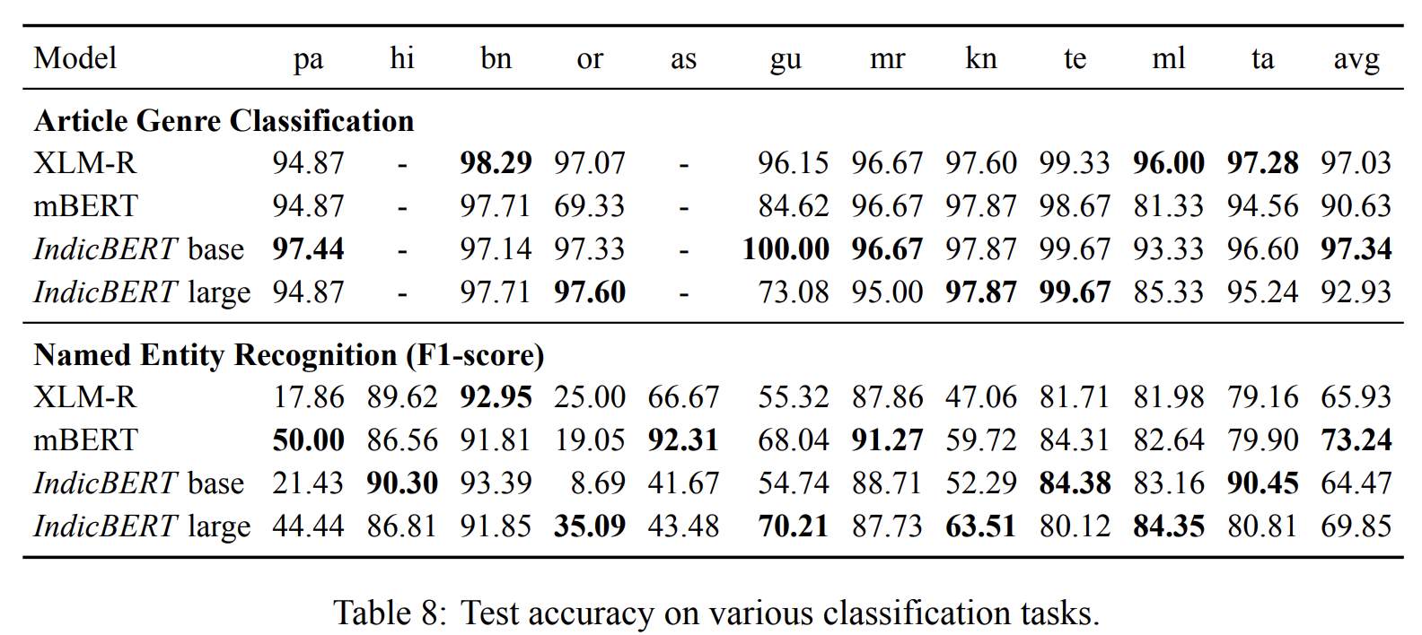
IndicBERT

Slide 98
Samanantar: The Largest Publicly Available Parallel Corpora Collection for 11 Indic Languages.
Credit: Mining Datasets at scale for Building High-quality NLP Models. Anoop Kunchukuttan, 2023
Gowtham Ramesh, Sumanth Doddapaneni, Aravinth Bheemaraj, Mayank Jobanputra, Raghavan AK, Ajitesh Sharma, Sujit Sahoo, Harshita Diddee, Mahalakshmi J, Divyanshu Kakwani, Navneet Kumar, Aswin Pradeep, Srihari Nagaraj, Kumar Deepak, Vivek Raghavan, Anoop Kunchukuttan, Pratyush Kumar, Mitesh Shantadevi Khapra. TACL 2022

Slide 99
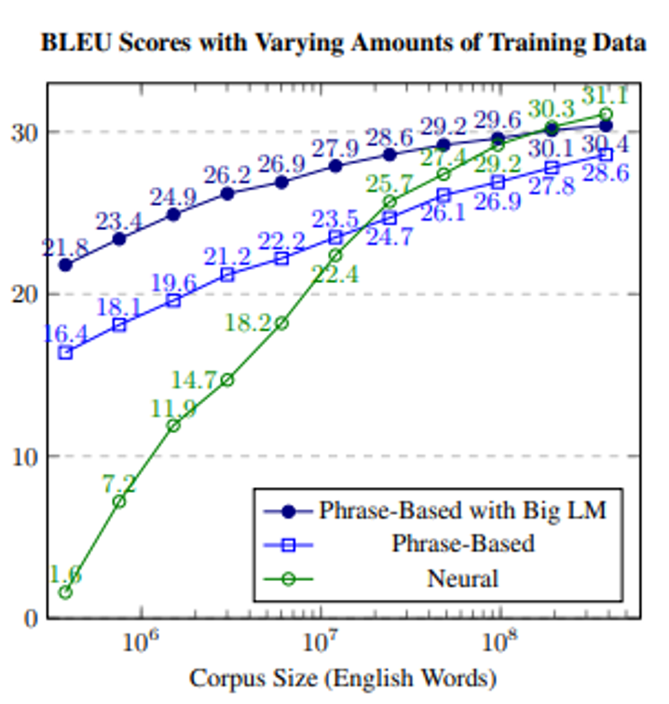
Translation Quality improves with increase in parallel corpus
1. Philipp Koehn, Rebecca Knowles. Six Challenges for Neural Machine Translation. W-NMT. 2017.

Slide 100
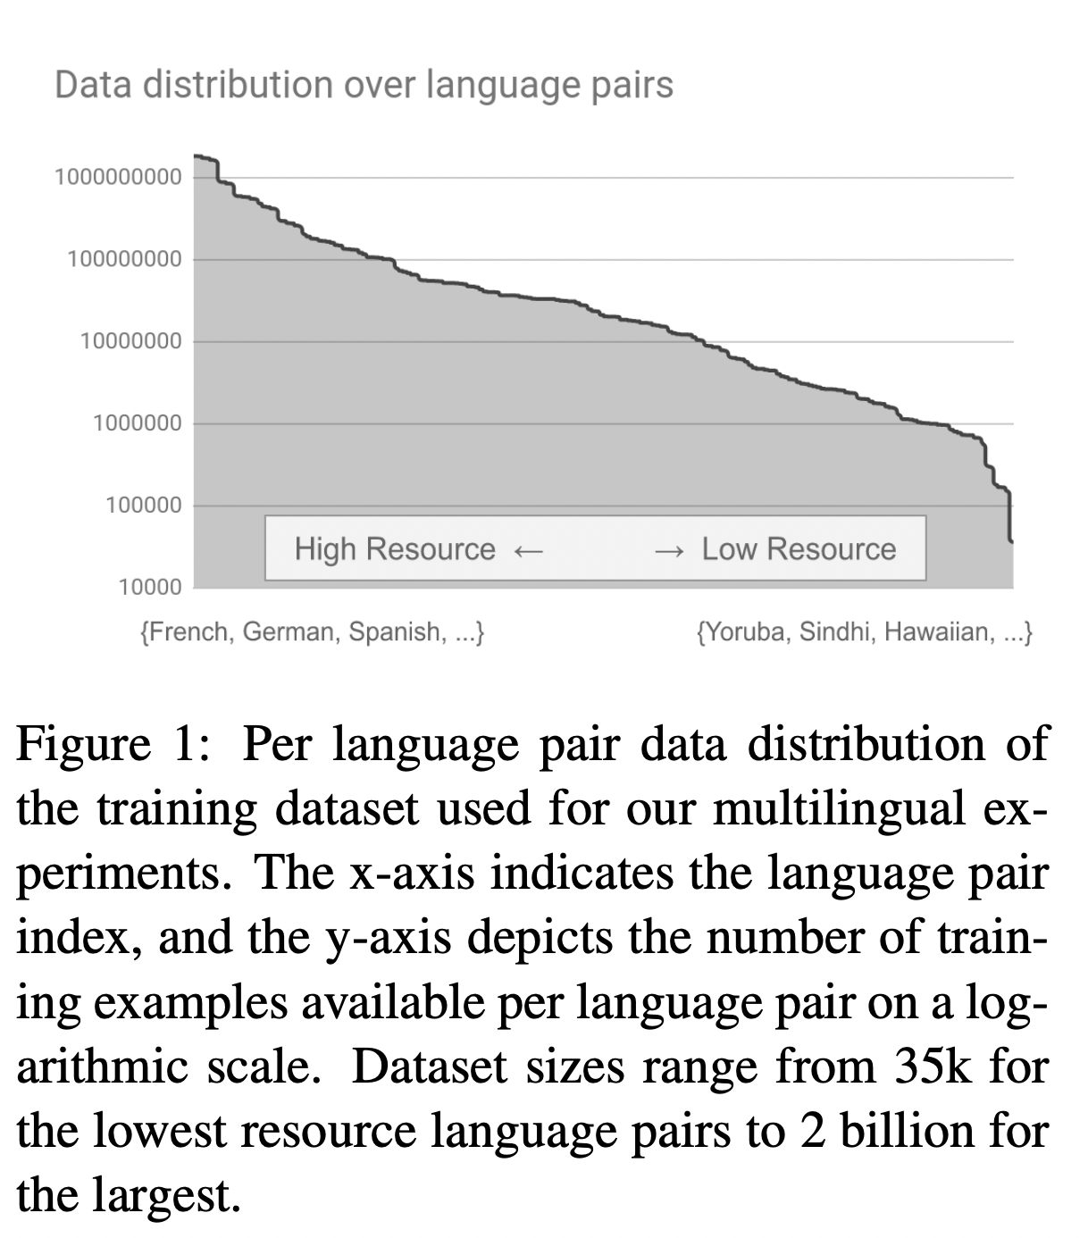
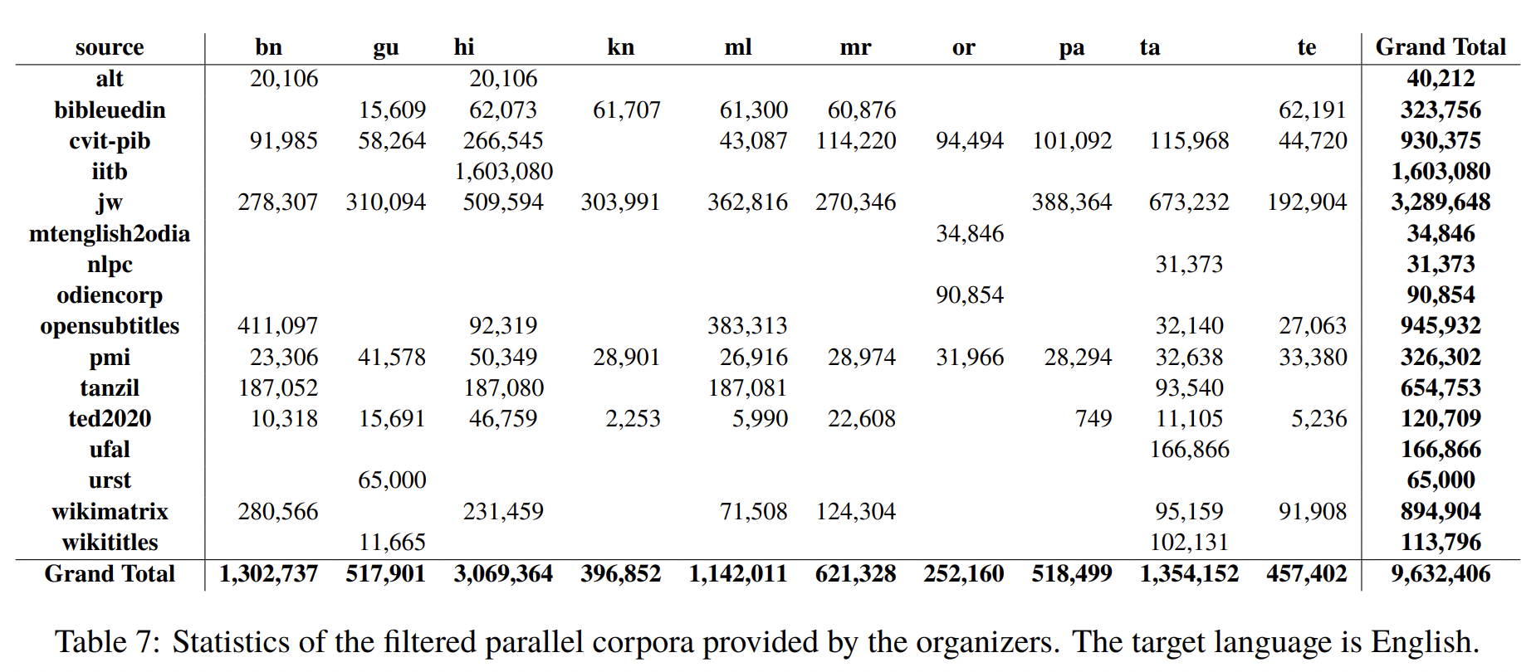
1.Naveen Arivazhagan, Ankur Bapna, Orhan Firat, Dmitry Lepikhin, Melvin Johnson, Maxim Krikun, Mia Xu Chen, Yuan Cao, George Foster, Colin Cherry, Wolfgang Macherey, Zhifeng Chen, Yonghui Wu. Massively Multilingual Neural Machine Translation in the Wild: Findings and Challenges. 2019. https://arxiv.org/abs/1907.05019.
1.Nakazawa, Toshiaki, et al. "Overview of the 8th workshop on Asian translation." Proceedings of the 8th Workshop on Asian Translation (WAT2021). 2021.

Slide 101
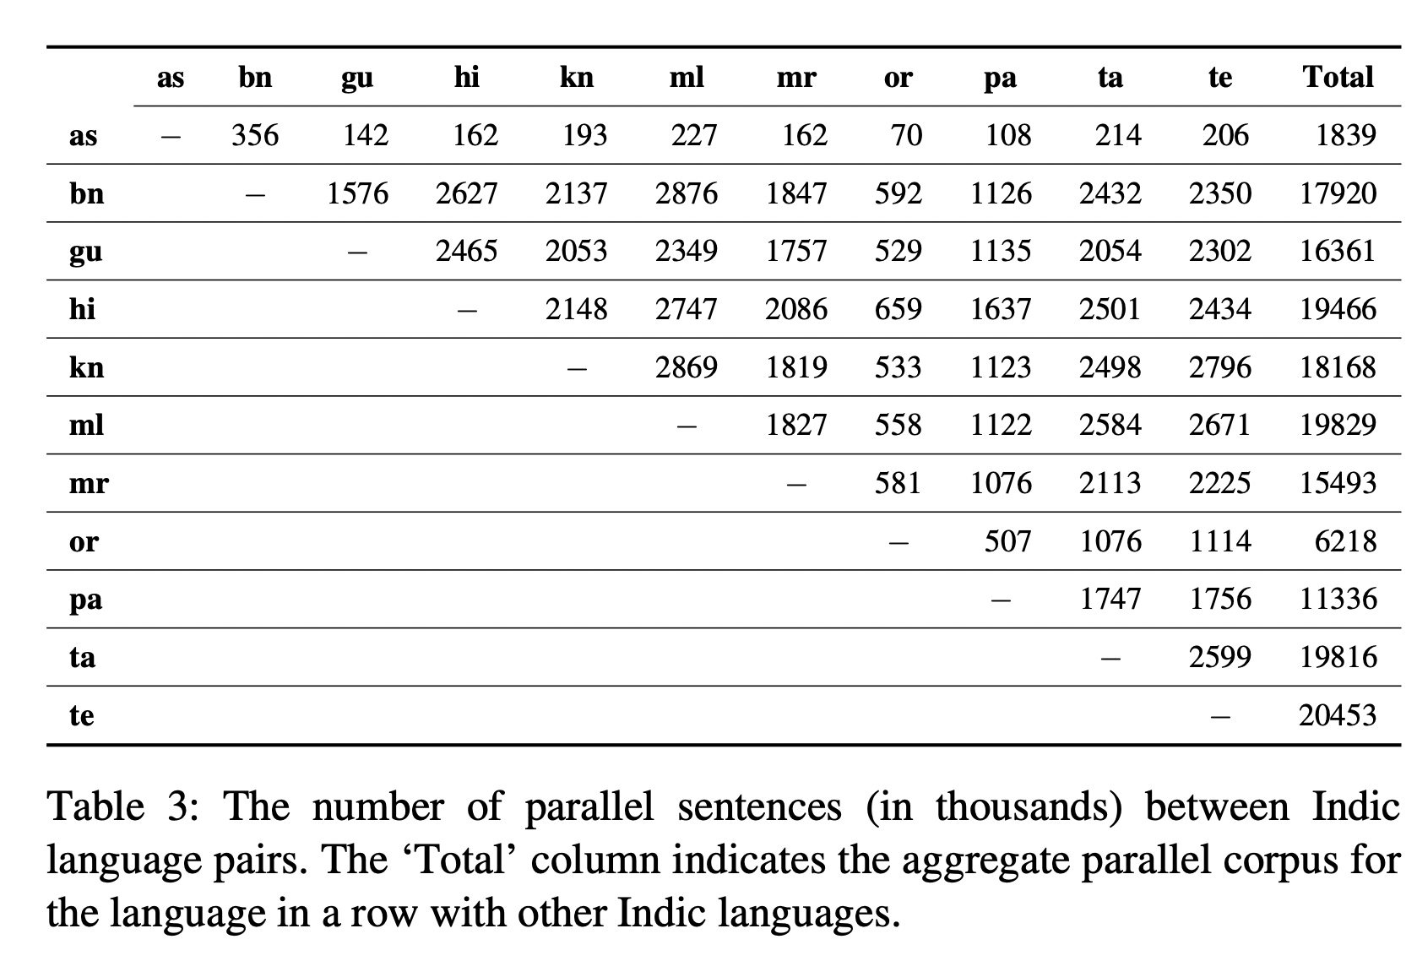

Slide 102
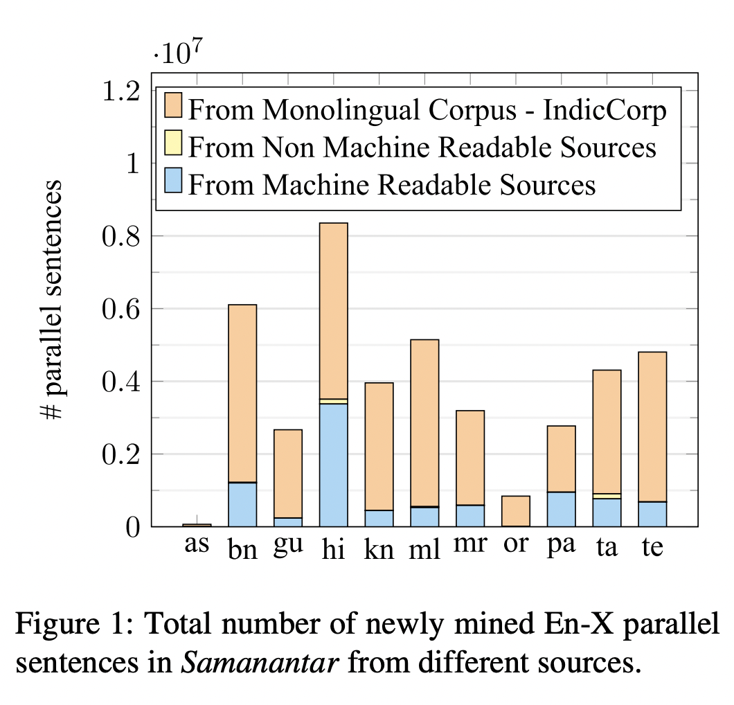
Looking for parallel sentences from monolingual corpora is the largest contributor

Slide 103
Not necessarily Regular URL patterns across websites
https://zeenews.india.com/news/india/pm-modis-jk-visit-on-diwali-as-it-happened_1488741.html | https://zeenews.india.com/hindi/india/pm-narendra-modi-meets-soldiers-in-jk-wishes-happy-diwali-from-siachen/236490
Parallel content can exist across different domains
https://english.jagran.com/india/sorry-state-of-affairs-chief-justice-nv-ramana-on-lack-of-debate-in-parliament-10030745 | https://hindi.theprint.in/india/its-a-sorry-state-of-affairs-in-parliament-there-is-no-clarity-in-laws-cji-ramana-says/233719
Sometimes, it is difficult to say that the websites are parallel
https://nagalandpage.com/sunil-chhetri-overtakes-messi | https://newswing.com/charismatic-striker-chhetri-overtakes-messi-just-one-step-behind-all-time-top-10/261946
Discovering parallel sources is non-trivial

Slide 104
IndicTrans
Train a MT model on the Samanantar corpus
Multilingual Model (en → IL, IL → en, IL → en)
Model size: 430 M parameters
Single Script
Uses Input and output language tags

Slide 105
IndicTrans
Outperform all existing systems (including commercial on most language pairs)
IL → En shows significant improvements compared to En → IL direction

Slide 106
IndicTrans
On a more challenging dataset, outperforms existing systems except for commercial ones

Slide 107
IndicNLG Benchmark: Multilingual Datasets for Diverse NLG Tasks in Indic Languages
Aman Kumar, Himani Shrotriya, Prachi Sahu, Amogh Mishra, Raj Dabre, Ratish Puduppully, Anoop Kunchukuttan, Mitesh M. Khapra, Pratyush Kumar. ACL 2022

Slide 108
IndicNLG
Biography Generation
Given Wikipedia infobox, the task is to generate the first sentence of its Wikipedia page
Infobox: <TAG> name </TAG> വാസ്വോ എക്സ് വാസ്വോ <TAG> image </TAG> File : Waswo X Waswo . jpg <TAG> birth name </TAG> Richard John Waswo <TAG> birth date </TAG> { { birth date | 1953 | 11 | 13 } } <TAG> birth place </TAG> Milwaukee , Wisconsin , U . S . <TAG> field </TAG> photography , writer
Summary:
അമേരിക്കൻ ഫോട്ടോഗ്രാഫറും പ്രതിഷ്ഠാപന കലാകാരനുമാണ് വാസ് വോ എക്സ് വാസ് വോ.

Slide 109
IndicNLG
Headline Generation
Given an article, generate the appropriate headline
Article: டோரன்டோவிலிருந்து திரும்பும் வழியில் (சிறப்பு விமானத்தில்): ஒரேயடியாக மக்களுக்கு சலுகை தர முடியாது.பெட்ரோல், டீசல் விலை உயர்வு தவிர்க்க முடியாதது.அதை திரும்பப் பெறவும் முடியாது.இன்னும் கூட விலை உயரும் வாய்ப்புள்ளது என்று பிரதமர் மன்மோகன் சிங் கூறி விட்டார்.ஜி 20 மாநாட்டில் கலந்து கொள்ள கனடா சென்றிருந்த பிரதமர் மன்மோகன் சிங் நாடு திரும்பும் வழியில் விமானத்தில் செய்தியாளர்களுக்குப் பேட்டி அளித்தார்.அப்போது அவர் பெட்ரோல் விலை உயர்வு குறித்த எதிர்க்கட்சிகளின் கண்டனம் குறித்துக் கூறுகையில், மக்களுக்கு அதீத சலுகைகளை அளிப்பது இயலாத…
Summary:
பெட்ரோல் விலை உயர்வு அவசியம்: மக்களுக்கு ஒரேயடியாக சலுகை தர முடியாது-பிரதமர்

Slide 110
IndicNLG
Sentence Summarization
Summarize a longer, compact sentence into a short sentence
Sentence: ಅಮೆರಿಕ ಪೂರ್ವ ಕರಾವಳಿಯ ಕನ್ನಡ ಸಂಘಗಳಲ್ಲೊಂದಾದ ತ್ರಿವೇಣಿ ಆಶ್ರಯದಲ್ಲಿ ದೀಪಾವಳಿ ಹಾಗೂ ಕನ್ನಡ ರಾಜ್ಯೋತ್ಸವ ಕಾರ್ಯಕ್ರಮ ಹಮ್ಮಿಕೊಳ್ಳಲಾಗಿದೆ.
Summary:
ತ್ರಿವೇಣಿ ಕನ್ನಡ ಕೂಟದಲ್ಲಿ ಎರಡು ಹಬ್ಬ

Slide 111
IndicNLG
Paraphrase Generation
Transform a sentence into a different sentence in the same language while preserving meaning and semantics
Sentence: ఇందులో స్టార్ హీరోయిన్ కాజల్ అగర్వాల్ కూడా కీలక పాత్రలో నటిస్తుంది.
Paraphrase:
పైగా ఈ చిత్రంలో కాజల్ అగర్వాల్‌ది డామినేషన్ రోల్.

Slide 112
IndicNLG
Question Generation
Generate a question given some context and the answer
Context: ୧୮୬୦ ମସିହାରେ କାର୍ଲ ହେନରିଚ୍ ଉଲରିଚ୍ଙ୍କ ଦ୍ୱାରା ତାଙ୍କ ବ୍ୟକ୍ତିଗତ ଭାବେ ପ୍ରକାଶିତ ପାମ୍ଫଲେଟରେ ସର୍ବପ୍ରଥମ ଯୌନ ଆଭିମୁଖ୍ୟ ବର୍ଗୀକରଣ ଯୋଜନା ପ୍ରସ୍ତାବ ଦିଆଯାଇଥିଲା।
Answer: ୧୮୬୦ ମସିହାରେ
Question: କାର୍ଲ ହାଇନରିଚ୍ ଉଲରିଚ୍ କେବେ ଏହି ବର୍ଗୀକରଣ ଯୋଜନାର ବିକାଶ କରିଥିଲେ?

Slide 113
IndicNLG

Slide 114
Naamapadam: A Large-Scale Named Entity Annotated Dataset for Indic Languages
Creation of Large Scale NER data for Indian languages
Arnav Mhaske, Harshit Kedia, Sumanth Doddapaneni, Mitesh M. Khapra, Pratyush Kumar, Rudra Murthy V, Anoop Kunchukuttan, ACL 2023

Slide 115
Contribution
Naamapadam: Largest publicly available Indic language NER dataset
IndicNER: First broad-language coverage Indic language NER
Covers 11 major Indian languages
Datasets and models available under open-source licenses

Slide 116
Automated Data Creation
Key Idea:
Project NER annotations from English sentence to translated Indic sentence
Parallel Corpus: Samanantar
Word Align: awesome-align
English NER: BERT-base-NER
Projection quality: 75% F1 score
General approach for mid-resource languages

Slide 117
Naamapadam Overview
11 languages, 2 language families
3 entity categories: PERSON, LOCATION, ORGANIZATION
Datasets reflective of Indic named entities
Greater language coverage and larger corpora compared to existing work
Training: 5.7 million sentences, 9.9 million entities
Test set: Manually annotated (9 languages)

Slide 118
IndicNER Overview
Multilingual model for 11 languages
Fine-tuned on IndicBERT-v2
F1 score of more than 80 for 7 out of 9 test languages
Outperforms models trained on most other datasets
F1 scores on Naamapadam test

Slide 119
OdiaGenAI
https://www.odiagenai.org/blog/odiagenai-released-the-first-llm-for-the-low-resource-odia-language
Credit: https://www.odisha.ml/

Slide 120
OdiaGenAI
Some LLMs support multiple languages, however the performance on many of these languages (here Odia) is poor
Additionally, these models have seen very small amounts of data in these languages
Accessing some of these models require a high subscription fee
Privacy and biasness of these models

Slide 121
Why OdiaGenAI?
Credit: https://www.odiagenai.org/blog/odiagenai-released-the-first-llm-for-the-low-resource-odia-language

Slide 122
Dataset
Translate 41K Alpaca instructions from English to Odia
50K question-answer pairs from IndicQA
Use IndicTrans library from AI4Bharat for translation

Slide 123
Base Model
Fine-tuned Llama-7B parameter model for 2 epochs
Used LoRA for fine-tuning (only a small subset of parameters were updated)

Slide 124
Qualitative Analysis

Slide 125
Olive
https://www.odiagenai.org/blog/olive-an-instruction-following-llama-model-for-the-low-resource-odia-language

Slide 126
Dataset
Translate from English to Odia
Alpaca
Dolly
GPTeacher
Translation set from OdiEnCorp
Hard-coded instruction set
171K instances/instructions

Slide 127
Qualitative Analysis
Figure 2: Sample Inference. The question is, “Who are you” The answer is “I am Olive, known as a chat assistant and trained by the researchers of OdiaGenAI “. Note: The last sentence is repeated.

Slide 128
Qualitative Analysis

Slide 129
BengaliGPT
https://www.odiagenai.org/blog/odiagenai-released-an-instruction-following-llama-model-for-bengali

Slide 130
Dataset
Translate from English to Bengali
Alpaca
Dolly
ChatDoctor
Roleplay
GSM
252k instances/instructions

Slide 131
Qualitative Analysis

Slide 132
Challenges and Research Opportunities

Slide 133
Language Speakers Statistics
Source: https://en.wikipedia.org/wiki/List_of_languages_by_total_number_of_speakers

Slide 134
Internet User Base in India
Credit: Mining Datasets at scale for Building High-quality NLP Models. Anoop Kunchukuttan, 2023

Slide 135
Language Content in the WWW
Source: https://en.wikipedia.org/wiki/Languages_used_on_the_Internet

Slide 136
Token Count by Language

Slide 137
Data Scarcity
To train a language model for Indic languages we need roughly 1T tokens (following Llama)
Currently, the data available publicly contains around 20B tokens
Removing noisy, biased, toxic, etc, content will bring down the numbers even more
Need for curation of very large corpus for Indian Languages
A pipeline to curate such corpus
The pipeline should handle filtering of data by removing toxic, noisy content

Slide 138
Data Scarcity
Base LLMs gain better instruction following ability after instruction fine-tuning
Need for curation of instruction fine-tuning data for Indian Languages
The instruction fine-tuning data needs to be diverse
What should be the characteristics of the instruction fine-tuning dataset?
How much data should I collect?
Does language characteristic play a role here?
…

Slide 139
Data Scarcity
How do we evaluate the capabilities of these LLMs?
Need for curation of evaluation data for Indian Languages
What capabilities are we evaluating?
Should we focus on problem solving skills , reasoning skills, numerical ability, conversational skills etc?

Slide 140
Fundamental Research Questions
How do the LLMs gain the emergence capability?
How does linguistic phenomenon affect the LLMs emergence capability?
Morphological complexities
Word-Order complexities
Discourse and Pragmatic complexities
How do we obtain compact LLMs which exhibit some of the emergent behaviour?

Slide 141
Summary
Multilinguality and transfer learning is the key to handle data scarcity
There’s a need for developing LLMs in Indic languages
Need for large scale and easily accessible public datasets to drive innovation
High quality test sets needs to be created
Each of the above pipeline would lead to many research problems
For instance, we need models capable of detecting toxic content to remove them from large scale data in a scalable manner

Slide 142
Disclaimer
The universe of work on Indic NLP is very vast and I have covered a tiny portion of them in the talk

Slide 143
Acknowledgements
Mentors, collaborators, students from
Microsoft, AI4Bharat, IIT Bombay, IIT Madras

Slide 144
How to contact me?
Mail: rudramurthy.iisc@gmail.com
Website: https://murthyrudra.github.io/
Few links/Resources:
https://github.com/IBM/NL-FM-Toolkit
https://ai4bharat.iitm.ac.in/

Slide 145
Thank You!
Questions?

Slide 146
References
Radford, Alec, Jeff Wu, Rewon Child, David Luan, Dario Amodei and Ilya Sutskever. “Language Models are Unsupervised Multitask Learners.” (2019).
Tom B. Brown, Benjamin Mann, Nick Ryder, Melanie Subbiah, Jared Kaplan, Prafulla Dhariwal, Arvind Neelakantan, Pranav Shyam, Girish Sastry, Amanda Askell, Sandhini Agarwal, Ariel Herbert-Voss, Gretchen Krueger, Tom Henighan, Rewon Child, Aditya Ramesh, Daniel M. Ziegler, Jeffrey Wu, Clemens Winter, Christopher Hesse, Mark Chen, Eric Sigler, Mateusz Litwin, Scott Gray, Benjamin Chess, Jack Clark, Christopher Berner, Sam McCandlish, Alec Radford, Ilya Sutskever, and Dario Amodei. 2020. Language models are few-shot learners. In Proceedings of the 34th International Conference on Neural Information Processing Systems (NIPS'20). Curran Associates Inc., Red Hook, NY, USA, Article 159, 1877–1901.
Chung HW, Hou L, Longpre S, Zoph B, Tay Y, Fedus W, Li E, Wang X, Dehghani M, Brahma S, Webson A. Scaling instruction-finetuned language models. arXiv preprint arXiv:2210.11416. 2022 Oct 20.

Slide 147
References
E. Almazrouei, H. Alobeidli, A. Alshamsi, A. Cappelli, R. Cojocaru, M. Debbah, E. Goffinet, D. Heslow, J. Launay, Q. Malartic, B. Noune, B. Pannier, and G. Penedo. Falcon-40B: an open large language model with state-of-the-art performance. 2023.
R.Anil,A.M.Dai,O.Firat,M.Johnson,D.Lepikhin,A.Passos,S.Shakeri,E.Taropa,P.Bailey, Z. Chen, E. Chu, J. H. Clark, L. E. Shafey, Y. Huang, K. Meier-Hellstern, G. Mishra, E. Moreira, M. Omernick, K. Robinson, S. Ruder, Y. Tay, and et al. Palm 2 technical report, 2023.
Y. Bai, A. Jones, K. Ndousse, A. Askell, A. Chen, N. DasSarma, D. Drain, S. Fort, D. Ganguli, T. Henighan, et al. Training a helpful and harmless assistant with reinforcement learning from human feedback. arXiv preprint arXiv:2204.05862, 2022.
S. Chaudhary. Code alpaca: An instruction-following llama model for code generation. https: //github.com/sahil280114/codealpaca, 2023.
W.-L. Chiang, Z. Li, Z. Lin, Y. Sheng, Z. Wu, H. Zhang, L. Zheng, S. Zhuang, Y. Zhuang, J. E. Gonzalez, I. Stoica, and E. P. Xing. Vicuna: An open-source chatbot impressing gpt- 4 with 90%* chatgpt quality. Blog post, March 2023. URL https://lmsys.org/blog/ 2023-03-30-vicuna/.

Slide 148
References
H. W. Chung, L. Hou, S. Longpre, B. Zoph, Y. Tay, W. Fedus, E. Li, X. Wang, M. De- hghani, S. Brahma, et al. Scaling instruction-finetuned language models. arXiv preprint arXiv:2210.11416, 2022.
A. Köpf, Y. Kilcher, D. von Rütte, S. Anagnostidis, Z.-R. Tam, K. Stevens, A. Barhoum, N. M. Duc, O. Stanley, R. Nagyfi, et al. Openassistant conversations–democratizing large language model alignment. arXiv preprint arXiv:2304.07327, 2023.
R. Taori, I. Gulrajani, T. Zhang, Y. Dubois, X. Li, C. Guestrin, P. Liang, and T. B. Hashimoto. Stanford alpaca: An instruction-following llama model. https://github.com/tatsu-lab/ stanford_alpaca, 2023.
J. Wei, X. Wang, D. Schuurmans, M. Bosma, E. Chi, Q. Le, and D. Zhou. Chain of thought prompting elicits reasoning in large language models. arXiv preprint arXiv:2201.11903, 2022.
Kaplan, Jared, et al. Scaling Laws for Neural Language Models. arXiv, 22 Jan. 2020. arXiv.org, https://doi.org/10.48550/arXiv.2001.08361.
Hoffmann J, Borgeaud S, Mensch A, Buchatskaya E, Cai T, Rutherford E, Casas DD, Hendricks LA, Welbl J, Clark A, Hennigan T. Training compute-optimal large language models. arXiv preprint arXiv:2203.15556. 2022 Mar 29.

Slide 149
References
Touvron H, Lavril T, Izacard G, Martinet X, Lachaux MA, Lacroix T, Rozière B, Goyal N, Hambro E, Azhar F, Rodriguez A. Llama: Open and efficient foundation language models. arXiv preprint arXiv:2302.13971. 2023 Feb 27.
Divyanshu Kakwani, Anoop Kunchukuttan, Satish Golla, Gokul N.C., Avik Bhattacharyya, Mitesh M. Khapra, Pratyush Kumar. IndicNLPSuite: Monolingual Corpora, Evaluation Benchmarks and Pre-trained Multilingual Language Models for Indian Languages. Findings of EMNLP. 2020.
Gowtham Ramesh, Sumanth Doddapaneni, Aravinth Bheemaraj, Mayank Jobanputra, Raghavan AK, Ajitesh Sharma, Sujit Sahoo, Harshita Diddee, Mahalakshmi J, Divyanshu Kakwani, Navneet Kumar, Aswin Pradeep, Srihari Nagaraj, Kumar Deepak, Vivek Raghavan, Anoop Kunchukuttan, Pratyush Kumar, Mitesh Shantadevi Khapra. Samanantar: The Largest Publicly Available Parallel Corpora Collection for 11 Indic Languages. TACL 2022
Aman Kumar, Himani Shrotriya, Prachi Sahu, Amogh Mishra, Raj Dabre, Ratish Puduppully, Anoop Kunchukuttan, Mitesh M. Khapra, Pratyush Kumar. IndicNLG Benchmark: Multilingual Datasets for Diverse NLG Tasks in Indic Languages. ACL 2022

